Slide 1
Information Extraction Lecture 8 – Ontological and Open IE
CIS, LMU München
Winter Semester 2013-2014
Dr. Alexander Fraser

Slide 2
Administravia
Today: 45 minute lecture + one two-person Referat
Next week: the same
Review session next week on Tuesday at 18:00, check web page for location
Klausur the following week!
Nachholklausur – probably April 2nd (week before Vorlesungsbeginn - check web page!)

Slide 3
Ontological IE
In the last lecture, we discussed how to extract relations from text
We looked in detail at relations expressed in a single sentence
Event extraction captures relations which can be expressed at the document level (i.e., in multiple sentences)
Consider the CMU Seminar task – the task is to extract events (seminars), with their date, location and title
Sometimes referred to as "Fact Extraction"
Today we will discuss updating a knowledge base with the extracted relations, facts or events
This is called "Ontological IE"

Slide 4
Ontologies
An ontology is a consistent knowledge base
without redundancy
Person | Nationality
Angela Merkel | German
Merkel | Germany
Merkel | French
✗
Entity | Relation | Entity
Angela Merkel | citizenOf | Germany
✓
Every entity appears only with exactly the same name
There are no semantic contradictions
Slide from Suchanek

Slide 5
Ontological IE
Ontological Information Extraction (IE) aims to create or extend an ontology.
Entity | Relation | Entity
Angela Merkel | citizenOf | Germany
Angela Merkel is the German chancellor....
...Merkel was born in Germany...
...A. Merkel has French nationality...
Person | Nationality
Angela Merkel | German
Merkel | Germany
Merkel | French
Slide from Suchanek

Slide 6
Ontological IE Challenges
Challenge 1:
Map names to names that are already known
Entity | Relation | Entity
Angela Merkel | citizenOf | Germany
Merkel
Angie
A. Merkel
Slide from Suchanek

Slide 7
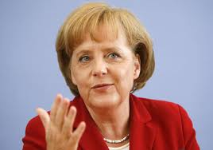
Ontological IE Challenges
Challenge 2:
Be sure to map the names to the right known names
Entity | Relation | Entity
Angela Merkel | citizenOf | Germany
Una Merkel | citizenOf | USA
?
Merkel is great!
Slide from Suchanek

Slide 8
Ontological IE Challenges
Challenge 3:
Map to known relationships
Entity | Relation | Entity
Angela Merkel | citizenOf | Germany
… has nationality …
… has citizenship …
… is citizen of …
Slide from Suchanek

Slide 9
Ontological IE Challenges
Challenge 4:
Take care of consistency
Entity | Relation | Entity
Angela Merkel | citizenOf | Germany
✗
Angela Merkel is French…
Slide from Suchanek

Slide 10
Triples
A triple (in the sense of ontologies) is a tuple of an entity, a relation name and another entity:
Entity | Relation | Entity
Angela Merkel | citizenOf | Germany
Most ontological IE approaches produce triples as output. This decreases the variance in schema.
Person | Country
Angela | Germany
Citizen | Nationality
Angela | Germany
Person | Birthdate | Country
Angela | 1980 | Germany
Slide from Suchanek

Slide 11
Triples
A triple can be represented in multiple forms:
Entity | Relation | Entity
Angela Merkel | citizenOf | Germany
=
citizenOf
=
<Angela Merkel, citizenOf, Germany>
Slide from Suchanek

Slide 12
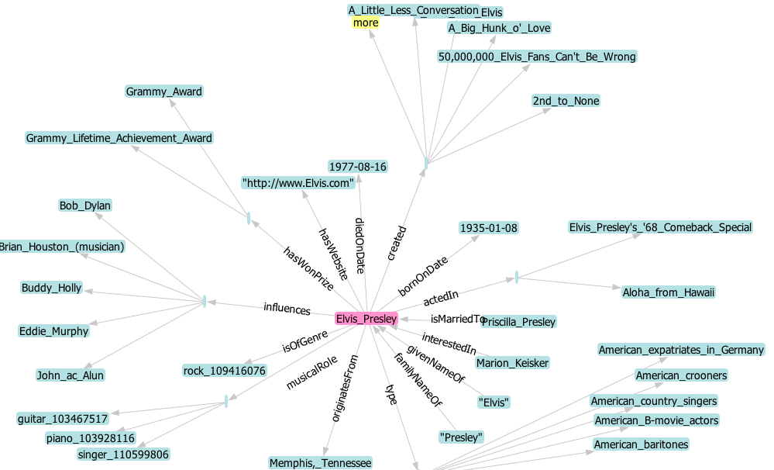
YAGO
Example: Elvis in YAGO
Slide from Suchanek

Slide 13
Wikipedia
Wikipedia is a free online encyclopedia
3.4 million articles in English
16 million articles in dozens of languages
Why is Wikipedia good for information extraction?
It is a huge, but homogenous resource
(more homogenous than the Web)
It is considered authoritative
(more authoritative than a random Web page)
It is well-structured with infoboxes and categories
It provides a wealth of meta information
(inter article links, inter language links, user discussion,...)
Slide from Suchanek

Slide 14
Ontological IE from Wikipedia
Wikipedia is a free online encyclopedia
3.4 million articles in English
16 million articles in dozens of languages
Every article is (should be) unique
=> We get a set of unique entities
that cover numerous areas of interest
Germany
Angela_Merkel
Una_Merkel
Theory_of_Relativity
Slide from Suchanek

Slide 15
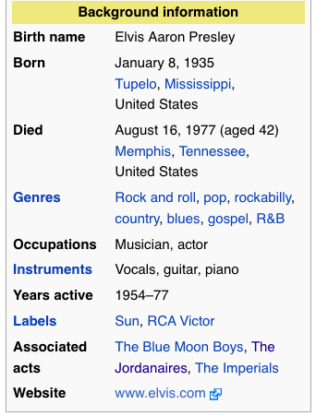
Wikipedia Source
Example: Elvis on Wikipedia
|Birth_name = Elvis Aaron Presley
|Born = {{Birth date|1935|1|8}}<br />
[[Tupelo, Mississippi|Tupelo]]
Slide from Suchanek

Slide 16
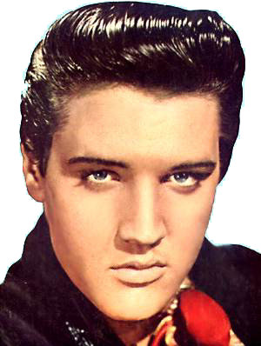
IE from Wikipedia
bornOnDate = 1935
(hello regexes!)
Elvis Presley
Blah blah blub fasel (do not read this, better listen to the talk) blah blah Elvis blub (you are still reading this) blah Elvis blah blub later became astronaut blah
~Infobox~
Born: 1935
...
born
1935
Exploit Infoboxes
Categories: Rock singers
Slide from Suchanek

Slide 17
IE from Wikipedia
Rock Singer
Elvis Presley
type
Blah blah blub fasel (do not read this, better listen to the talk) blah blah Elvis blub (you are still reading this) blah Elvis blah blub later became astronaut blah
~Infobox~
Born: 1935
...
born
1935
Exploit Infoboxes
Exploit conceptual categories
Categories: Rock singers
Slide from Suchanek

Slide 18
IE from Wikipedia
Every singer is a person
WordNet
Person
Person
subclassOf
subclassOf
Singer
Singer
subclassOf
Rock Singer
Elvis Presley
type
Blah blah blub fasel (do not read this, better listen to the talk) blah blah Elvis blub (you are still reading this) blah Elvis blah blub later became astronaut blah
~Infobox~
Born: 1935
...
born
1935
Exploit Infoboxes
Exploit conceptual categories
Categories: Rock singers
Slide from Suchanek

Slide 19
Consistency Checks
Person
subclassOf
Singer
subclassOf
Guitar
Guitarist
Rock Singer
type
1977
diedInPlace
born
1935
Check uniqueness of functional arguments
Check domains and ranges of relations
Check type coherence
Slide from Suchanek

Slide 20
Ontological IE from Wikipedia
YAGO
3m entities, 28m facts
focus on precision 95%
(automatic checking of facts)
http://yago-knowledge.org
DBpedia
3.4m entities
1b facts (also from non-English Wikipedia)
large community
http://dbpedia.org
Community project on top of Wikipedia
(bought by Google, but still open)
http://freebase.com
Slide from Suchanek

Slide 21
Ontological IE by Reasoning
born
1935
Elvis was born in 1935
Recap: The challenges:
died in, was killed in
deliver canonic relations
Elvis, Elvis Presley, The King
deliver canonic entities
deliver consistent facts
born (Elvis, 1970)
born (Elvis, 1935)
Idea: These problems are interleaved,
solve all of them together.
Slide from Suchanek

Slide 22
Using Reasoning
Ontology
First Order Logic
type(Elvis_Presley,singer)
subclassof(singer,person)
...
appears(“Elvis”,”was born in”,
”1935”)
...
means(“Elvis”,Elvis_Presley,0.8)
means(“Elvis”,Elvis_Costello,0.2)
...
born(X,Y) & died(X,Z) => Y<Z
appears(A,P,B) & R(A,B)
=> expresses(P,R)
appears(A,P,B) & expresses(P,R)
=> R(A,B)
...
Documents
born
1935
Elvis was born in 1935
Consistency Rules
birthdate<deathdate
SOFIE
system
Slide from Suchanek

Slide 23
Ontological IE by Reasoning
Reasoning-based approaches use logical rules
to extract knowledge from natural language documents.
Current approaches use either
Weighted MAX SAT
or Datalog
or Markov Logic
Input:
often an ontology
manually designed rules
Condition:
homogeneous corpus helps
Slide from Suchanek

Slide 24
Ontological IE Summary
Ontological Information Extraction (IE) tries to create or extend an ontology through information extraction.
nationality
Current hot approaches:
extraction from Wikipedia
reasoning-based approaches
Slide from Suchanek

Slide 25
Open Information Extraction
Open Information Extraction/Machine Reading
aims at information extraction from the entire Web.
Vision of Open Information Extraction:
the system runs perpetually, constantly gathering
new information
the system creates meaning on its own
from the gathered data
the system learns and becomes more intelligent,
i.e. better at gathering information
Slide from Suchanek

Slide 26
Open Information Extraction
Open Information Extraction/Machine Reading
aims at information extraction from the entire Web.
Rationale for Open Information Extraction:
We do not need to care for every single sentence,
but just for the ones we understand
The size of the Web generates redundancy
The size of the Web can generate synergies

Slide 27
KnowItAll &Co
KnowItAll, KnowItNow and TextRunner are projects
at the University of Washington (in Seattle, WA).
Subject | Verb | Object | Count
Egyptians | built | pyramids | 400
Americans | built | pyramids | 20
... | ... | ... | ...
Valuable
common sense
knowledge
(if filtered)
http://www.cs.washington.edu/research/textrunner/
Slide from Suchanek

Slide 28
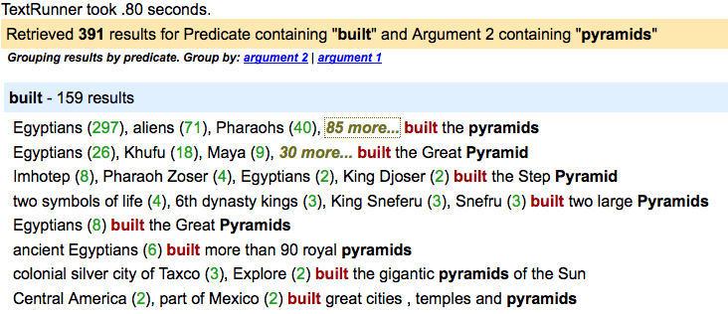
KnowItAll &Co
http://www.cs.washington.edu/research/textrunner/
Slide from Suchanek

Slide 29
Read the Web
“Read the Web” is a project at the
Carnegie Mellon University in Pittsburgh, PA.
Initial Ontology
Table Extractor
Krzewski Blue Angels
Miller Red Angels
Natural Language
Pattern Extractor
Krzewski coaches the Blue Devils.
Mutual exclusion
sports coach != scientist
Type Check
If I coach, am I a coach?
http://rtw.ml.cmu.edu/rtw/
Slide from Suchanek

Slide 30
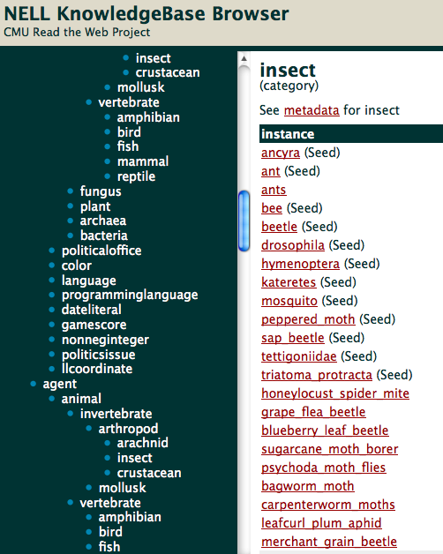
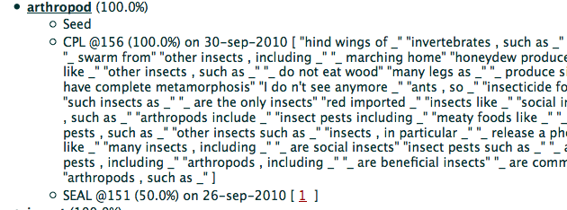
Open IE: Read the Web
http://rtw.ml.cmu.edu/rtw/
Slide from Suchanek

Slide 31
Open Information Extraction
Open Information Extraction/Machine Reading
aims at information extraction from the entire Web.
Main hot projects
TextRunner (University of Washington)
Read the Web (Carnegie Mellon)
Prospera/SOFIE (Max-Planck Informatics Saarbrücken)
Input
The Web
Read the Web: Manual rules
Read the Web: initial ontology
Conditions
none
Slide modified from Suchanek

Slide 32
Slide sources
The slides today came from the Information Extraction course of Fabian Suchanek (Télécom ParisTech)

Slide 33
Thank you for your attention!

