Slide 1
Information Extraction
Lecture 9 – Multilingual Extraction
CIS, LMU München
Winter Semester 2013-2014
Dr. Alexander Fraser

Slide 2
Administravia
Klausur next week, same time (Wed, 4 pm c.t.)
Location: Geschwister Scholl Platz 1 (a) – Zimmer A 119
Nachholklausur – probably April 2nd (week before Vorlesungsbeginn - check web page!)

Slide 3
Outline
Up until today: basics of information extraction
  Primarily based on named entities and relation extraction
However, there are some other tasks associated with information extraction
  Two important tasks are terminology extraction and bilingual dictionary extraction
  I will talk very briefly about terminology extraction (one slide) and then focus on bilingual dictionary extraction

Slide 4
Terminology Extraction
Terminology extraction tries to find words or sequences of words which have a domain-specific meaning
  For instance "rotator blade" refers to a specialized concept in helicopters or wind turbines
To do terminology extraction, we need domain-specific corpora
Terminology extraction is often broken down into two phases:
  First a very large list of types using a linguistic pattern (such as noun phrase types) is made by extracting matching tokens from the domain-specific corpus
  Then statistical tests are used to determine if the presence of this term in the domain-specific corpus implies that it is domain-specific terminology
    The challenge here is to separate terminology from general language
    A "blue helicopter" is not a technical term, it is a helicopter which is blue
    "rotator blade" is a technical term

Slide 5
Bilingual Dictionaries
Extracting bilingual information
  Easiest to extract if we have a parallel corpus
    This consists of text in one language and the translation of the text in another language
  Given such a resource, we can extract bilingual dictionaries
    Mostly used for machine translation, cross-lingual retrieval and other natural language processing applications
    But also useful for human lexicographers and linguists

Slide 6
Parallel corpus
Example from DE-News (8/1/1996)
English | German
Diverging opinions about planned tax reform | Unterschiedliche Meinungen zur geplanten Steuerreform
The discussion around the envisaged major tax reform continues . | Die Diskussion um die vorgesehene grosse Steuerreform dauert an .
The FDP economics expert , Graf Lambsdorff , today came out in favor of advancing the enactment of significant parts of the overhaul , currently planned for 1999 . | Der FDP - Wirtschaftsexperte Graf Lambsdorff sprach sich heute dafuer aus , wesentliche Teile der fuer 1999 geplanten Reform vorzuziehen .
Modified from Dorr, Monz

Slide 7
Availability of parallel corpora
European Documents
  Languages of the EU
  For two European languages (e.g., English and German), European documents such as the proceedings of the European parliament are often used
United Nations Documents
  Official UN languages: Arabic, Chinese, English, French, Russian, Spanish
  For any two languages out of the 6 United Nations languages we can obtain large amounts of parallel UN documents
For other language pairs (e.g., German and Russian), it can be problematic to get parallel data

Slide 8
Document alignment
In the collections we have mentioned, the document alignment is given
  We know which documents contain the proceedings of the UN General Assembly from Monday June 1st at 9am in all 6 languages
It is also possible to find parallel web documents using cross-lingual information retrieval techniques
Once we have the document alignment, we first need to "sentence align" the parallel documents

Slide 9
Sentence alignment
If document D_{e} is translation of document D_{f} how do we find the translation for each sentence?
The n-th sentence in D_{e} is not necessarily the translation of the n-th sentence in document D_{f}
In addition to 1:1 alignments, there are also 1:0, 0:1, 1:n, and n:1 alignments
In European Parliament proceedings, approximately 90% of the sentence alignments are 1:1
Modified from Dorr, Monz

Slide 10
Sentence alignment
There are several sentence alignment algorithms:
  Align (Gale & Church): Aligns sentences based on their character length (shorter sentences tend to have shorter translations then longer sentences). Works well
  Char-align: (Church): Aligns based on shared character sequences. Works fine for similar languages or technical domains
  K-Vec (Fung & Church): Induces a translation lexicon from the parallel texts based on the distribution of foreign-English word pairs
  Cognates (Melamed): Use positions of cognates (including punctuation)
  Length + Lexicon (Moore; Braune and Fraser): Two passes, high accuracy, freely available
Modified from Dorr, Monz

Slide 11

Word alignments
Given a parallel sentence pair we can link (align) words or phrases that are translations of each other:
Modified from Dorr, Monz

Slide 12
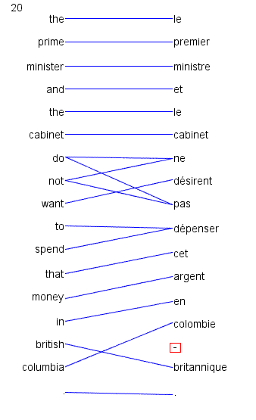
Word alignment is annotation of minimal translational correspondences
  Annotated in the context in which they occur
  Not idealized translations!
(solid blue lines annotated by a bilingual expert)

Slide 13
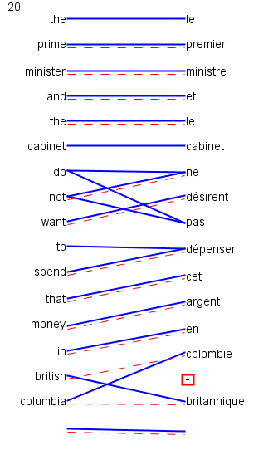
Automatic word alignments are typically generated using a model called IBM Model 4
No linguistic knowledge
No correct alignments are supplied to the system
  Unsupervised learning
  (red dashed line = automatically generated hypothesis)

Slide 14
Uses of Word Alignment
Multilingual
  Machine Translation
  Cross-Lingual Information Retrieval
  Translingual Coding (Annotation Projection)
  Document/Sentence Alignment
  Extraction of Parallel Sentences from Comparable Corpora
Monolingual
  Paraphrasing
  Query Expansion for Monolingual Information Retrieval
  Summarization
  Grammar Induction

Slide 15
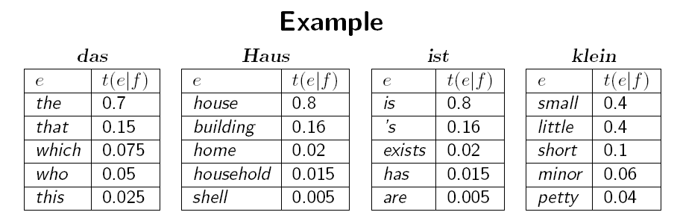
Extracting Word-to-Word Dictionaries
Given a word aligned corpus, we can extract word-to-word dictionaries
We do this by looking at all links to "das".
  If there are 1000 links to "das", and 700 of them are from "the", then we get a score of 70%
Example from Koehn 2008

Slide 16
Word-to-word dictionaries are useful
  For example, they are used to translate queries in cross-lingual retrieval
    Given the query "das Haus", the two query words are translated independently (we use all translations and the scores)
However, they are too simple to capture larger units of meaning, they link exactly one token to one token

Slide 17
"Phrase" dictionaries
Consider the links of two words that are next to each other in the source language
The links to these two words are often next to each other in the target language too
If this is true, we can extract a larger unit, relating two words in the source language to two words in the target language
We call these "phrases"
  WARNING: we may extract linguistic phrases, but much of what we extract is not a linguistic phrase!

Slide 18
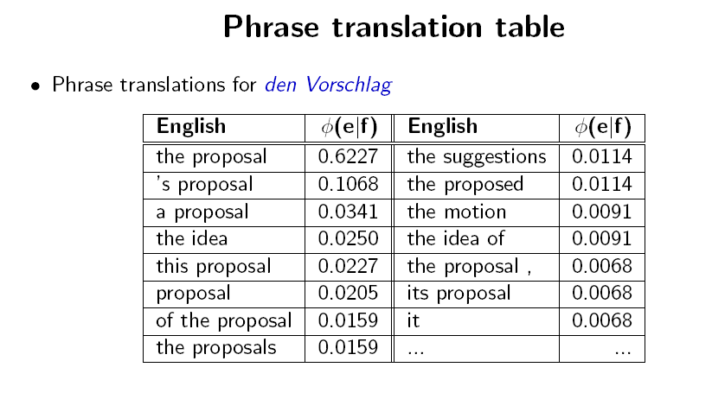
Slide from Koehn 2008

Slide 19
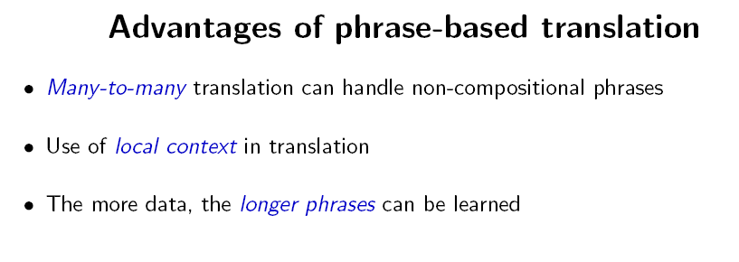
Slide from Koehn 2008

Slide 20
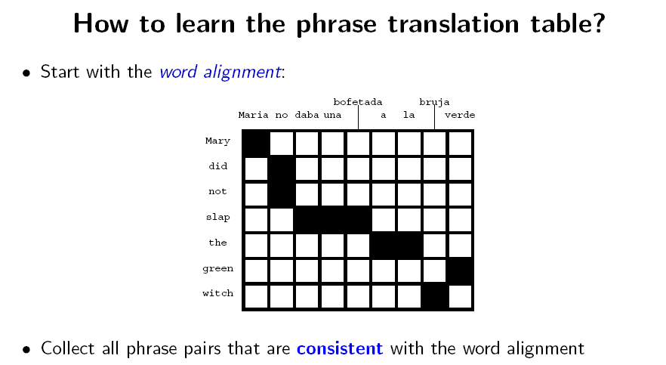
Slide from Koehn 2008

Slide 21
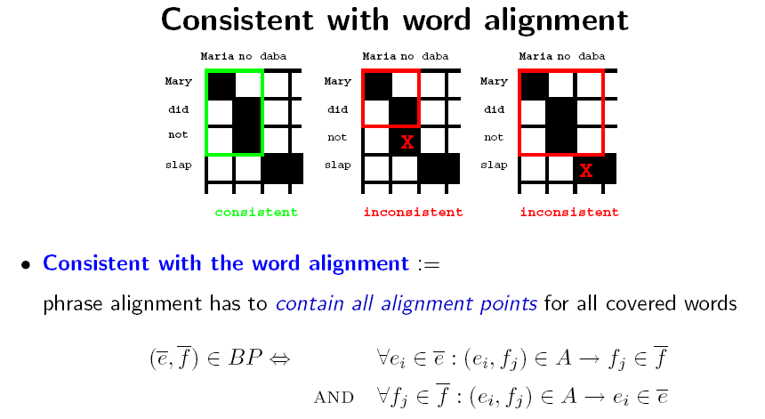
Slide from Koehn 2008

Slide 22
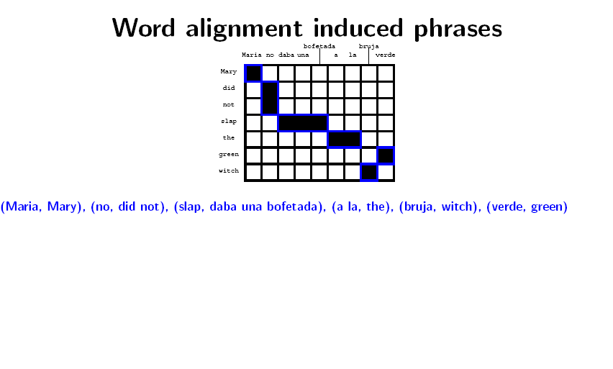
Slide from Koehn 2008

Slide 23
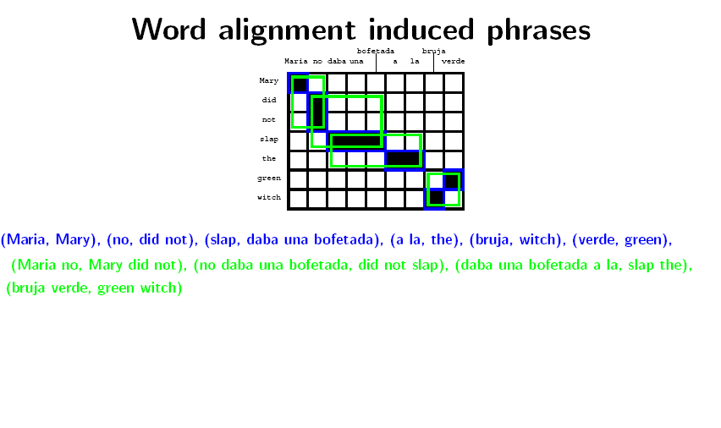
Slide from Koehn 2008

Slide 24
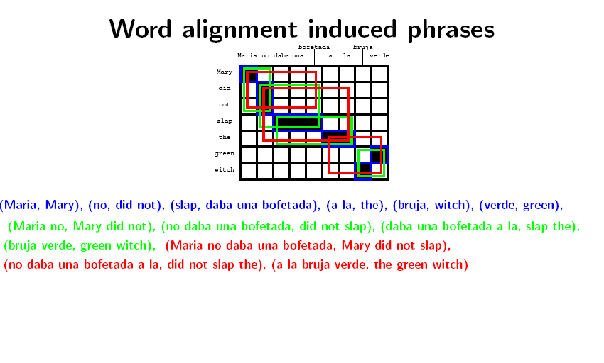
Slide from Koehn 2008

Slide 25
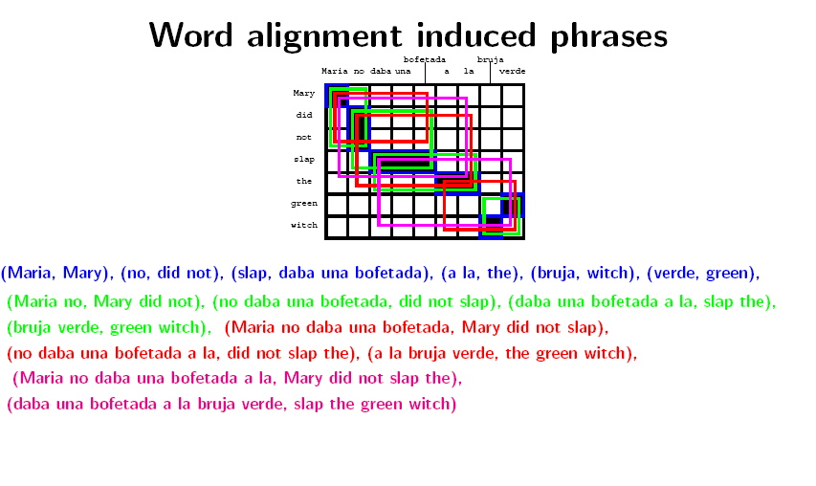
Slide from Koehn 2008

Slide 26
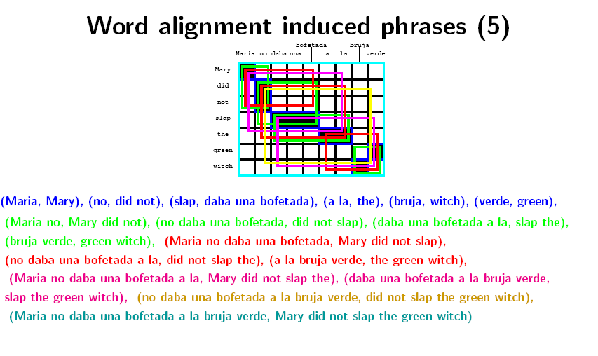
Slide from Koehn 2008

Slide 27
Using phrase dictionaries
The dictionaries we extract like this are the key technology behind statistical machine translation systems
Google Translate, for instance, uses phrase dictionaries for many language pairs
There are further generalizations of this idea
  We can introduce gaps in the phrases
    Like: "hat GAP gemacht | did GAP"
    The gaps are processed recursively
  We can labels the rules (and gaps) with syntactic constituents to try to control what goes inside the gap
    Like: S/S -> "NP hat es gesehen | NP saw it"

Slide 28
Extracting Multilingual Information
Word-aligned parallel corpora are one valuable source of bilingual information
In the seminar, we will see several other bilingual tasks including:
  Translating names between scripts ("transliteration")
  Extracting the translations of technical terminology
  Projecting linguistic annotation (such as syntactic treebank annotation) from one language to another

Slide 29
Slide sources
  The slides today are mostly from Philipp Koehn's course Statistical Machine Translation and from me (but see also attributions on individual slides)

Slide 30
Thank you for your attention!

