Slide 1
Information Extraction Lecture 12 – Multilingual Extraction
CIS, LMU München
Winter Semester 2014-2015
Dr. Alexander Fraser, CIS

Slide 2
Outline
Up until today: basics of information extraction
Primarily based on named entities and relation extraction
Last lecture was on sentiment analysis
There are some other tasks associated with the basic idea of information extraction
Two important tasks are terminology extraction and bilingual dictionary extraction
I will talk very briefly about terminology extraction (one slide) and then focus on bilingual dictionary extraction

Slide 3
Terminology Extraction
Terminology extraction tries to find words or sequences of words which have a domain-specific meaning
For instance "rotator blade" refers to a specialized concept in helicopters or wind turbines
To do terminology extraction, we need domain-specific corpora
Terminology extraction is often broken down into two phases:
First a very large list of types using a linguistic pattern (such as noun phrase types) is made by extracting matching tokens from the domain-specific corpus
Then statistical tests are used to determine if the presence of this term in the domain-specific corpus implies that it is domain-specific terminology
The challenge here is to separate terminology from general language
A "blue helicopter" is not a technical term, it is a helicopter which is blue
"rotator blade" is a technical term

Slide 4
Bilingual Dictionaries
Extracting bilingual information
Easiest to extract if we have a parallel corpus
This consists of text in one language and the translation of the text in another language
Given such a resource, we can extract bilingual dictionaries
Mostly used for machine translation, cross-lingual retrieval and other natural language processing applications
But also useful for human lexicographers and linguists

Slide 5
Parallel corpus
Example from DE-News (8/1/1996)
English | German
Diverging opinions about planned tax reform | Unterschiedliche Meinungen zur geplanten Steuerreform
The discussion around the envisaged major tax reform continues . | Die Diskussion um die vorgesehene grosse Steuerreform dauert an .
The FDP economics expert , Graf Lambsdorff , today came out in favor of advancing the enactment of significant parts of the overhaul , currently planned for 1999 . | Der FDP - Wirtschaftsexperte Graf Lambsdorff sprach sich heute dafuer aus , wesentliche Teile der fuer 1999 geplanten Reform vorzuziehen .
Modified from Dorr, Monz

Slide 6
Availability of parallel corpora
European Documents
24 Languages of the EU (Croatian most recent one)
For two European languages (e.g., English and German), European documents such as the proceedings of the European parliament are often used
United Nations Documents
Official UN languages: Arabic, Chinese, English, French, Russian, Spanish
For any two languages out of the 6 United Nations languages we can obtain large amounts of parallel UN documents
For other language pairs (e.g., German and Russian), it can be problematic to get parallel data

Slide 7
Most statistical machine translation research
has focused on a few high-resource languages
(European, Chinese, Japanese, Arabic).
(~200M words)
Approximate
Parallel Text Available
(with English)
Various
Western European
languages:
parliamentary
proceedings,
govt documents
(~30M words)
{
u
{
Bible/Koran/
Book of Mormon/
Dianetics
(~1M words)
Nothing/
Univ. Decl.
Of Human
Rights
(~1K words)
{
…
…
…
French
Arabic
German
Finnish
Serbian
Uzbek
Chechen
Kasem
Chinese
Spanish
Tamil
Pwo
Modified from Schafer&Smith

Slide 8
Document alignment
In the collections we have mentioned, the document alignment is given
We know which documents contain the proceedings of the UN General Assembly from Monday June 1st at 9am in all 6 languages
It is also possible to find parallel web documents using cross-lingual information retrieval techniques
Once we have the document alignment, we first need to "sentence align" the parallel documents

Slide 9
Sentence alignment
If document D_{e} is translation of document D_{f} how do we find the translation for each sentence?
The n-th sentence in D_{e} is not necessarily the translation of the n-th sentence in document D_{f}
In addition to 1:1 alignments, there are also 1:0, 0:1, 1:n, and n:1 alignments
In European Parliament proceedings, approximately 90% of the sentence alignments are 1:1
Modified from Dorr, Monz

Slide 10
Sentence alignment
There are several sentence alignment algorithms:
Align (Gale & Church): Aligns sentences based on their character length (shorter sentences tend to have shorter translations then longer sentences). Works well
Char-align: (Church): Aligns based on shared character sequences. Works fine for similar languages or technical domains
K-Vec (Fung & Church): Induces a translation lexicon from the parallel texts based on the distribution of foreign-English word pairs
Cognates (Melamed): Use positions of cognates (including punctuation)
Length + Lexicon (Moore; Braune and Fraser): Two passes, high accuracy, freely available
Modified from Dorr, Monz

Slide 11
Word alignments
Given a parallel sentence pair we can link (align) words or phrases that are translations of each other:
Modified from Dorr, Monz

Slide 12
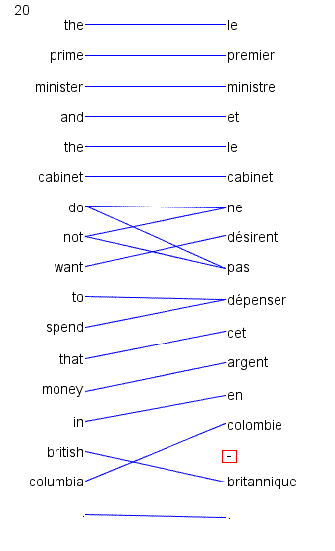
Word alignment is annotation of minimal translational correspondences
Annotated in the context in which they occur
Not idealized translations!
(solid blue lines annotated by a bilingual expert)

Slide 13
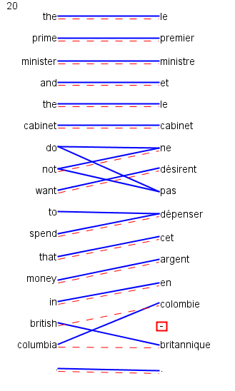
Automatic word alignments are typically generated using a model called IBM Model 4
No linguistic knowledge
No correct alignments are supplied to the system
Unsupervised learning
(red dashed line = automatically generated hypothesis)

Slide 14
Uses of Word Alignment
Multilingual
Machine Translation
Cross-Lingual Information Retrieval
Translingual Coding (Annotation Projection)
Document/Sentence Alignment
Extraction of Parallel Sentences from Comparable Corpora
Monolingual
Paraphrasing
Query Expansion for Monolingual Information Retrieval
Summarization
Grammar Induction

Slide 15
Extracting Word-to-Word Dictionaries
Given a word aligned corpus, we can extract word-to-word dictionaries
We do this by looking at all links to "das".
If there are 1000 links to "das", and 700 of them are from "the", then we get a score of 70%
Example from Koehn 2008

Slide 16
Word-to-word dictionaries are useful
For example, they are used to translate queries in cross-lingual retrieval
Given the query "das Haus", the two query words are translated independently (we use all translations and the scores)
However, they are too simple to capture larger units of meaning, they link exactly one token to one token

Slide 17
"Phrase" dictionaries
Consider the links of two words that are next to each other in the source language
The links to these two words are often next to each other in the target language too
If this is true, we can extract a larger unit, relating two words in the source language to two words in the target language
We call these "phrases"
WARNING: we may extract linguistic phrases, but much of what we extract is not a linguistic phrase!

Slide 18
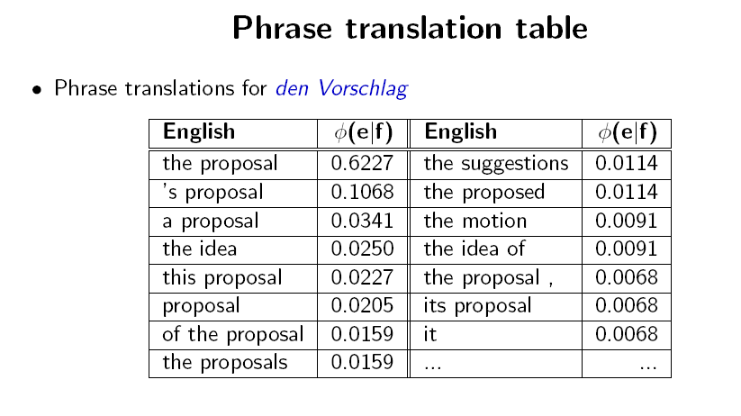
Slide from Koehn 2008

Slide 19
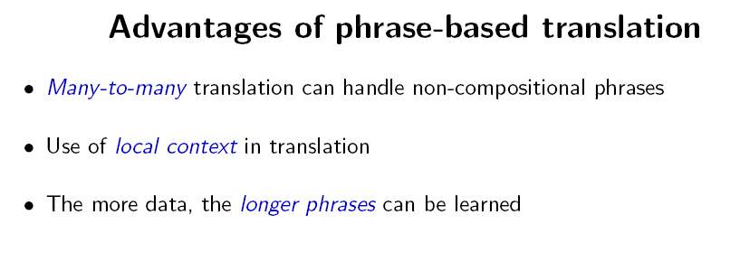
Slide from Koehn 2008

Slide 20
Slide from Koehn 2008

Slide 21
Slide from Koehn 2008

Slide 22
Slide from Koehn 2008

Slide 23
Slide from Koehn 2008

Slide 24
Slide from Koehn 2008

Slide 25
Slide from Koehn 2008

Slide 26
Slide from Koehn 2008

Slide 27
Using phrase dictionaries
The dictionaries we extract like this are the key technology behind statistical machine translation systems
Google Translate, for instance, uses phrase dictionaries for many language pairs
There are further generalizations of this idea
We can introduce gaps in the phrases
Like: "hat GAP gemacht | did GAP"
The gaps are processed recursively
We can labels the rules (and gaps) with syntactic constituents to try to control what goes inside the gap
Like: S/S -> "NP hat es gesehen | NP saw it"

Slide 28
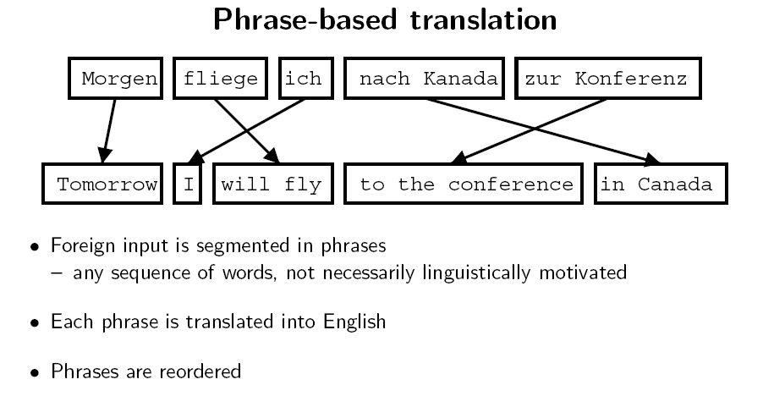
Slide from Koehn 2008

Slide 29
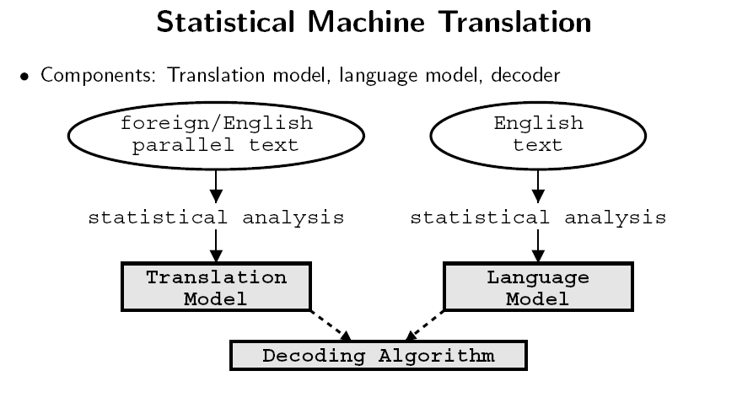
Slide from Koehn 2008

Slide 30
Decoding
Goal: find the best target translation of a source sentence
Involves search
Find maximum probability path in a dynamically generated search graph
Generate English string, from left to right, by covering parts of Foreign string
Generating English string left to right allows scoring with the n-gram language model
Here is an example of one path

Slide 31
Slide from Koehn 2008

Slide 32
Slide from Koehn 2008

Slide 33
Slide from Koehn 2008

Slide 34
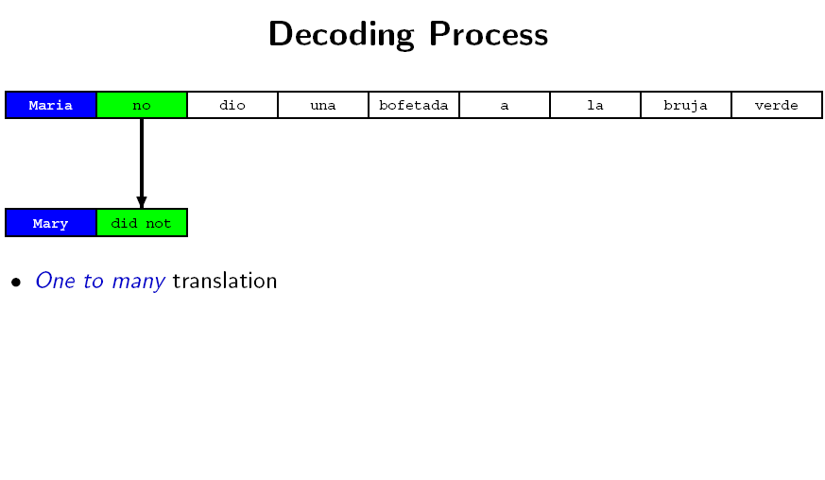
Slide from Koehn 2008

Slide 35
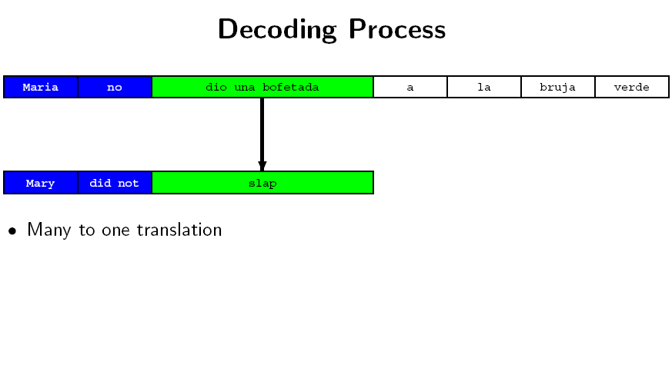
Slide from Koehn 2008

Slide 36
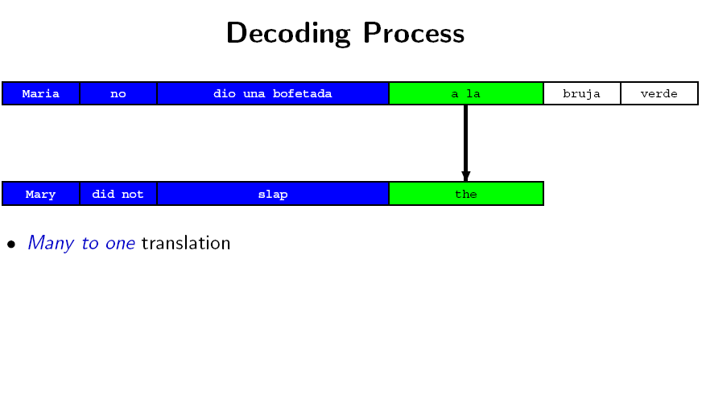
Slide from Koehn 2008

Slide 37
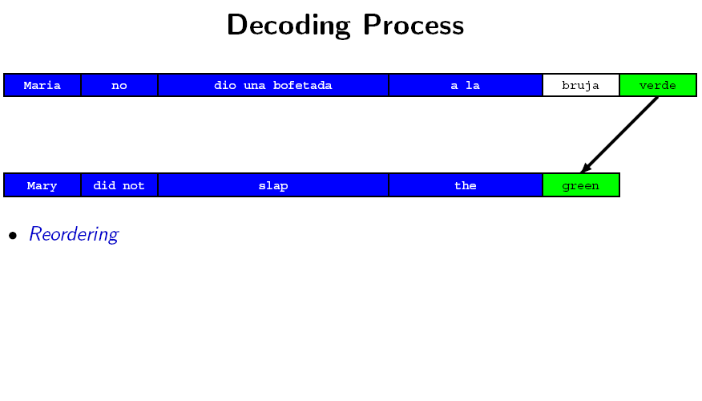
Slide from Koehn 2008

Slide 38
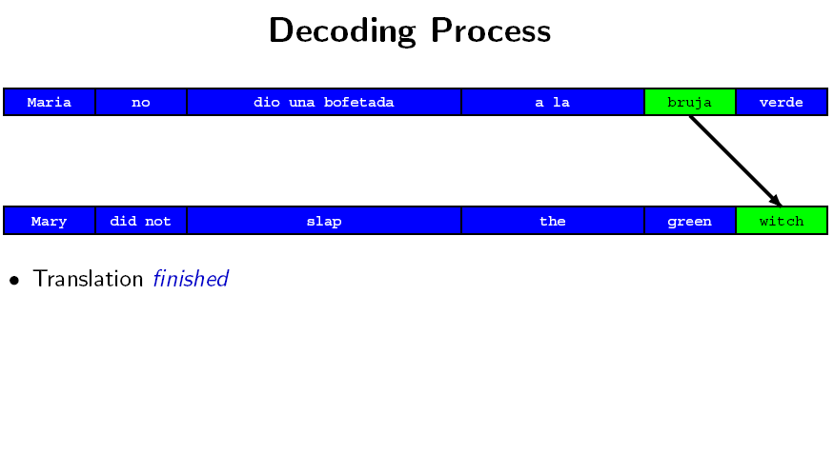
Slide from Koehn 2008

Slide 39
More on Statistical Machine Translation
I teach a course on Statistical Machine Translation, not sure when it will be offered next
Other resources: Philipp Koehn’s book ->
Kevin Knight’s tutorial on word alignment is long, but it is good!

Slide 40
Extracting Multilingual Information
Word-aligned parallel corpora are one valuable source of bilingual information
Other interesting multilingual extraction tasks include:
Translating words such as names between scripts ("transliteration")
Extracting the translations of technical terminology from comparable corpora
Extracting parallel sentences (or smaller units) from comparable corpora
Projecting linguistic annotation (such as syntactic treebank annotation) from one language to another

Slide 41
Slide sources
The slides today are mostly from Philipp Koehn's course Statistical Machine Translation and original slides I created (but see also attributions on individual slides)

Slide 42
Thank you for your attention!

