Slide 1
Information Extraction
Lecture 8 – Relation Extraction
CIS, LMU München
Winter Semester 2015-2016
Dr. Alexander Fraser, CIS

Slide 2
Relation Extraction
Up until now we have focused on early stages of the Information Extraction pipeline
  We have emphasized named entity tagging
Now we will discuss extracting facts about these entities
  This can include IS-A facts (similar to named entity types), but also more complicated relations

Slide 3
Extracting relations from text
Company report: “International Business Machines Corporation (IBM or the company) was incorporated in the State of New York on June 16, 1911, as the Computing-Tabulating-Recording Co. (C-T-R)…”
Extracted Complex Relation:
        Company-Founding
          Company IBM
          Location New York
          Date June 16, 1911
          Original-Name Computing-Tabulating-Recording Co.
But we will focus on the simpler task of extracting relation triples
        Founding-year(IBM, 1911)
        Founding-location(IBM, New York)
Slide from D. Jurafsky

Slide 4
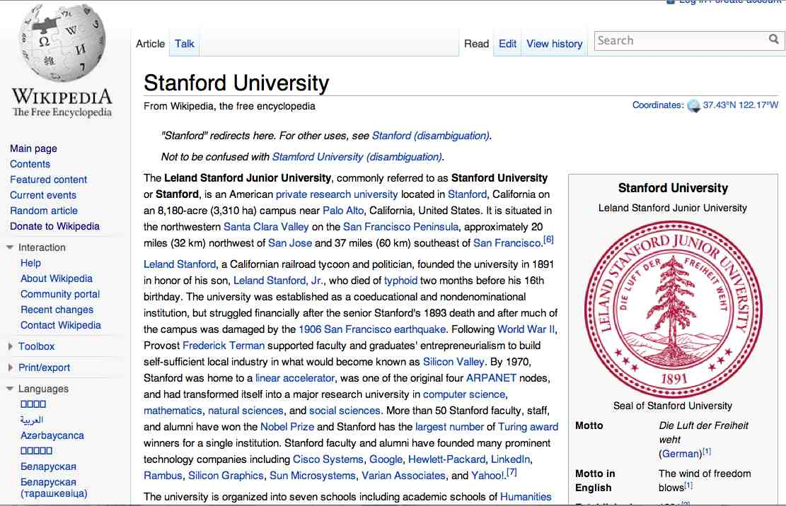
Extracting Relation Triples from Text
The Leland Stanford Junior University, commonly referred to as Stanford University or Stanford, is an American private research university located in Stanford, California … near Palo Alto, California… Leland Stanford…founded the university in 1891
Stanford EQ Leland Stanford Junior University
Stanford LOC-IN California
Stanford IS-A research university
Stanford LOC-NEAR Palo Alto
Stanford FOUNDED-IN 1891
Stanford FOUNDER Leland Stanford
Slide from D. Jurafsky

Slide 5
Automated Content Extraction (ACE)
17 relations from 2008 “Relation Extraction Task”
Slide from D. Jurafsky

Slide 6
Automated Content Extraction (ACE)
Physical-Located PER-GPE
  He was in Tennessee
Part-Whole-Subsidiary ORG-ORG
  XYZ, the parent company of ABC
Person-Social-Family PER-PER
  John’s wife Yoko
Org-AFF-Founder PER-ORG
  Steve Jobs, co-founder of Apple…
Slide from D. Jurafsky

Slide 7
UMLS: Unified Medical Language System
134 entity types, 54 relations
Injury disrupts Physiological Function
Bodily Location location-of Biologic Function
Anatomical Structure part-of Organism
Pharmacologic Substance causes Pathological Function
Pharmacologic Substance treats Pathologic Function
Slide from D. Jurafsky

Slide 8
Extracting UMLS relations from a sentence
Doppler echocardiography can be used to diagnose left anterior descending artery stenosis in patients with type 2 diabetes
⬇
Echocardiography, Doppler DIAGNOSES Acquired stenosis
Slide from D. Jurafsky

Slide 9
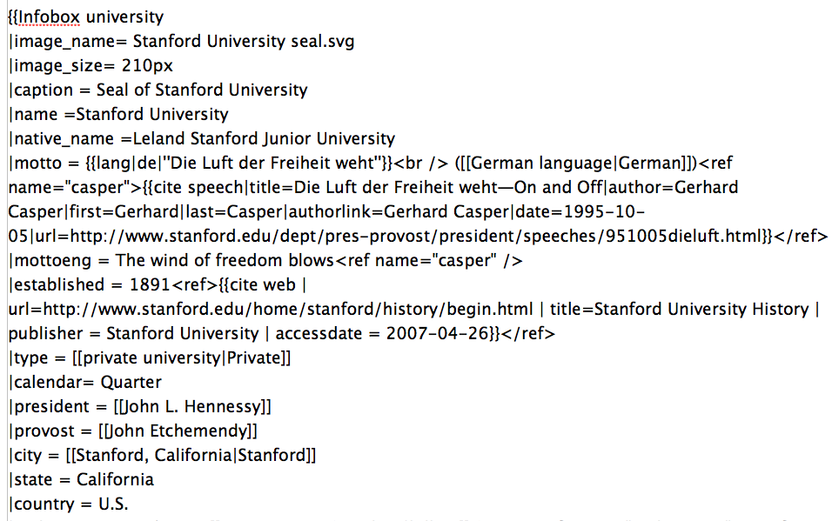
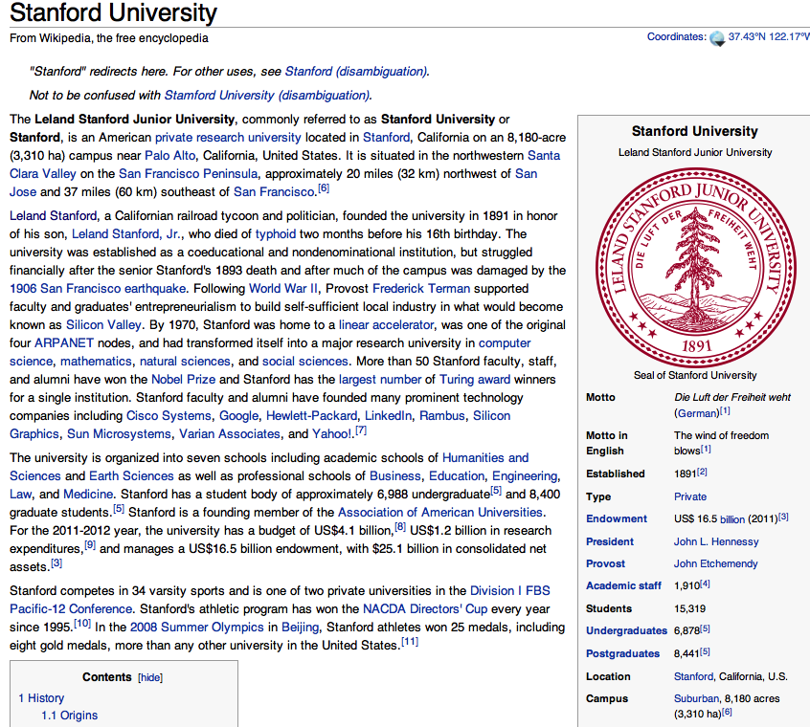
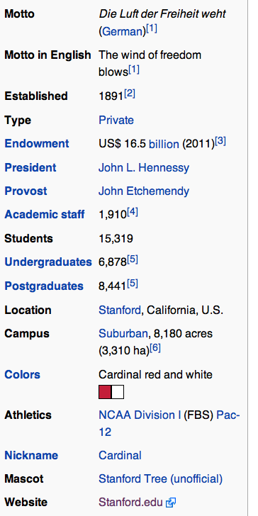
Databases of Wikipedia Relations
Wikipedia Infobox
Relations extracted from Infobox
Stanford state California
Stanford motto “Die Luft der Freiheit weht”
…
Slide from D. Jurafsky

Slide 10
Relation databases that draw from Wikipedia
Resource Description Framework (RDF) triples
  subject predicate object
  Golden Gate Park location San Francisco
  dbpedia:Golden_Gate_Park dbpedia-owl:location dbpedia:San_Francisco
DBPedia: 1 billion RDF triples, 385 from English Wikipedia
Frequent Freebase relations:
    people/person/nationality, location/location/contains
    people/person/profession, people/person/place-of-birth
    biology/organism_higher_classification film/film/genre
Slide from D. Jurafsky

Slide 11
Ontological relations
Examples from the WordNet Thesaurus
IS-A (hypernym): subsumption between classes
  Giraffe IS-A ruminant IS-A ungulate IS-A mammal IS-A vertebrate IS-A animal…
Instance-of: relation between individual and class
  San Francisco instance-of city
Slide from D. Jurafsky

Slide 12
Patterns for Relation Extraction
Hand-written rules for relation extraction were used in MUC (such as the Fastus system)
Recently there has been a renewed wide interest in learning rules for relation extraction focused on precision
  The presumption is that interesting information occurs many times on the web, with different contexts
    e.g., how many times does "Barack Obama is the 44th President of the United States" occur on the web?
  Focusing on high precision is reasonable because the high redundancy will allow us to deal with recall

Slide 13
How to build relation extractors
Hand-written patterns
Supervised machine learning
Semi-supervised and unsupervised
  Bootstrapping (using seeds)
  Distant supervision
  Unsupervised learning from the web
Slide from D. Jurafsky

Slide 14
Rules for extracting IS-A relation
Early intuition from Hearst (1992)
  “Agar is a substance prepared from a mixture of red algae, such as Gelidium, for laboratory or industrial use”
What does Gelidium mean?
How do you know?`
Slide from D. Jurafsky

Slide 15
Rules for extracting IS-A relation
Early intuition from Hearst (1992)
  “Agar is a substance prepared from a mixture of red algae, such as Gelidium, for laboratory or industrial use”
What does Gelidium mean?
How do you know?`
Slide from D. Jurafsky

Slide 16
Hearst’s Patterns for extracting IS-A relations
(Hearst, 1992): Automatic Acquisition of Hyponyms
“Y such as X ((, X)* (, and|or) X)”
“such Y as X”
“X or other Y”
“X and other Y”
“Y including X”
“Y, especially X”
Slide from D. Jurafsky

Slide 17
Hearst’s Patterns for extracting IS-A relations
Hearst pattern | Example occurrences
X and other Y | ...temples, treasuries, and other important civic buildings.
X or other Y | Bruises, wounds, broken bones or other injuries...
Y such as X | The bow lute, such as the Bambara ndang...
Such Y as X | ...such authors as Herrick, Goldsmith, and Shakespeare.
Y including X | ...common-law countries, including Canada and England...
Y , especially X | European countries, especially France, England, and Spain...
Slide from D. Jurafsky

Slide 18
Extracting Richer Relations Using Rules
Intuition: relations often hold between specific entities
  located-in (ORGANIZATION, LOCATION)
  founded (PERSON, ORGANIZATION)
  cures (DRUG, DISEASE)
Start with Named Entity tags to help extract relation!
Slide from D. Jurafsky

Slide 19


Named Entities aren’t quite enough.
Which relations hold between 2 entities?
Cure?
Prevent?
Drug
Cause?
Disease
Slide from D. Jurafsky
Notes:
Drug and disease pictures from Wikimedia Commons
http://commons.wikimedia.org/wiki/File:Gnome-face-sick.svg

Slide 20
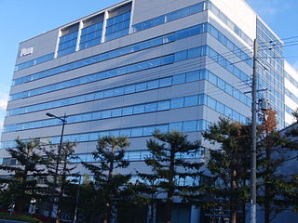

What relations hold between 2 entities?
Founder?
Investor?
Member?
PERSON
ORGANIZATION
Employee?
President?
Slide from D. Jurafsky
Notes:
pictures from Wikimedia Commons
http://upload.wikimedia.org/wikipedia/commons/thumb/9/9a/Sanyo_Electric_Corporation.JPG/320px-Sanyo_Electric_Corporation.JPG

Slide 21
Extracting Richer Relations Using Rules and
Named Entities
Who holds what office in what organization?
  PERSON, POSITION of ORG
    George Marshall, Secretary of State of the United States
  PERSON(named|appointed|chose|etc.) PERSON Prep? POSITION
    Truman appointed Marshall Secretary of State
  PERSON [be]? (named|appointed|etc.) Prep? ORG POSITION
    George Marshall was named US Secretary of State
Slide from D. Jurafsky

Slide 22
Hand-built patterns for relations
Plus:
  Human patterns tend to be high-precision
  Can be tailored to specific domains
Minus
  Human patterns are often low-recall
  A lot of work to think of all possible patterns!
  Don’t want to have to do this for every relation!
  We’d like better accuracy
Slide from D. Jurafsky

Slide 23
Supervised Methods
For named entity tagging, statistical taggers are the state of the art
However, for relation extraction, this is not necessarily true
  Still many hand-crafted rule-based systems out there that work well
  But hand-crafting such systems takes a lot of work, so classification approaches are very interesting (and they are improving with time)
I'll now discuss how to formulate relation extraction as a supervised classification problem

Slide 24
Supervised machine learning for relations
Choose a set of relations we’d like to extract
Choose a set of relevant named entities
Find and label data
  Choose a representative corpus
  Label the named entities in the corpus
  Hand-label the relations between these entities
  Break into training, development, and test
Train a classifier on the training set
Slide from D. Jurafsky

Slide 25
How to do classification in supervised relation extraction
Find all pairs of named entities (usually in same sentence)
Decide if 2 entities are related
If yes, classify the relation
Why the extra step?
  Faster classification training by eliminating most pairs
  Can use distinct feature-sets appropriate for each task.
Slide from D. Jurafsky

Slide 26
Automated Content Extraction (ACE)
17 sub-relations of 6 relations from 2008 “Relation Extraction Task”
Slide from D. Jurafsky

Slide 27

Relation Extraction
Classify the relation between two entities in a sentence
American Airlines, a unit of AMR, immediately matched the move, spokesman Tim Wagner said.
EMPLOYMENT
FAMILY
NIL
CITIZEN
…
INVENTOR
SUBSIDIARY
FOUNDER
Slide from D. Jurafsky

Slide 28
Word Features for Relation Extraction
American Airlines, a unit of AMR, immediately matched the move, spokesman Tim Wagner said
Mention 1
Mention 2
Headwords of M1 and M2, and combination
    Airlines Wagner Airlines-Wagner
Bag of words and bigrams in M1 and M2
{American, Airlines, Tim, Wagner, American Airlines, Tim Wagner}
Words or bigrams in particular positions left and right of M1/M2
    M2: -1 spokesman
    M2: +1 said
Bag of words or bigrams between the two entities
  {a, AMR, of, immediately, matched, move, spokesman, the, unit}
Slide from D. Jurafsky

Slide 29
Named Entity Type and Mention Level
Features for Relation Extraction
American Airlines, a unit of AMR, immediately matched the move, spokesman Tim Wagner said
Mention 1
Mention 2
Named-entity types
  M1: ORG
  M2: PERSON
Concatenation of the two named-entity types
  ORG-PERSON
Entity Level of M1 and M2 (NAME, NOMINAL, PRONOUN)
  M1: NAME [it or he would be PRONOUN]
  M2: NAME [the company would be NOMINAL]
Slide from D. Jurafsky

Slide 30
Parse Features for Relation Extraction
American Airlines, a unit of AMR, immediately matched the move, spokesman Tim Wagner said
Mention 1
Mention 2
Base syntactic chunk sequence from one to the other
  NP NP PP VP NP NP
Constituent path through the tree from one to the other
  NP ⬆ NP ⬆ S ⬆ S ⬇ NP
Dependency path
Airlines matched Wagner said
Slide from D. Jurafsky

Slide 31
Gazetteer and trigger word features for relation extraction
Trigger list for family: kinship terms
  parent, wife, husband, grandparent, etc. [from WordNet]
Gazetteer:
  Lists of useful geo or geopolitical words
    Country name list
    Other sub-entities
Slide from D. Jurafsky

Slide 32
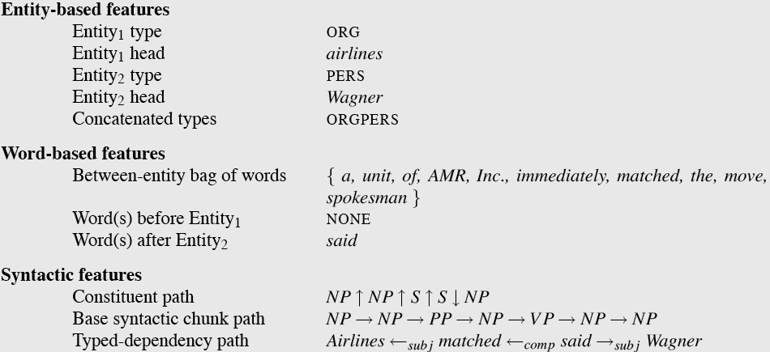
  American Airlines, a unit of AMR, immediately matched the move, spokesman Tim Wagner said.
Slide from D. Jurafsky

Slide 33
Classifiers for supervised methods
Now you can use any classifier you like
  Decision Tree
  MaxEnt
  Naïve Bayes
  SVM
  ...
Train it on the training set, tune on the dev set, test on the test set
Slide modified from D. Jurafsky

Slide 34
Evaluation of Supervised Relation Extraction
Compute P/R/F₁ for each relation
Slide from D. Jurafsky

Slide 35
Summary: Supervised Relation Extraction
+ Can get high accuracies with enough hand-labeled training data, if test similar enough to training
- Labeling a large training set is expensive
- Supervised models are brittle, don’t generalize well to different domains (topics and genres)
Slide modified from D. Jurafsky

Slide 36
Semi-Supervised Methods
We'd like to minimize our reliance on having a large training set
Instead, given a few examples or a few high-precision patterns, we'd like to generalize
  This is sometimes referred to as "bootstrapping"

Slide 37
Relation Bootstrapping (Hearst 1992)
Gather a set of seed pairs that have relation R
Iterate:
  Find sentences with these pairs
  Look at the context between or around the pair and generalize the context to create patterns
  Use the patterns to grep for more pairs
Slide from D. Jurafsky

Slide 38
Bootstrapping
<Mark Twain, Elmira> Seed tuple
  Grep (google) for the environments of the seed tuple
  “Mark Twain is buried in Elmira, NY.”
    X is buried in Y
  “The grave of Mark Twain is in Elmira”
    The grave of X is in Y
  “Elmira is Mark Twain’s final resting place”
    Y is X’s final resting place.
Use those patterns to grep for new tuples
Iterate
Slide from D. Jurafsky

Slide 39
Dipre: Extract <author, book> pairs
Brin, Sergei. 1998. Extracting Patterns and Relations from the World Wide Web.
Author | Book
Isaac Asimov | The Robots of Dawn
David Brin | Startide Rising
James Gleick | Chaos: Making a New Science
Charles Dickens | Great Expectations
William Shakespeare | The Comedy of Errors
Start with 5 seeds:
Find Instances:
  The Comedy of Errors, by William Shakespeare, was
  The Comedy of Errors, by William Shakespeare, is
  The Comedy of Errors, one of William Shakespeare's earliest attempts
  The Comedy of Errors, one of William Shakespeare's most
Extract patterns (group by middle, take longest common prefix/suffix)
  ?x , by ?y , ?x , one of ?y ‘s
Now iterate, finding new seeds that match the pattern
Slide from D. Jurafsky

Slide 40
Snowball
E. Agichtein and L. Gravano 2000. Snowball: Extracting Relations
from Large Plain-Text Collections. ICDL
Organization | Location of Headquarters
Microsoft | Redmond
Exxon | Irving
IBM | Armonk
Similar iterative algorithm
Group instances w/similar prefix, middle, suffix, extract patterns
  But require that X and Y be named entities
  And compute a confidence for each pattern
.69
ORGANIZATION
{’s, in, headquarters}
LOCATION
.75
LOCATION
{in, based}
ORGANIZATION
Slide from D. Jurafsky

Slide 41
Distant Supervision
Snow, Jurafsky, Ng. 2005. Learning syntactic patterns for automatic hypernym discovery. NIPS 17
Fei Wu and Daniel S. Weld. 2007. Autonomously Semantifying Wikipeida. CIKM 2007
Mintz, Bills, Snow, Jurafsky. 2009. Distant supervision for relation extraction without labeled data. ACL09
Combine bootstrapping with supervised learning
  Instead of 5 seeds,
    Use a large database to get huge # of seed examples
  Create lots of features from all these examples
  Combine in a supervised classifier
Slide from D. Jurafsky

Slide 42
Distant supervision paradigm
Like supervised classification:
    Uses a classifier with lots of features
    Supervised by detailed hand-created knowledge
    Doesn’t require iteratively expanding patterns
Like unsupervised classification:
    Uses very large amounts of unlabeled data
    Not sensitive to genre issues in training corpus
Slide from D. Jurafsky

Slide 43
Distantly supervised learning of relation extraction patterns
For each relation
For each tuple in big database
Find sentences in large corpus with both entities
Extract frequent features (parse, words, etc)
Train supervised classifier using thousands of patterns
Born-In
1
<Edwin Hubble, Marshfield>
<Albert Einstein, Ulm>
2
3
Hubble was born in Marshfield
Einstein, born (1879), Ulm
Hubble’s birthplace in Marshfield
4
PER was born in LOC
PER, born (XXXX), LOC
PER’s birthplace in LOC
5
P(born-in | f₁,f₂,f₃,…,f₇₀₀₀₀)
Slide from D. Jurafsky

Slide 44
Unsupervised relation extraction
M. Banko, M. Cararella, S. Soderland, M. Broadhead, and O. Etzioni. 2007. Open information extraction from the web. IJCAI
Open Information Extraction:
  extract relations from the web with no training data, no list of relations
Use parsed data to train a “trustworthy tuple” classifier
Single-pass extract all relations between NPs, keep if trustworthy
Assessor ranks relations based on text redundancy
    (FCI, specializes in, software development)
    (Tesla, invented, coil transformer)
Slide from D. Jurafsky

Slide 45
Evaluation of Semi-supervised and
Unsupervised Relation Extraction
Since it extracts totally new relations from the web
  There is no gold set of correct instances of relations!
    Can’t compute precision (don’t know which ones are correct)
    Can’t compute recall (don’t know which ones were missed)
Instead, we can approximate precision (only)
  Draw a random sample of relations from output, check precision manually
Can also compute precision at different levels of recall.
  Precision for top 1000 new relations, top 10,000 new relations, top 100,000
  In each case taking a random sample of that set
But no way to evaluate recall
Slide from D. Jurafsky

Slide 46
Slide sources
  Most of the slides today came from a lecture of Dan Jurafsky's in Chris Manning and Dan Jurafsky's online NLP course at Stanford (covers very broad range of NLP and Machine Learning topics)
(Last words on next slide)

Slide 47
Last words
As discussed in Sarawagi, traditional IE and web-based IE differ
  Traditional IE: find relation between entities in one text (think of CMU Seminars for instance)
  Web IE: find relation between "real-world" entities. Relations may occur on many different pages expressed in different ways
  There are also tasks that are in between these two extremes
Event extraction is like relation extraction
  The difference is that we fill out templates
  We have seen examples of these templates several times (for instance: outbreak – location – date)
  We'll see more on event extraction next time

Slide 48
Thank you for your attention!

