Slide 1
Information Extraction
Lecture 5 – Decision Trees (Basic Machine Learning)
CIS, LMU München
Winter Semester 2023-2024
Prof. Dr. Alexander Fraser, CIS

Slide 2
Lecture Today
Last week, we covered a basic idea of how NER classification works
  We talked about sliding windows and features
  Today I will complete this introduction by comparing sliding windows with boundary detection
After that, we'll spend the rest of the lecture on an important topic in machine learning

Slide 3
How can we pose this as a classification (or learning) problem?
…
00 : pm Place : Wean Hall Rm 5409 Speaker : Sebastian Thrun
…
prefix
contents
suffix
Data
Label
0
0
classifier
1
train a
predictive
model
1
0
Slide from Kauchak

Slide 4
Lots of possible techniques
Classify Candidates
Sliding Window
Boundary Models
Abraham Lincoln was born in Kentucky.
Abraham Lincoln was born in Kentucky.
Abraham Lincoln was born in Kentucky.
Classifier
BEGIN
Classifier
which class?
which class?
Classifier
Try alternate
window sizes:
which class?
BEGIN
END
BEGIN
END
Finite State Machines
Wrapper Induction
Abraham Lincoln was born in Kentucky.
<b><i>Abraham Lincoln</i></b> was born in Kentucky.
Most likely state sequence?
Learn and apply pattern for a website
<b>
<i>
PersonName
Any of these models can be used to capture words, formatting or both.
Slide from Kauchak

Slide 5

Information Extraction by Sliding Window
GRAND CHALLENGES FOR MACHINE LEARNING
Jaime Carbonell
School of Computer Science
Carnegie Mellon University
3:30 pm
7500 Wean Hall
Machine learning has evolved from obscurity in the 1970s into a vibrant and popular discipline in artificial intelligence during the 1980s and 1990s. As a result of its success and growth, machine learning is evolving into a collection of related disciplines: inductive concept acquisition, analytic learning in problem solving (e.g. analogy, explanation-based learning), learning theory (e.g. PAC learning), genetic algorithms, connectionist learning, hybrid systems, and so on.
CMU UseNet Seminar Announcement
Slide from Kauchak

Slide 6
Information Extraction by Sliding Window
GRAND CHALLENGES FOR MACHINE LEARNING
Jaime Carbonell
School of Computer Science
Carnegie Mellon University
3:30 pm
7500 Wean Hall
Machine learning has evolved from obscurity in the 1970s into a vibrant and popular discipline in artificial intelligence during the 1980s and 1990s. As a result of its success and growth, machine learning is evolving into a collection of related disciplines: inductive concept acquisition, analytic learning in problem solving (e.g. analogy, explanation-based learning), learning theory (e.g. PAC learning), genetic algorithms, connectionist learning, hybrid systems, and so on.
CMU UseNet Seminar Announcement
Slide from Kauchak

Slide 7
Information Extraction by Sliding Window
GRAND CHALLENGES FOR MACHINE LEARNING
Jaime Carbonell
School of Computer Science
Carnegie Mellon University
3:30 pm
7500 Wean Hall
Machine learning has evolved from obscurity in the 1970s into a vibrant and popular discipline in artificial intelligence during the 1980s and 1990s. As a result of its success and growth, machine learning is evolving into a collection of related disciplines: inductive concept acquisition, analytic learning in problem solving (e.g. analogy, explanation-based learning), learning theory (e.g. PAC learning), genetic algorithms, connectionist learning, hybrid systems, and so on.
CMU UseNet Seminar Announcement
Slide from Kauchak

Slide 8
Information Extraction by Sliding Window
GRAND CHALLENGES FOR MACHINE LEARNING
Jaime Carbonell
School of Computer Science
Carnegie Mellon University
3:30 pm
7500 Wean Hall
Machine learning has evolved from obscurity in the 1970s into a vibrant and popular discipline in artificial intelligence during the 1980s and 1990s. As a result of its success and growth, machine learning is evolving into a collection of related disciplines: inductive concept acquisition, analytic learning in problem solving (e.g. analogy, explanation-based learning), learning theory (e.g. PAC learning), genetic algorithms, connectionist learning, hybrid systems, and so on.
CMU UseNet Seminar Announcement
Slide from Kauchak

Slide 9
Information Extraction by Sliding Window
GRAND CHALLENGES FOR MACHINE LEARNING
Jaime Carbonell
School of Computer Science
Carnegie Mellon University
3:30 pm
7500 Wean Hall
Machine learning has evolved from obscurity in the 1970s into a vibrant and popular discipline in artificial intelligence during the 1980s and 1990s. As a result of its success and growth, machine learning is evolving into a collection of related disciplines: inductive concept acquisition, analytic learning in problem solving (e.g. analogy, explanation-based learning), learning theory (e.g. PAC learning), genetic algorithms, connectionist learning, hybrid systems, and so on.
CMU UseNet Seminar Announcement
Slide from Kauchak

Slide 10
Information Extraction by Sliding Window
…
00 : pm Place : Wean Hall Rm 5409 Speaker : Sebastian Thrun
…
w _{t-m}
w _{t-1}
w _{t}
w _{t+n}
w _{t+n+1}
w _{t+n+m}
prefix
contents
suffix
Standard supervised learning setting
  Positive instances?
  Negative instances?
Slide from Kauchak

Slide 11
Information Extraction by Sliding Window
…
00 : pm Place : Wean Hall Rm 5409 Speaker : Sebastian Thrun
…
w _{t-m}
w _{t-1}
w _{t}
w _{t+n}
w _{t+n+1}
w _{t+n+m}
prefix
contents
suffix
Standard supervised learning setting
  Positive instances: Windows with real label
  Negative instances: All other windows
  Features based on candidate, prefix and suffix
Slide from Kauchak

Slide 12
IE by Boundary Detection
GRAND CHALLENGES FOR MACHINE LEARNING
Jaime Carbonell
School of Computer Science
Carnegie Mellon University
3:30 pm
7500 Wean Hall
Machine learning has evolved from obscurity in the 1970s into a vibrant and popular discipline in artificial intelligence during the 1980s and 1990s. As a result of its success and growth, machine learning is evolving into a collection of related disciplines: inductive concept acquisition, analytic learning in problem solving (e.g. analogy, explanation-based learning), learning theory (e.g. PAC learning), genetic algorithms, connectionist learning, hybrid systems, and so on.
CMU UseNet Seminar Announcement
Slide from Kauchak

Slide 13
IE by Boundary Detection
GRAND CHALLENGES FOR MACHINE LEARNING
Jaime Carbonell
School of Computer Science
Carnegie Mellon University
3:30 pm
7500 Wean Hall
Machine learning has evolved from obscurity in the 1970s into a vibrant and popular discipline in artificial intelligence during the 1980s and 1990s. As a result of its success and growth, machine learning is evolving into a collection of related disciplines: inductive concept acquisition, analytic learning in problem solving (e.g. analogy, explanation-based learning), learning theory (e.g. PAC learning), genetic algorithms, connectionist learning, hybrid systems, and so on.
CMU UseNet Seminar Announcement
Slide from Kauchak

Slide 14
IE by Boundary Detection
GRAND CHALLENGES FOR MACHINE LEARNING
Jaime Carbonell
School of Computer Science
Carnegie Mellon University
3:30 pm
7500 Wean Hall
Machine learning has evolved from obscurity in the 1970s into a vibrant and popular discipline in artificial intelligence during the 1980s and 1990s. As a result of its success and growth, machine learning is evolving into a collection of related disciplines: inductive concept acquisition, analytic learning in problem solving (e.g. analogy, explanation-based learning), learning theory (e.g. PAC learning), genetic algorithms, connectionist learning, hybrid systems, and so on.
CMU UseNet Seminar Announcement
Slide from Kauchak

Slide 15
IE by Boundary Detection
GRAND CHALLENGES FOR MACHINE LEARNING
Jaime Carbonell
School of Computer Science
Carnegie Mellon University
3:30 pm
7500 Wean Hall
Machine learning has evolved from obscurity in the 1970s into a vibrant and popular discipline in artificial intelligence during the 1980s and 1990s. As a result of its success and growth, machine learning is evolving into a collection of related disciplines: inductive concept acquisition, analytic learning in problem solving (e.g. analogy, explanation-based learning), learning theory (e.g. PAC learning), genetic algorithms, connectionist learning, hybrid systems, and so on.
CMU UseNet Seminar Announcement
Slide from Kauchak

Slide 16
IE by Boundary Detection
GRAND CHALLENGES FOR MACHINE LEARNING
Jaime Carbonell
School of Computer Science
Carnegie Mellon University
3:30 pm
7500 Wean Hall
Machine learning has evolved from obscurity in the 1970s into a vibrant and popular discipline in artificial intelligence during the 1980s and 1990s. As a result of its success and growth, machine learning is evolving into a collection of related disciplines: inductive concept acquisition, analytic learning in problem solving (e.g. analogy, explanation-based learning), learning theory (e.g. PAC learning), genetic algorithms, connectionist learning, hybrid systems, and so on.
CMU UseNet Seminar Announcement
Slide from Kauchak

Slide 17
Some concerns
Begin
Begin
End
Begin
Begin
End
End
…
Begin
End
Slide from Kauchak

Slide 18
Learning to detect boundaries
Learn three probabilistic classifiers:
  Begin(i) = probability position i starts a field
  End(j) = probability position j ends a field
  Len(k) = probability an extracted field has length k
Score a possible extraction (i,j) by
  Begin(i) * End(j) * Len(j-i)
Len(k) is estimated from a histogram data
Begin(i) and End(j) may combine multiple boundary detectors!
Slide from Kauchak

Slide 19
Problems with Sliding Windows and Boundary Finders
Decisions in neighboring parts of the input are made independently from each other.
  Sliding Window may predict a “seminar end time” before the “seminar start time”.
  It is possible for two overlapping windows to both be above threshold.
  In a Boundary-Finding system, left boundaries are laid down independently from right boundaries
Slide from Kauchak

Slide 20
Where we are going
What we just completed: introduction to NER using classifiers
  Features, sliding windows vs. boundaries
Rest of today: look at decision trees as part of a general introduction to machine learning
  I will present a different perspective from the Statistical Methods course
  Necessary background to linear models, which I will present next week
    Next week, I will connect linear models with NER
    The rest of this lecture is a short break from NER

Slide 21
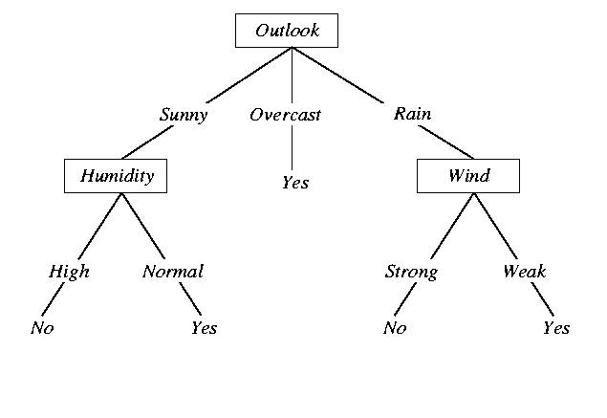
Decision Tree Representation for ‘Play Tennis?’
Internal node
~ test an attribute
Branch
~ attribute value
Leaf
~ classification result
Slide from A. Kaban
Notes:
Suppose that you have a free afternoon and you are thinking whether or not to go and play tennis.
How you do that?

Slide 22
When is it useful?
  Medical diagnosis
  Equipment diagnosis
  Credit risk analysis
  etc
Slide from A. Kaban
Notes:
When can something like this useful in practice?
Let us look at a situation more closely….

Slide 23
Outline
Contingency tables
  Census data set
Information gain
  Beach data set
Learning an unpruned decision tree recursively
  Gasoline usage data set
Training error
Test error
Overfitting
Avoiding overfitting

Slide 24
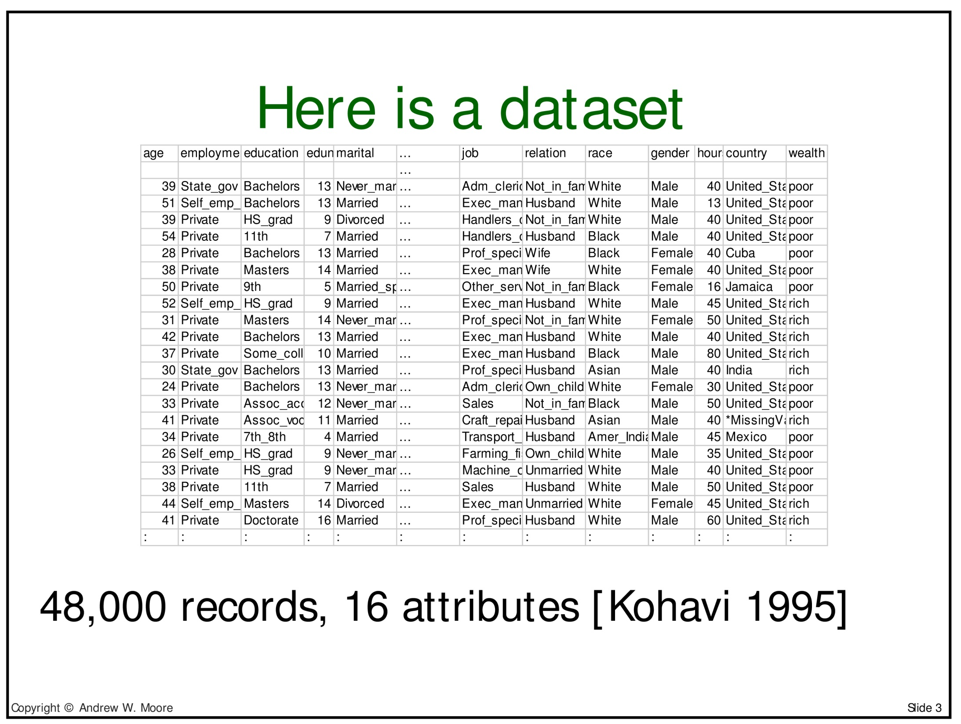

Slide 25
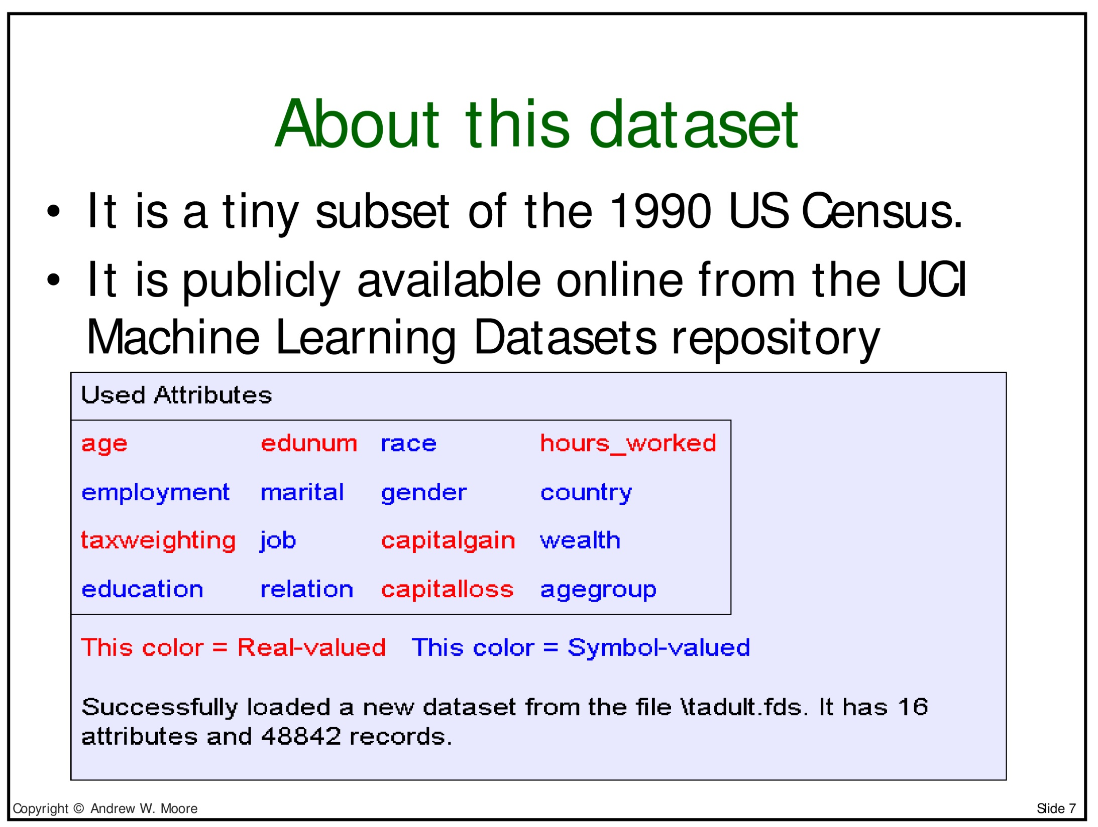

Slide 26
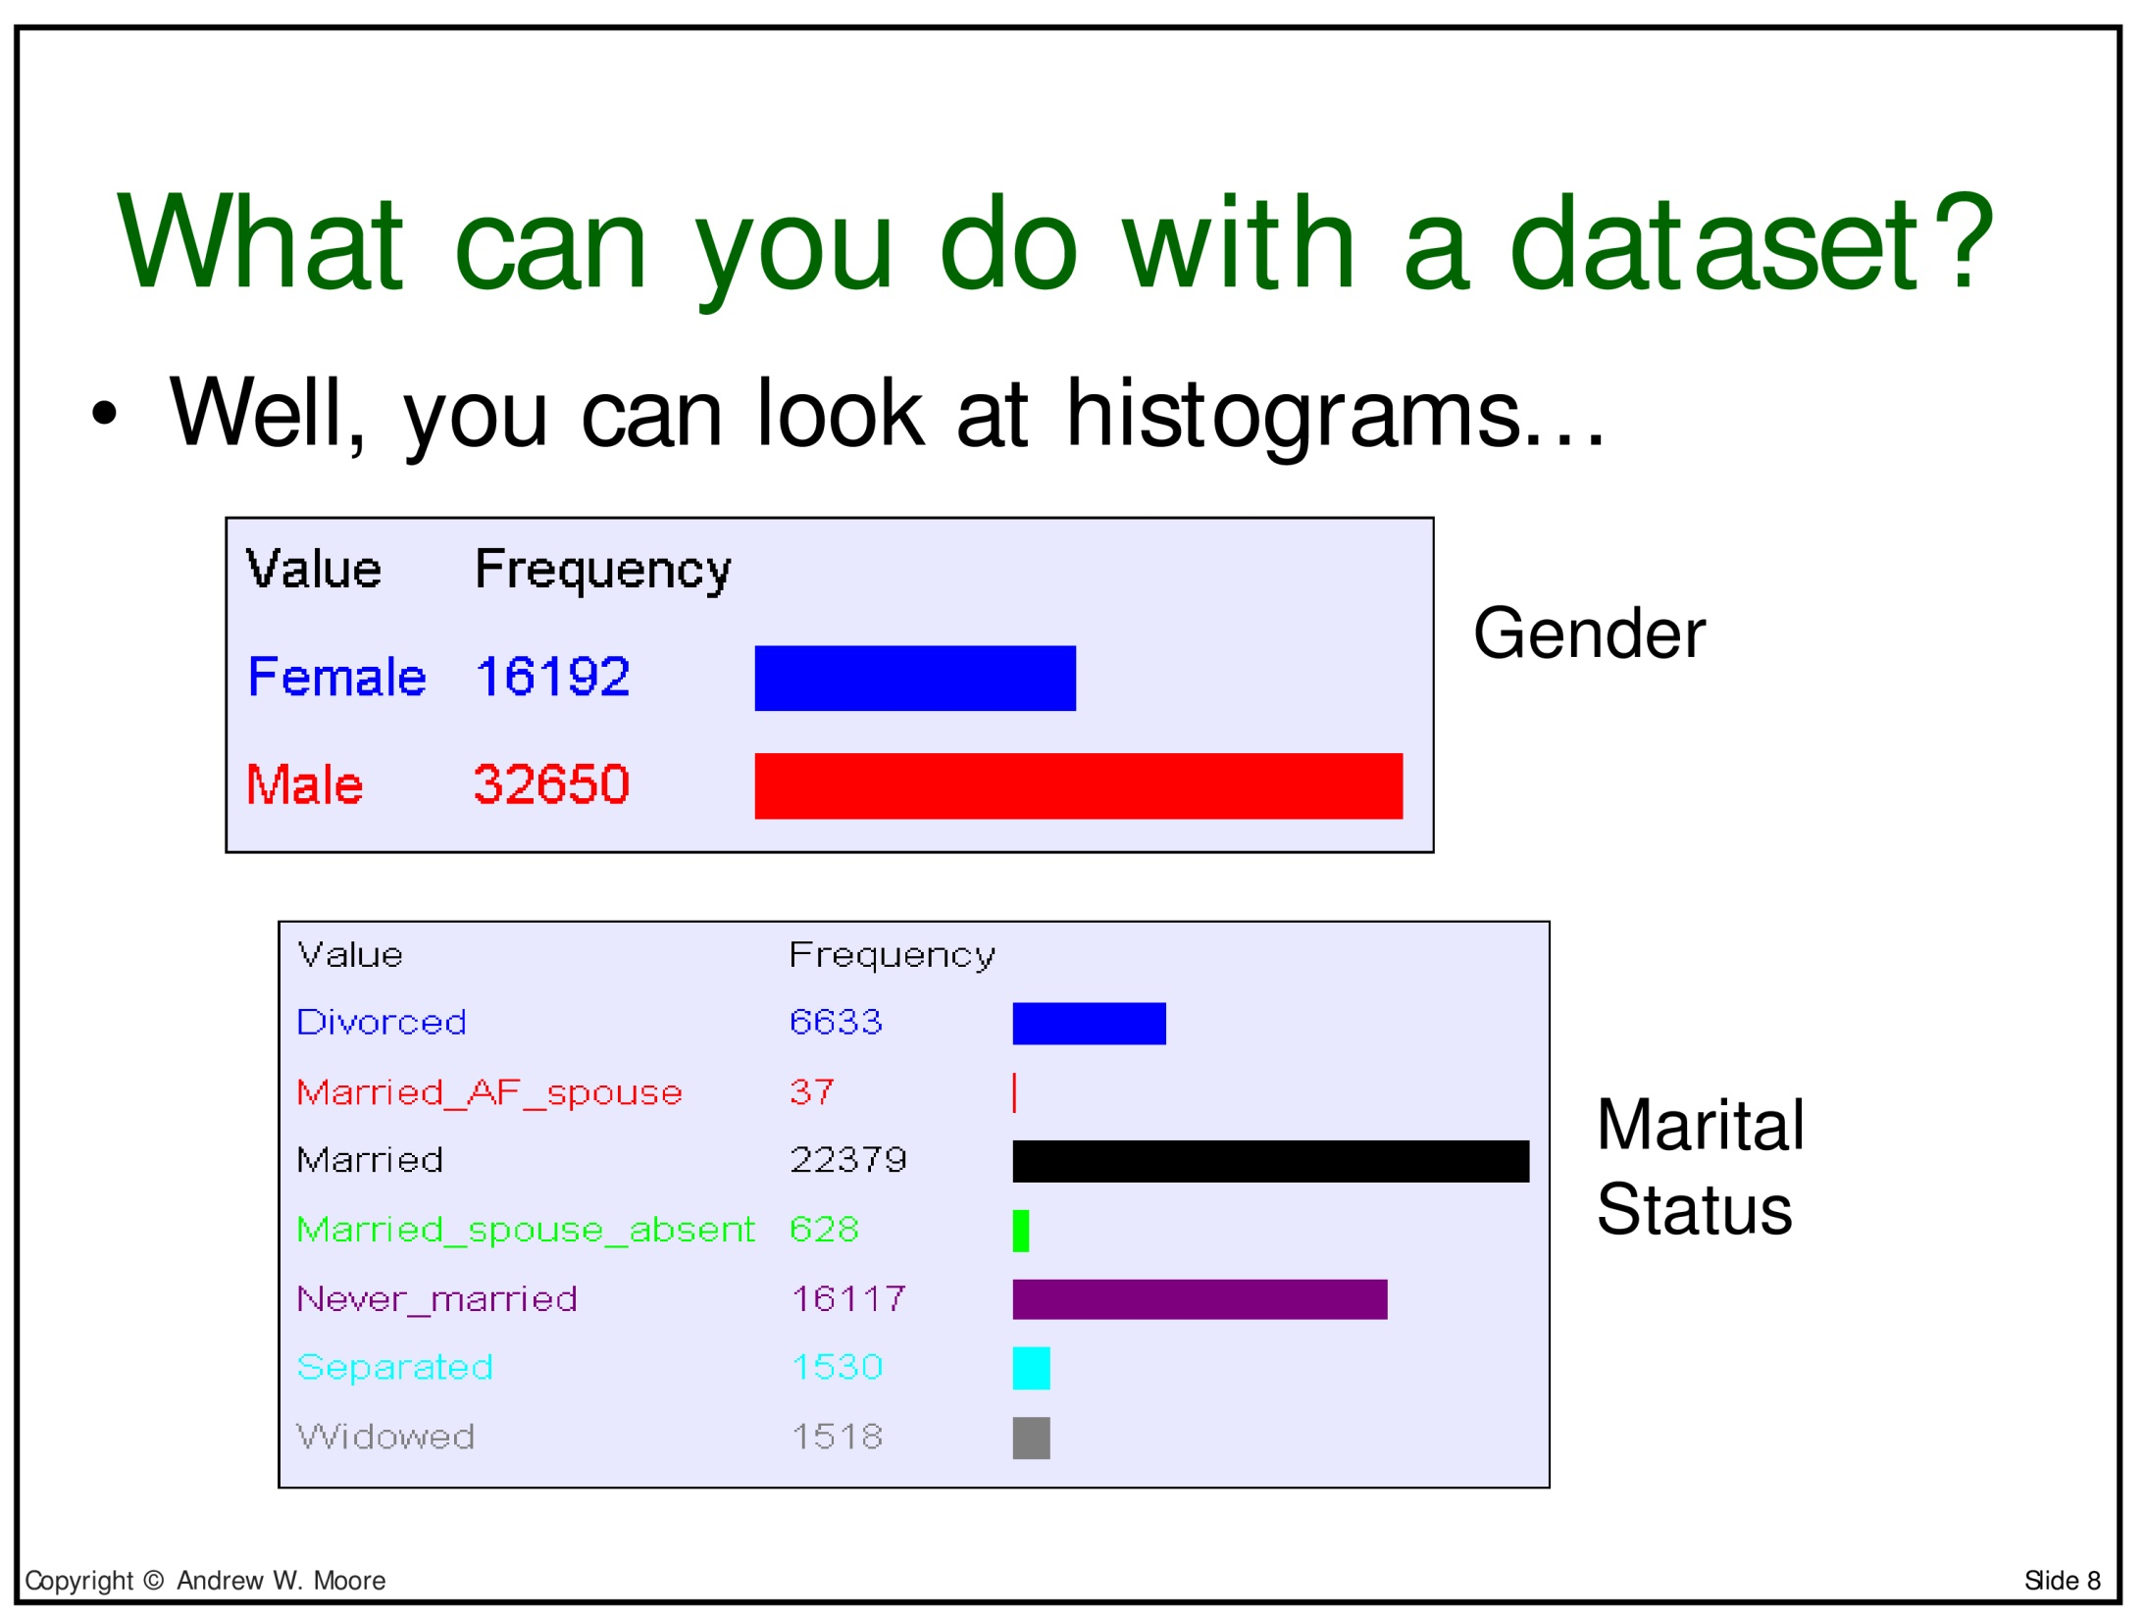

Slide 27
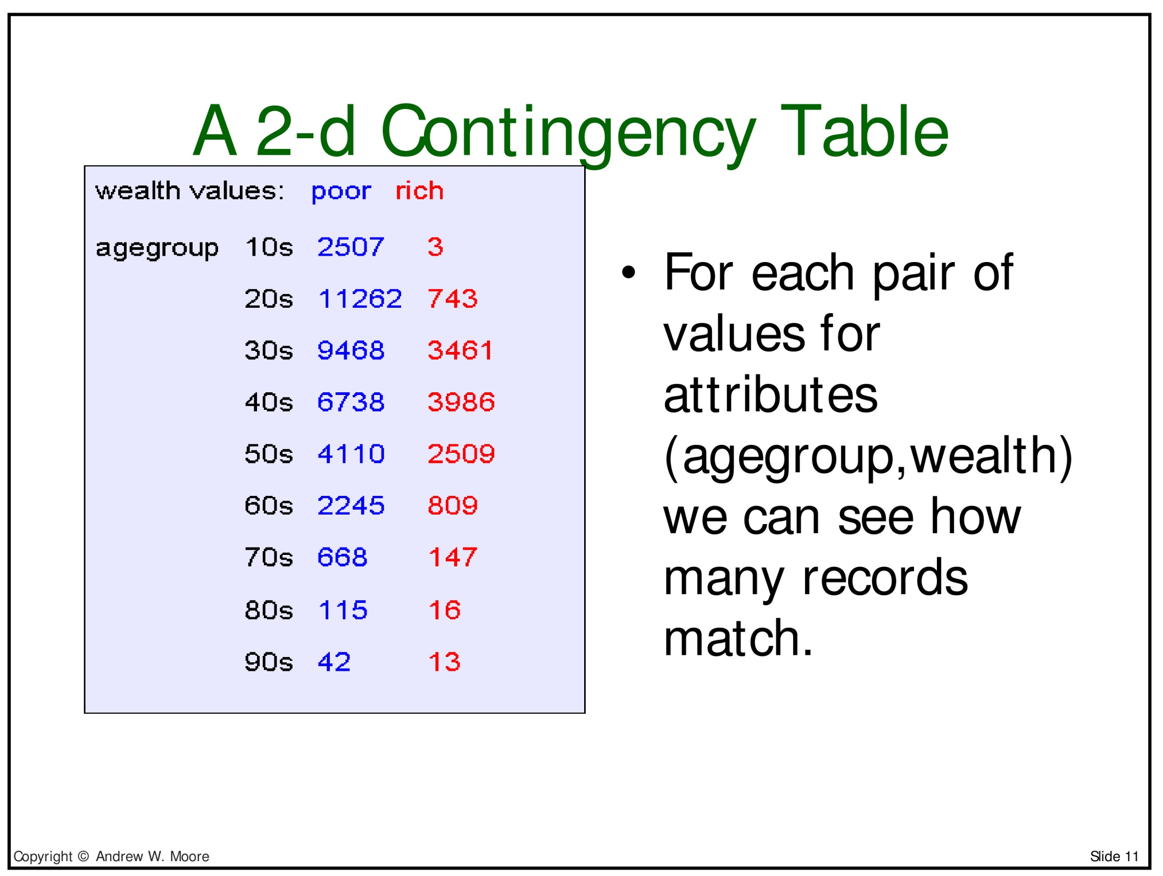

Slide 28
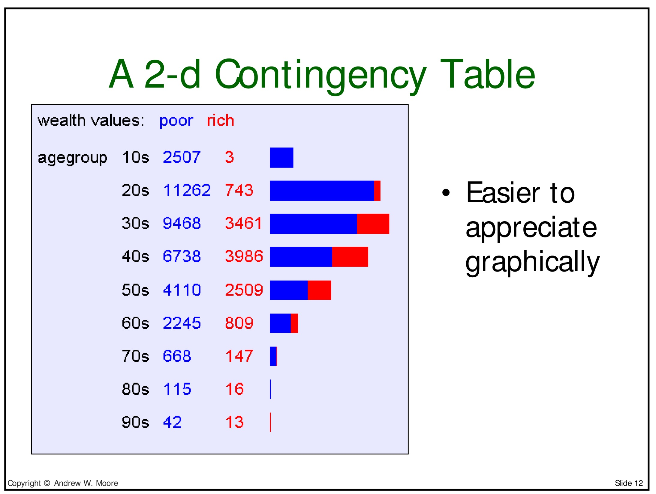

Slide 29
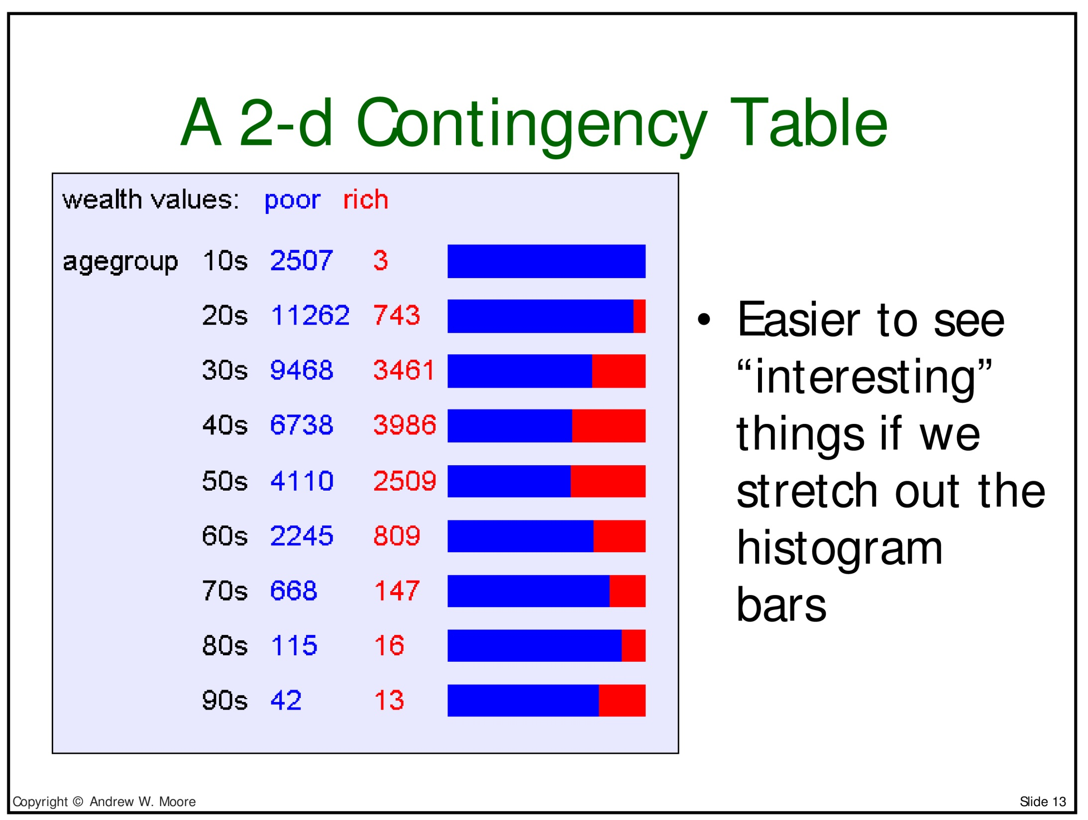

Slide 30
Using this idea for classification
We will now look at a (toy) dataset presented in Winston's Artificial Intelligence textbook
It is often used when explaining decision trees
The variable we are trying to pick is "got_a_sunburn" (or "is_sunburned" if you like)
We will look at different decision trees that can be used to correctly classify this data

Slide 31
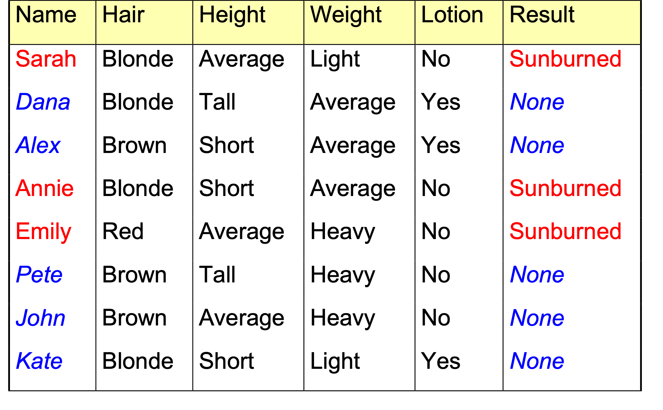
Sunburn Data Collected
Slide from A. Kaban
Notes:
You want the observed properties of the people to help you predict whether another person is likely to get sunburned
How can you do this?
You might hope that the new person would be an exact match to one of the examples in the table. What are the chances of this?
Actually there are 3 x 3 x 3x 2 = 54 possible combinations of attributes. Eight examples so chance of an exact match for a randomly chosen example is 8/54=0.15
Not good. In general there would be many more factors or attributes and each might take many values.
You could look for the nearest example to the new person. However some of the attributes may be irrelevant!

Slide 32
Decision Tree 1
is_sunburned
Height
short
tall
average
Hair colour
Weight
Dana, Pete
blonde
red
brown
light
average
heavy
Alex
Sarah
Weight
Hair colour
blonde
light
average
heavy
red
brown
Emily
John
Katie
Annie
Slide from A. Kaban
Notes:
Here is another way of looking at the data -- called a decision tree.
It correctly CLASSIFIES all the data!
You can view it as an IF-THEN_ELSE statement which tells us whether someone will suffer from sunburn.

Slide 33
Sunburn sufferers are ...
If height=“average” then
  if weight=“light” then
    return(true) ;;; Sarah
  elseif weight=“heavy” then
    if hair_colour=“red” then
      return(true) ;;; Emily
elseif height=“short” then
  if hair_colour=“blonde” then
    if weight=“average” then
      return(true) ;;; Annie
else return(false) ;;;everyone else
Slide from A. Kaban
Notes:
Is there anything you don’t like about this this program for predicting whether people will suffer from sunburn?
It is all perfectly reasonable?
Of course it isn’t reasonable at all. We KNOW that height is IRRELEVANT for determining whether someone will suffer from sunburn.
Well, what I mean is that there are much MORE relevant decision variables to use.
Now I want you to draw a new decision diagram that makes a bit more sense. I ‘ll give you five minutes.

Slide 34
Decision Tree 2
is_sunburned
Lotion used
no
yes
Hair colour
Hair colour
blonde
blonde
red
brown
red
Sarah, Annie
brown
Dana, Katie
Emily
Pete, John
Alex
Slide from A. Kaban
Notes:
Did any of you produce this decision tree?
It is a lot better than the first one and it doesn’t involve any of the irrelevant attributes
Unfortunately though it uses the hair colour attribute twice which doesn’t seem so efficient. Perhaps we should use hair colour first.

Slide 35
Decision Tree 3
is_sunburned
Hair colour
brown
blonde
red
Alex, Pete, John
Emily
Lotion used
no
yes
Sarah, Annie
Dana, Katie
Slide from A. Kaban
Notes:
Did you produce this tree?
If so, well done. This is the simplest one possible and it makes a lot of sense.
It classifies 4 of the people on just the hair colour alone.
Before we get too carried away with our success, let’s stop a moment and think. We used our common sense about what attributes were most likely to be relevant to whether people will get sunburn.
We are trying to create an automatic program that finds a good decision tree.
In many cases we have problems where all the attributes have some relevance. So what do we do then?

Slide 36
Summing up
Irrelevant attributes do not classify the data well
Using irrelevant attributes thus causes larger decision trees
a computer could look for simpler decision trees
Q: How?
Slide from A. Kaban

Slide 37
A: How WE did it?
Q: Which is the best attribute for splitting up the data?
A: The one which is most informative for the classification we want to get.
Q: What does it mean ‘more informative’?
A: The attribute which best reduces the uncertainty or the disorder
Slide from A. Kaban

Slide 38
We need a quantity to measure the disorder in a set of examples
S={s₁, s₂, s₃, …, s_{n}}
where s1=“Sarah”, s2=“Dana”, …
Then we need a quantity to measure the amount of reduction of the disorder level in the instance of knowing the value of a particular attribute
Slide from A. Kaban

Slide 39
What properties should the Disorder (D) have?
Suppose that D(S)=0 means that all the examples in S have the same class
Suppose that D(S)=1 means that half the examples in S are of one class and half are the opposite class
Slide from A. Kaban
Notes:
We are trying to find decision variables that make D(S) small
When we apply this we will have to take into account the number of examples in the class also

Slide 40
Examples
D({“Dana”,“Pete”}) =0
D({“Sarah”,“Annie”,“Emily” })=0
D({“Sarah”,“Emily”,“Alex”,“John” })=1
D({“Sarah”,“Emily”, “Alex” })=?
Slide from A. Kaban
Notes:
If we applied D to the examples
How could we define something that would allows us to calculate this one?
Well, we could make D depend on the proportion of positive examples?
So in this case it would be 2/5 = 0.4.
How about this? (click for next slide)

Slide 41
D({“Sarah”,“Emily”, “Alex” })=0.918
1.0
0.918
Disorder, D
0
0
0.5
0.67
1.0
Proportion of positive examples, p₊
Slide from A. Kaban
Notes:
Try to remember the shape of this graph it will remind you of many of the properties of the disorder function.
There is nothing sacred about this curve. Decision tree learning could define another (say straight lines)

Slide 42
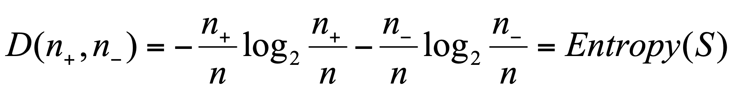
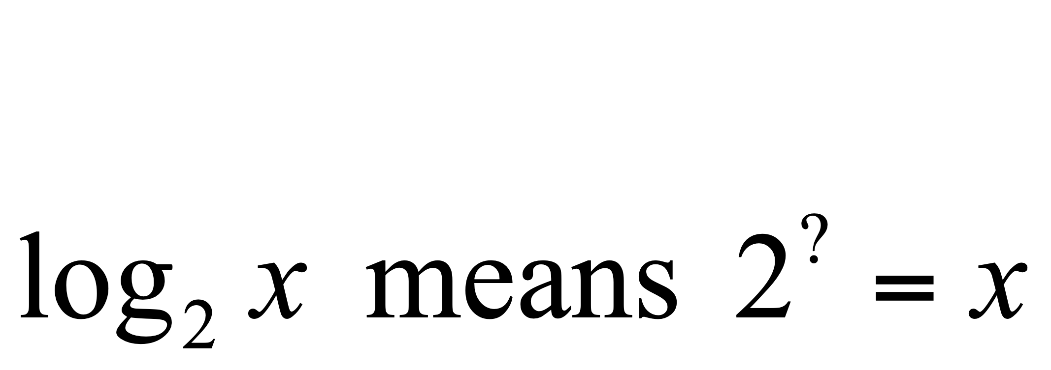
Definition of Disorder
The Entropy measures the disorder of a set S containing a total of n examples of which n₊ are positive and n₋ are negative and it is given by
where
Check it!
D(0,1) = ? D(1,0)=? D(0.5,0.5)=?
Slide from A. Kaban

Slide 43
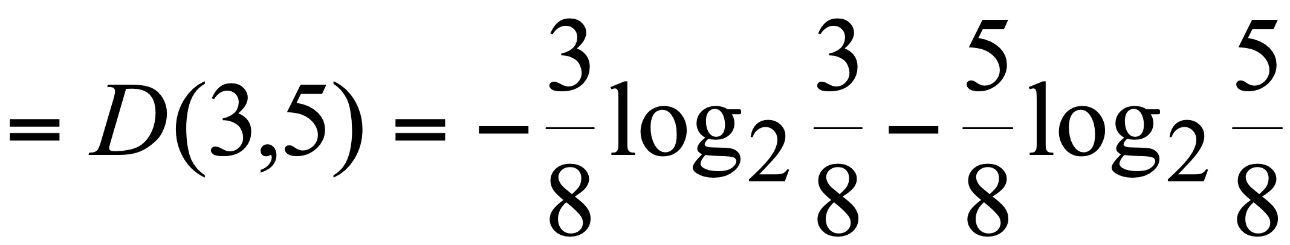
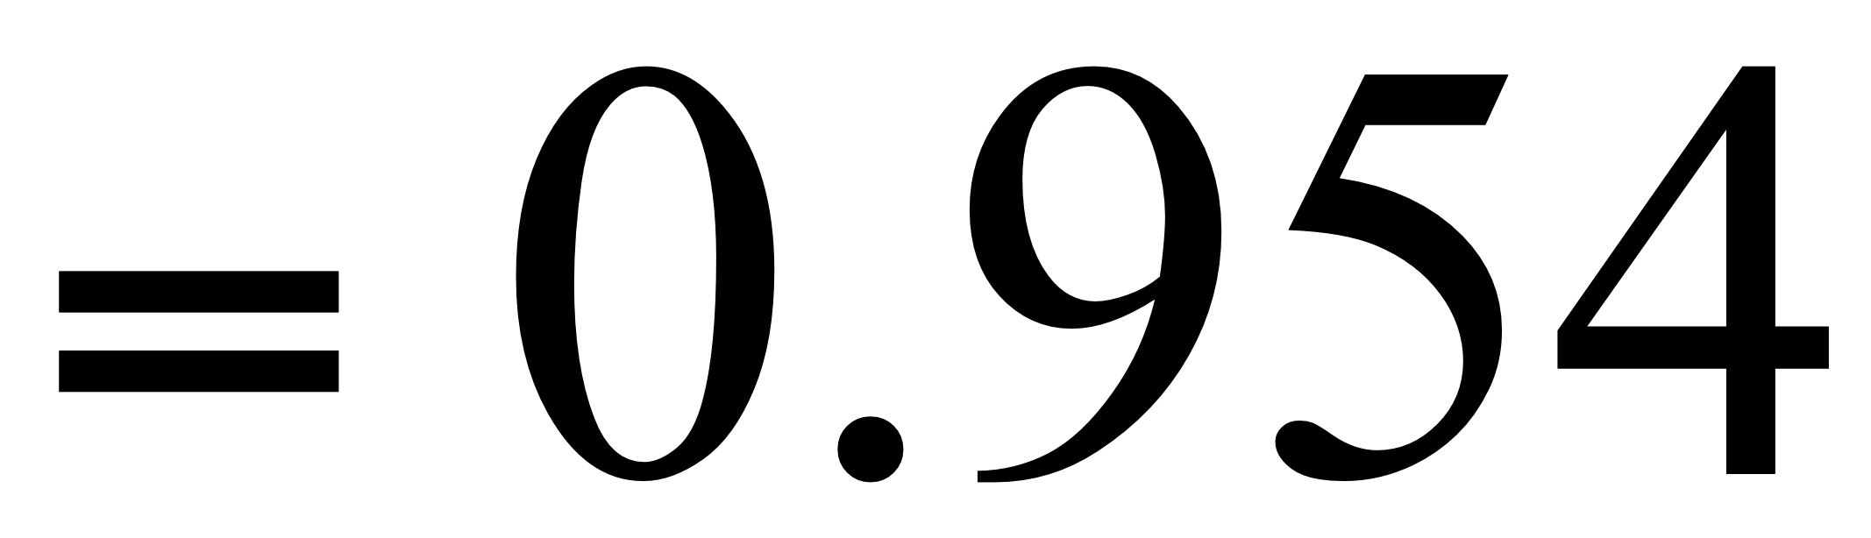
Back to the beach (or the disorder of sunbathers)!
D({ “Sarah”,“Dana”,“Alex”,“Annie”, “Emily”,“Pete”,“John”,“Katie”})
Slide from A. Kaban

Slide 44
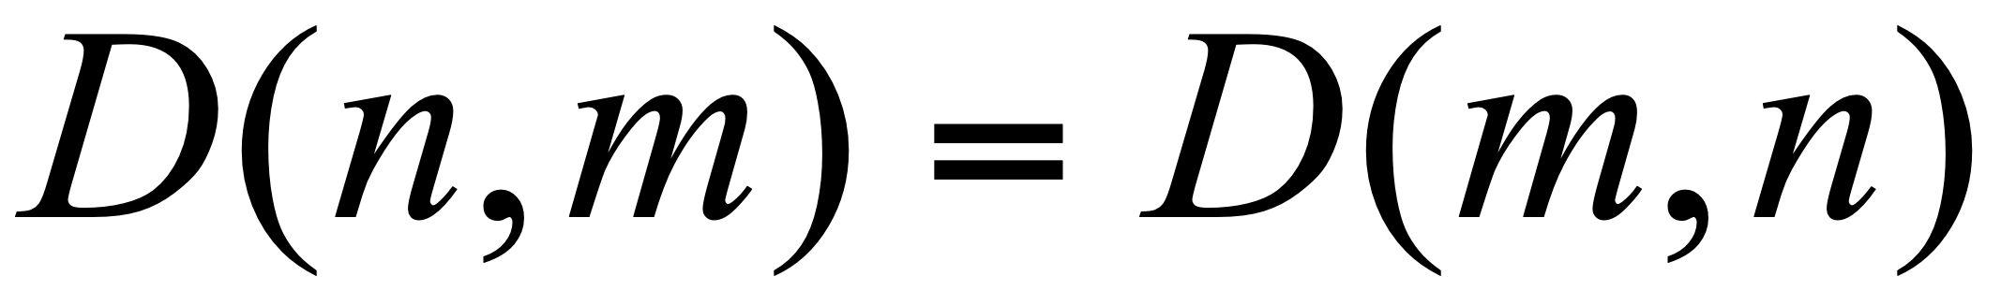
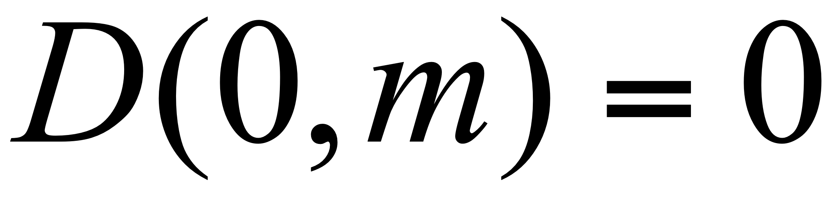
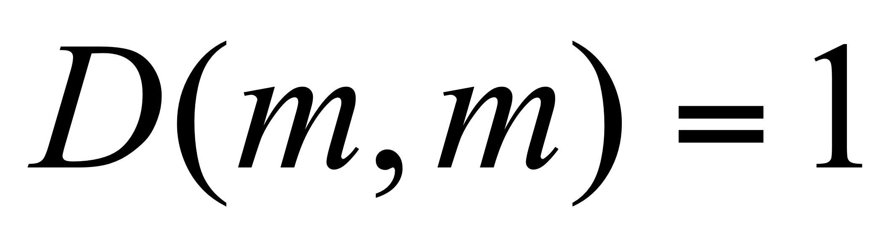
Some more useful properties of the Entropy
Slide from A. Kaban

Slide 45
So: We can measure the disorder ☺
What’s left:
  We want to measure how much by knowing the value of a particular attribute the disorder of a set would reduce.
Slide from A. Kaban

Slide 46
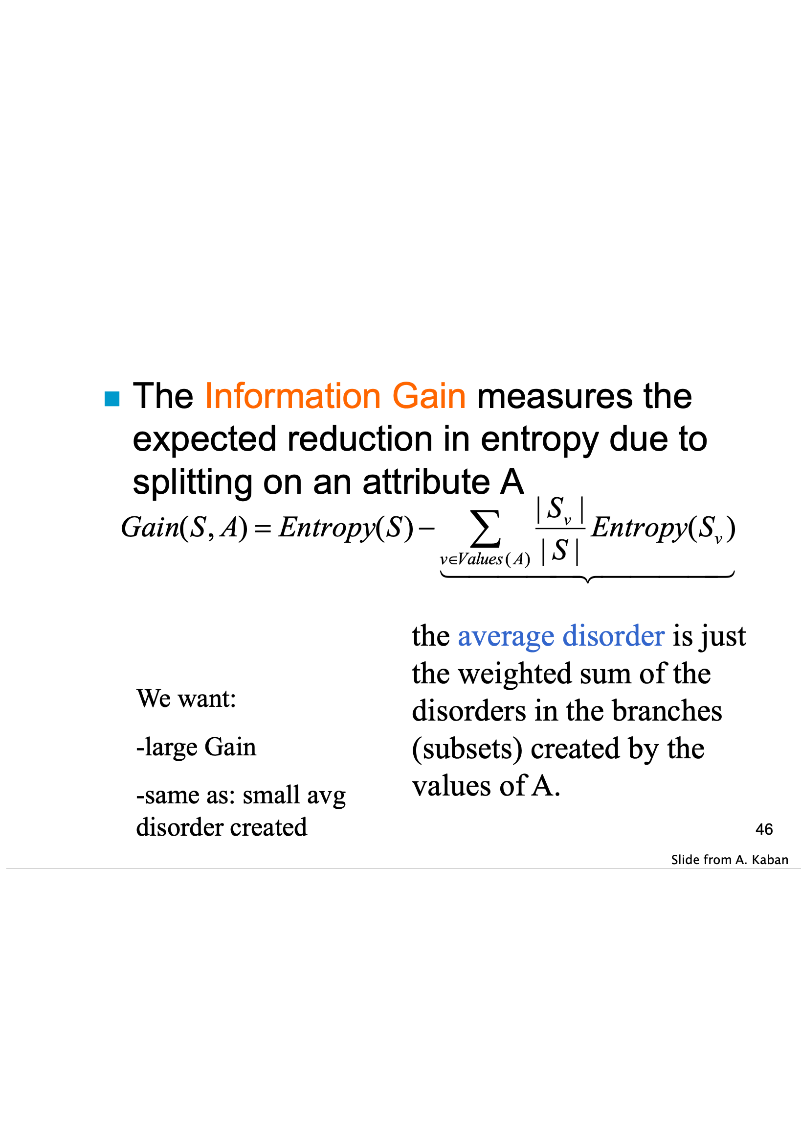

Slide 47
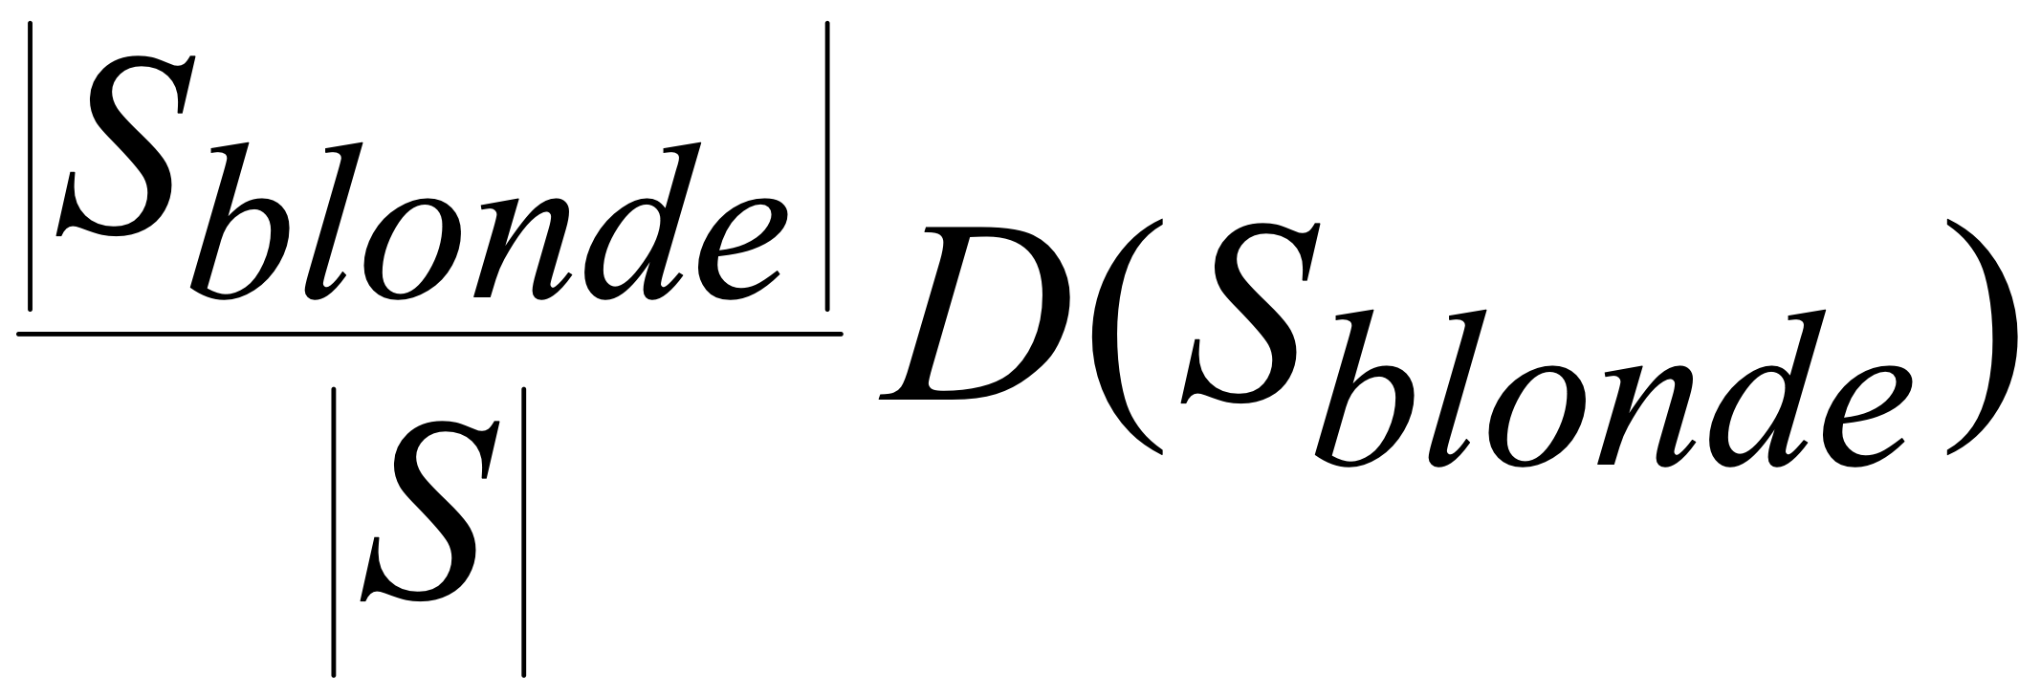
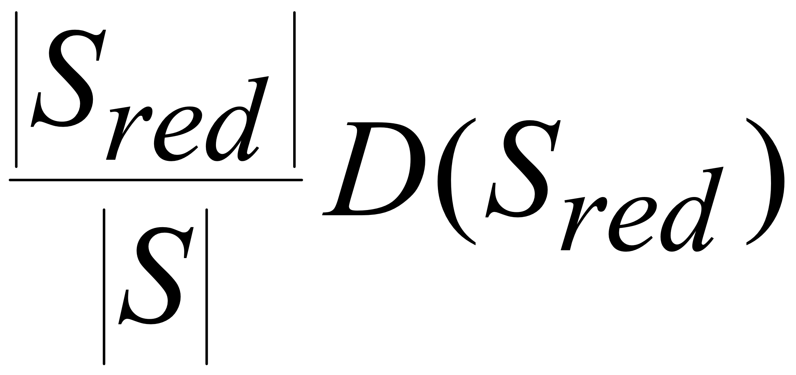
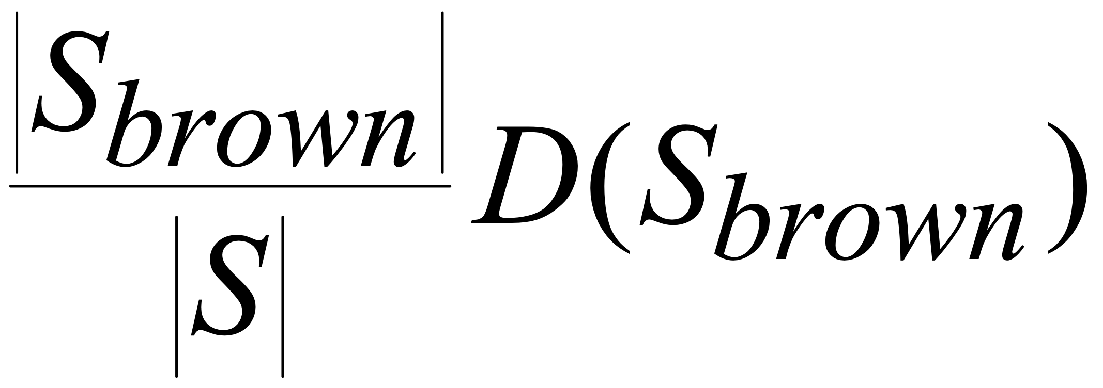
Back to the beach: calculate the Average Disorder associated with Hair Colour
Hair colour
blonde
brown
red
Sarah AnnieDana Katie
Emily
Alex Pete John
Slide from A. Kaban

Slide 48
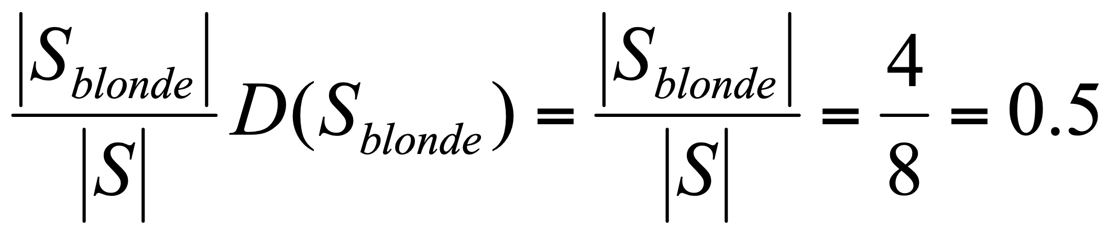
…Calculating the Disorder of the “blondes”
The first term of the sum:
D(S_{blonde})=
D({ “Sarah”,“Annie”,“Dana”,“Katie”}) = D(2,2)
=1
Slide from A. Kaban
Notes:
8 sunbathers in total
4 blondes

Slide 49
…Calculating the disorder of the others
The second and third terms of the sum:
S_{red}={“Emily”}
S_{brown}={ “Alex”, “Pete”, “John”}.
These are both 0 because within each set all the examples have the same class
So the avg disorder created when splitting on ‘hair colour’ is 0.5+0+0=0.5
Slide from A. Kaban
Notes:
For the next couple of minutes
I want you to calculate the disorder of the reds and the browns.

Slide 50
Which decision variable minimises the disorder?
Test Disorder
Hair 0.5 – this what we just computed
height 0.69
weight 0.94
lotion 0.61
these are the avg disorders of the other attributes, computed in the same way
Which decision variable maximises the Info Gain then?
Remember it’s the one which minimises the avg disorder (see slide 46 for memory refreshing).
Slide from A. Kaban
Notes:
This is exercise 3 on the next question sheet

Slide 51
So what is the best decision tree?
is_sunburned
Hair colour
blonde
red
brown
Emily
Alex, Pete, John
?
Sarah AnnieDana Katie
Slide from A. Kaban
Notes:
Once we have finished with hair colour we then need to calculate the remaining branches of the decision tree.
The examples corresponding to that branch are now the total set and no reference is made to the whole set of examples.
One just applies the same procedure as before with JUST those examples (i.e. the blondes).
This is left as an exercise for you on the exercise sheet.

Slide 52
Outline
Contingency tables
  Census data set
Information gain
  Beach data set
Learning an unpruned decision tree recursively
  Good/bad gasoline usage = "miles per gallon" data set
Training error
Test error
Overfitting
Avoiding overfitting

Slide 53
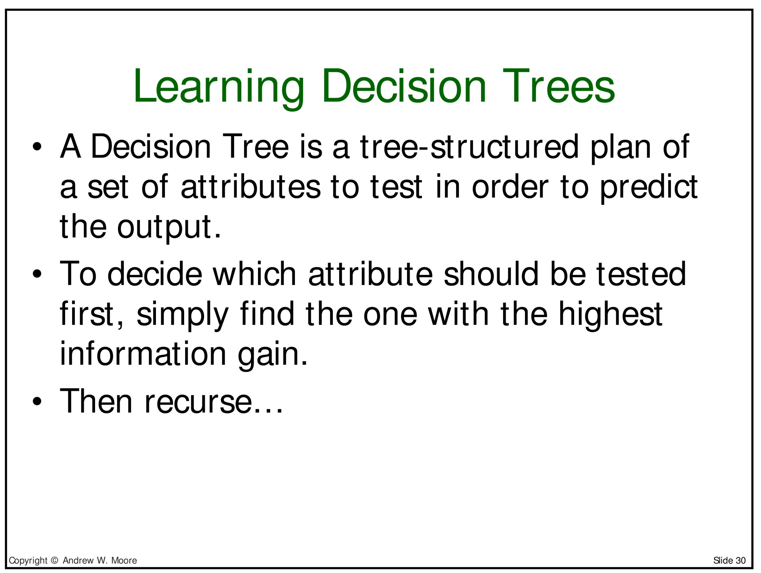

Slide 54
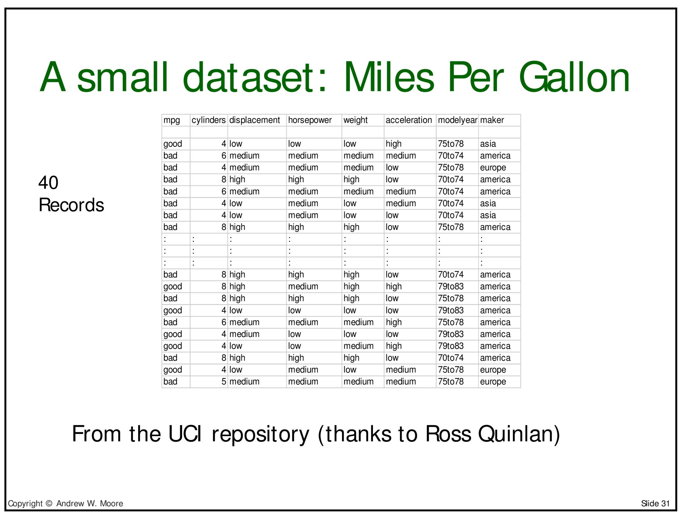

Slide 55
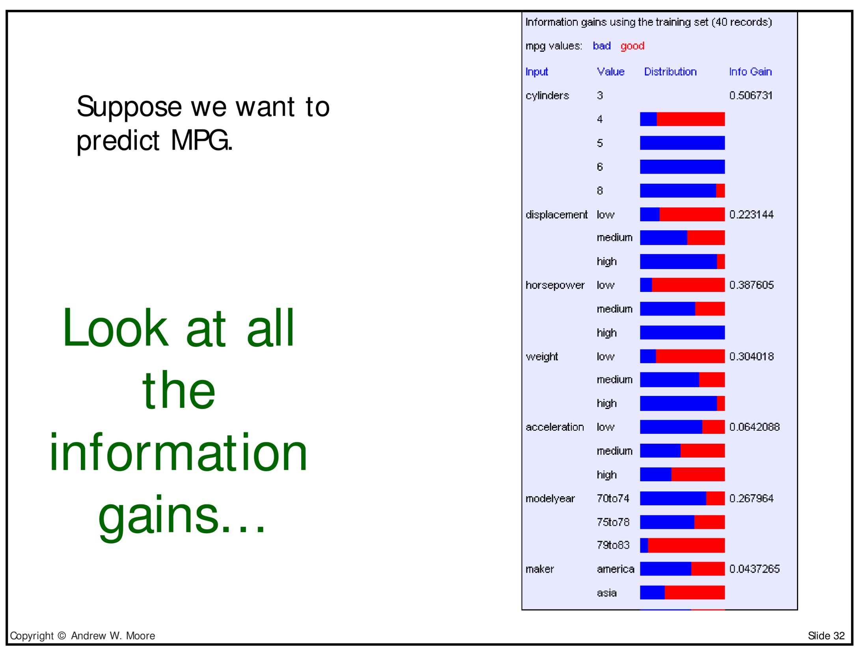

Slide 56
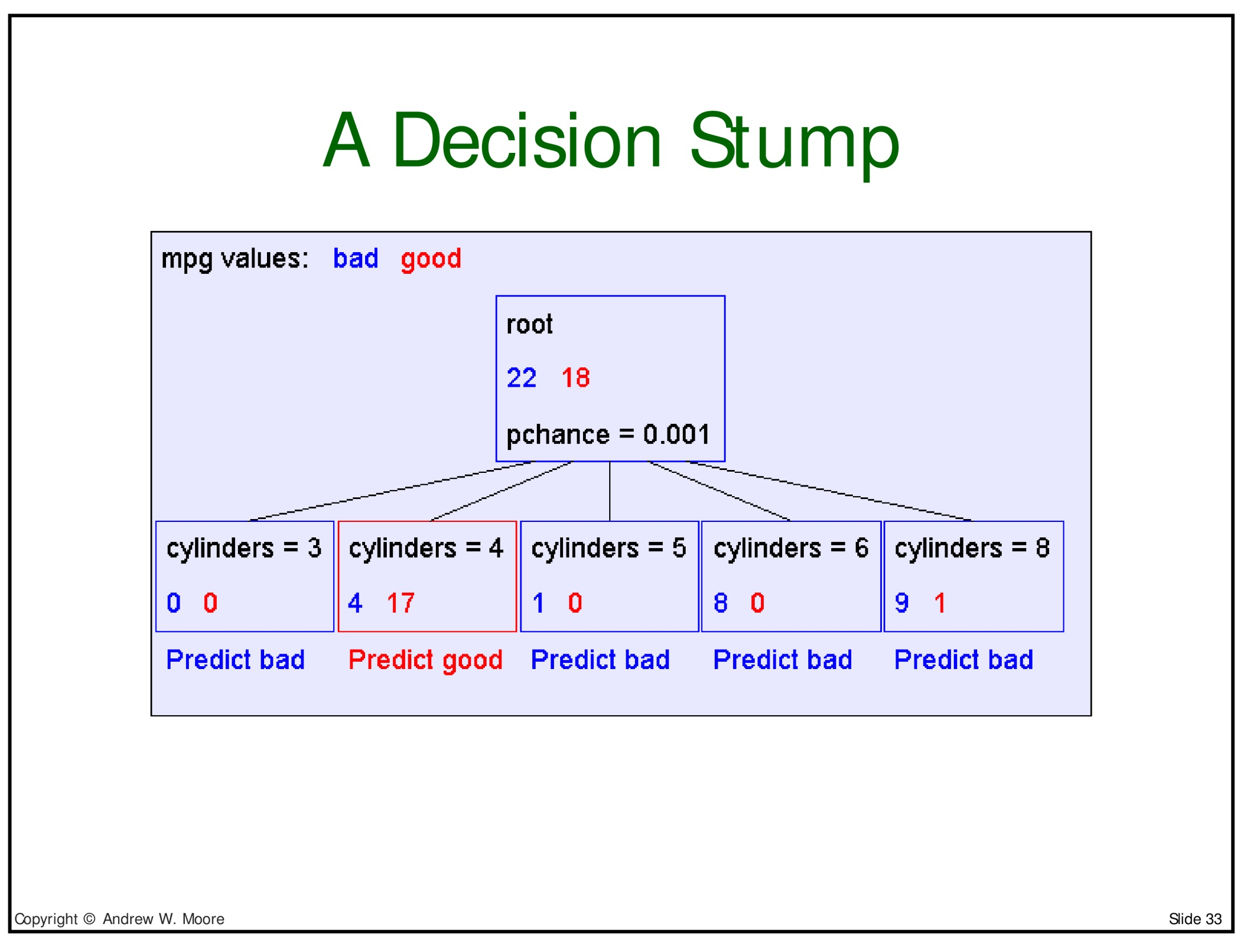

Slide 57
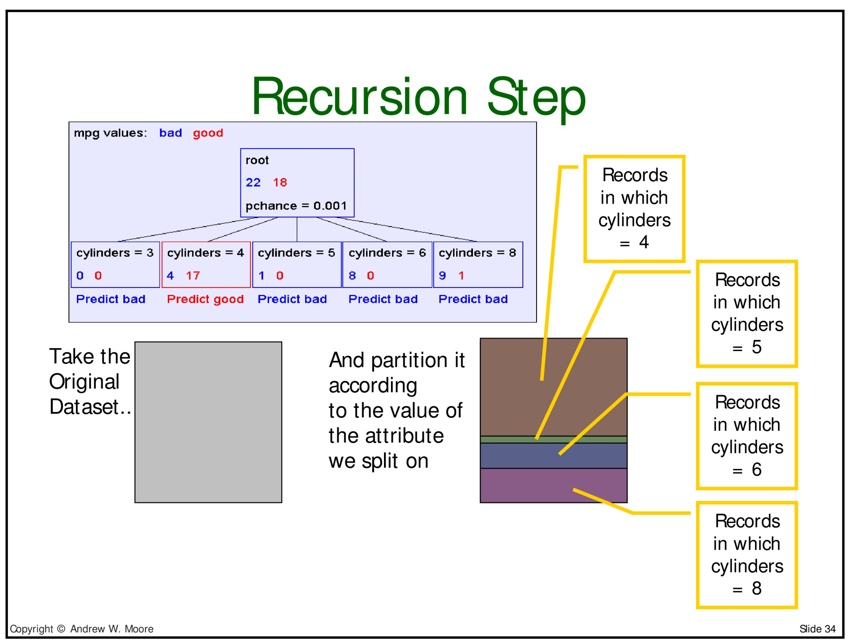

Slide 58
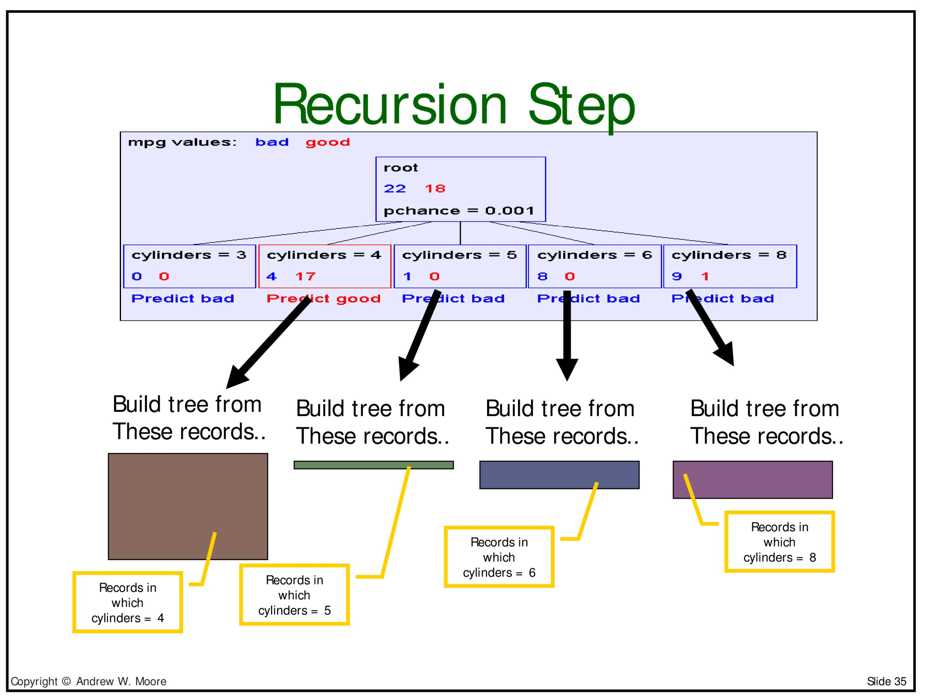

Slide 59
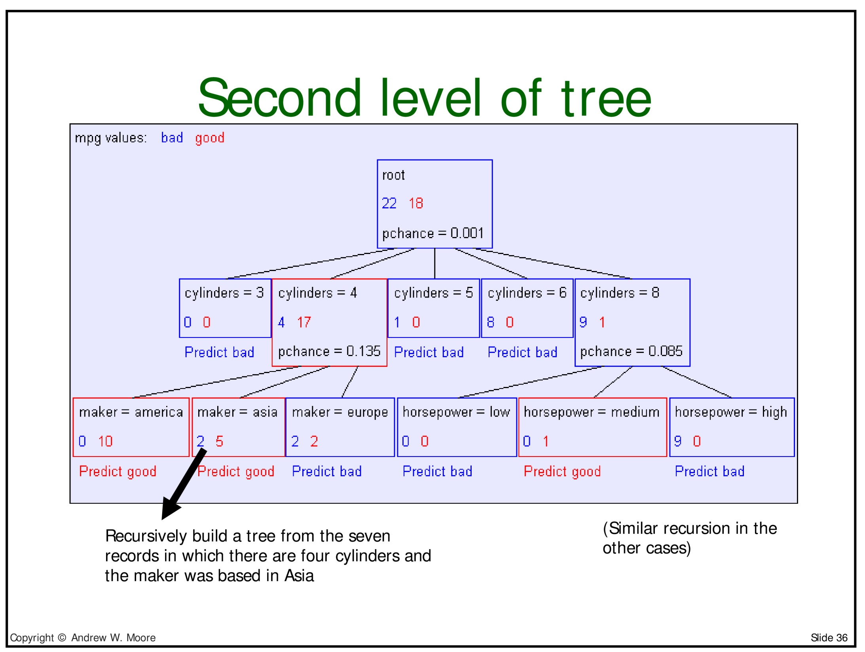
Predict good

Slide 60
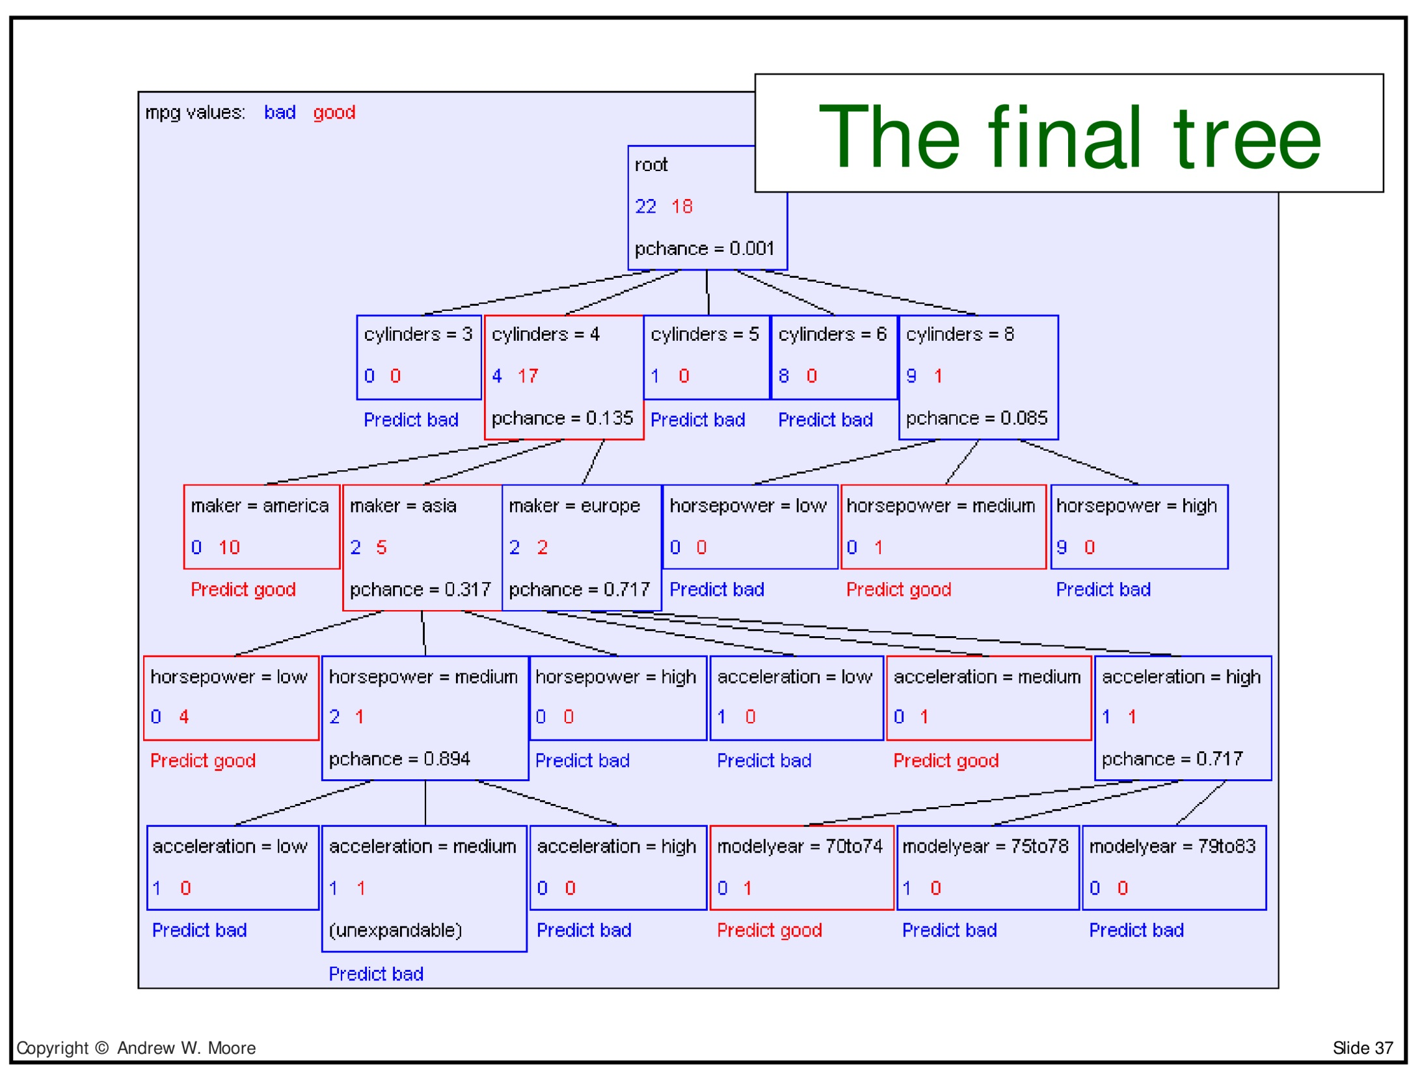

Slide 61
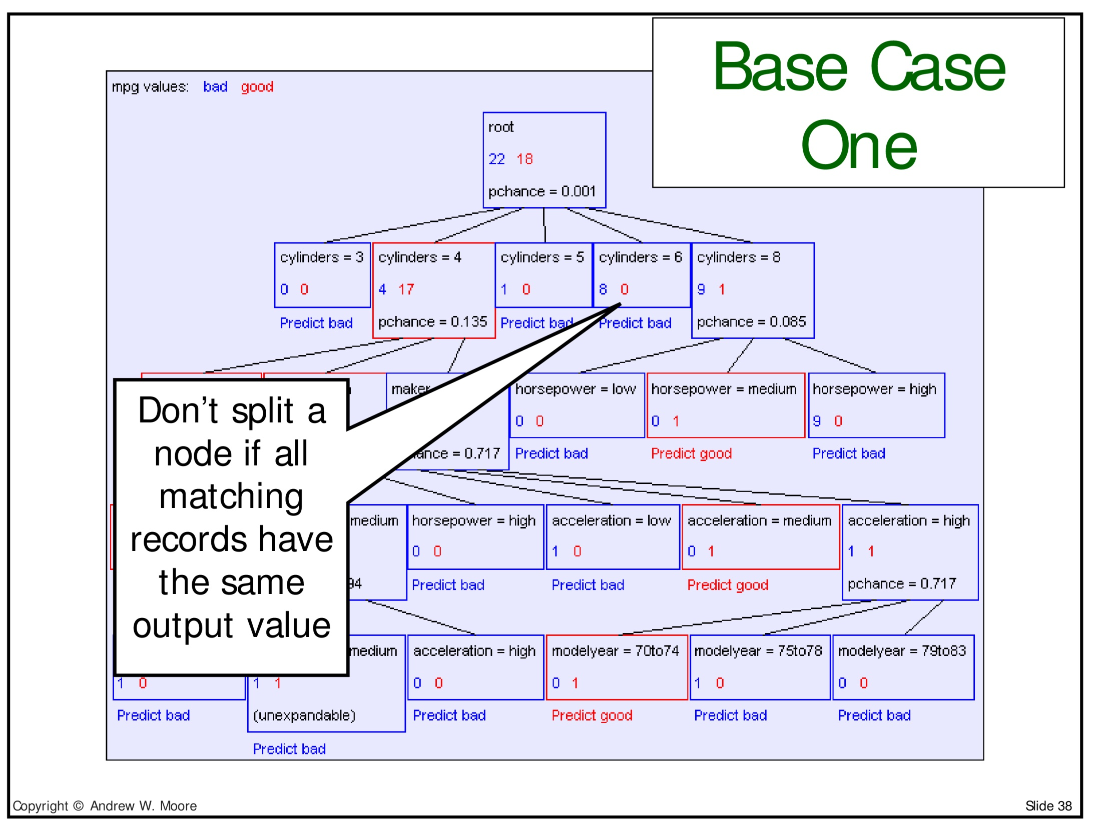

Slide 62
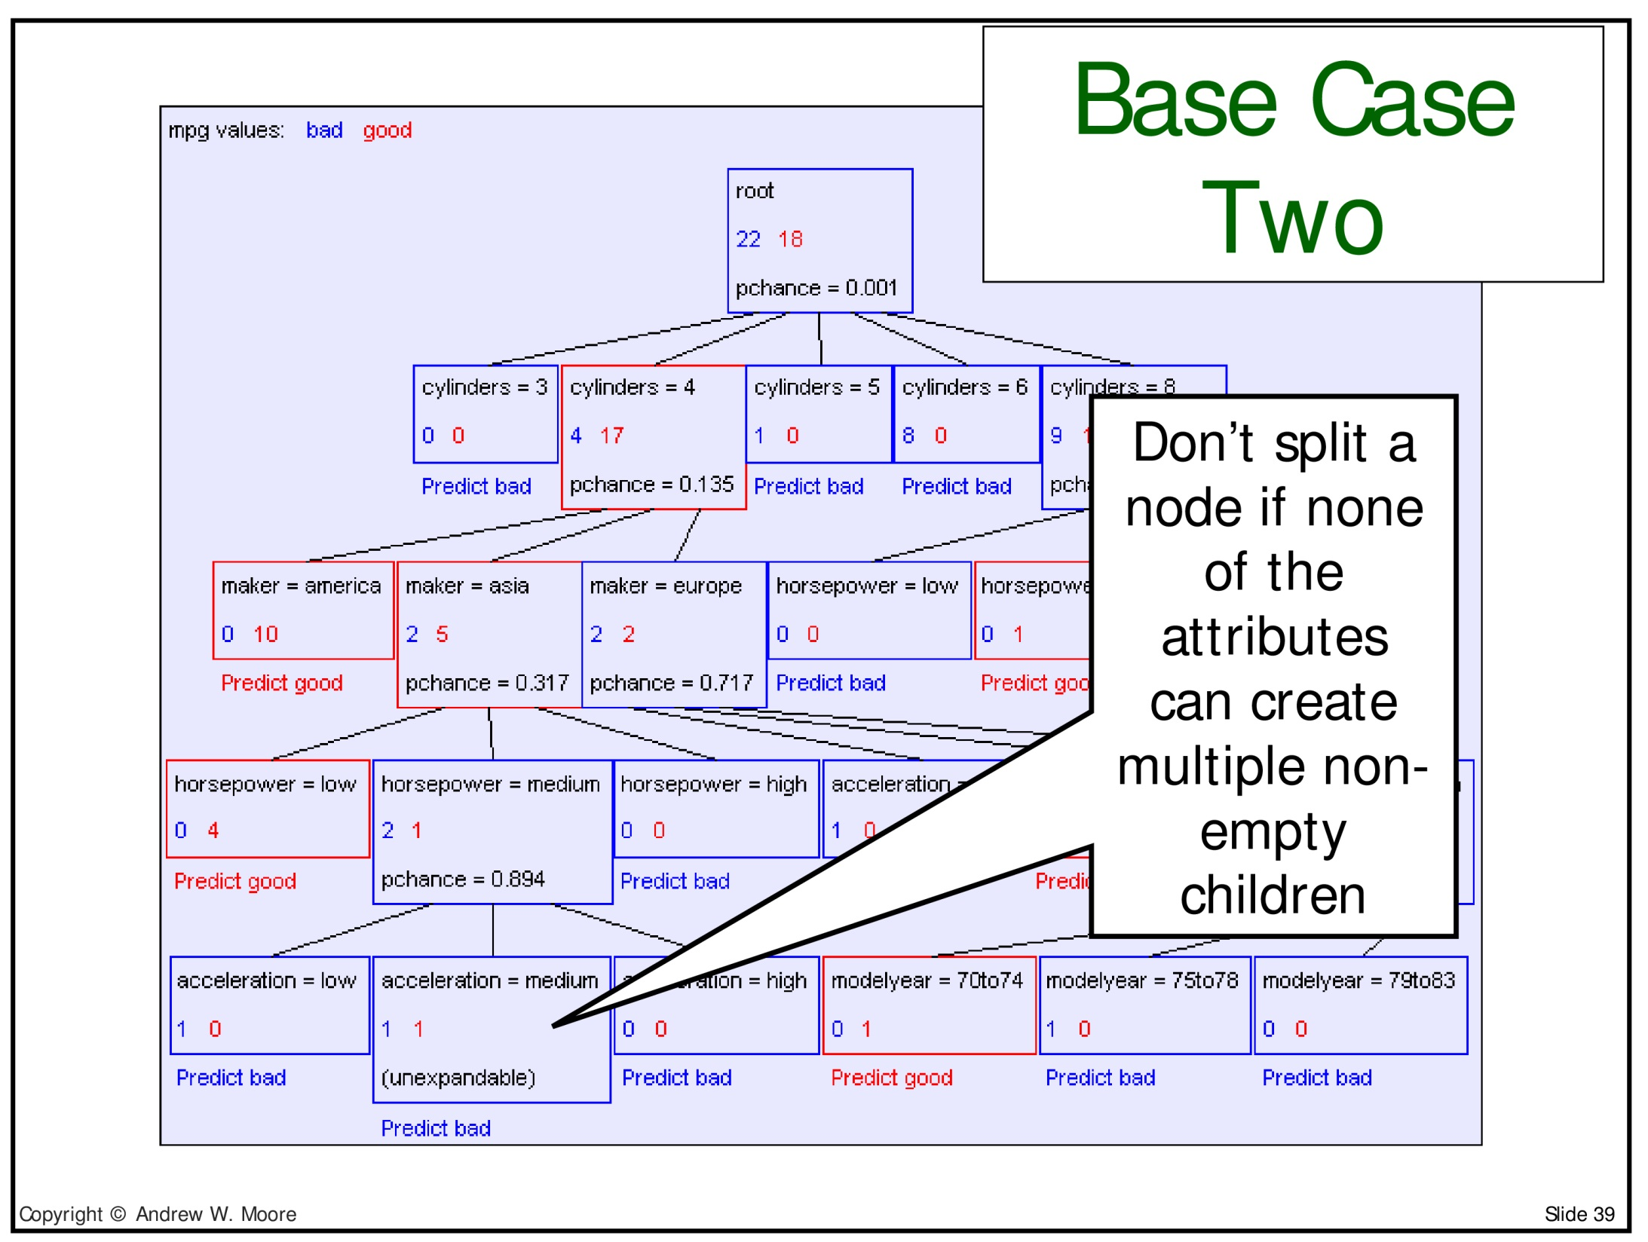

Slide 63
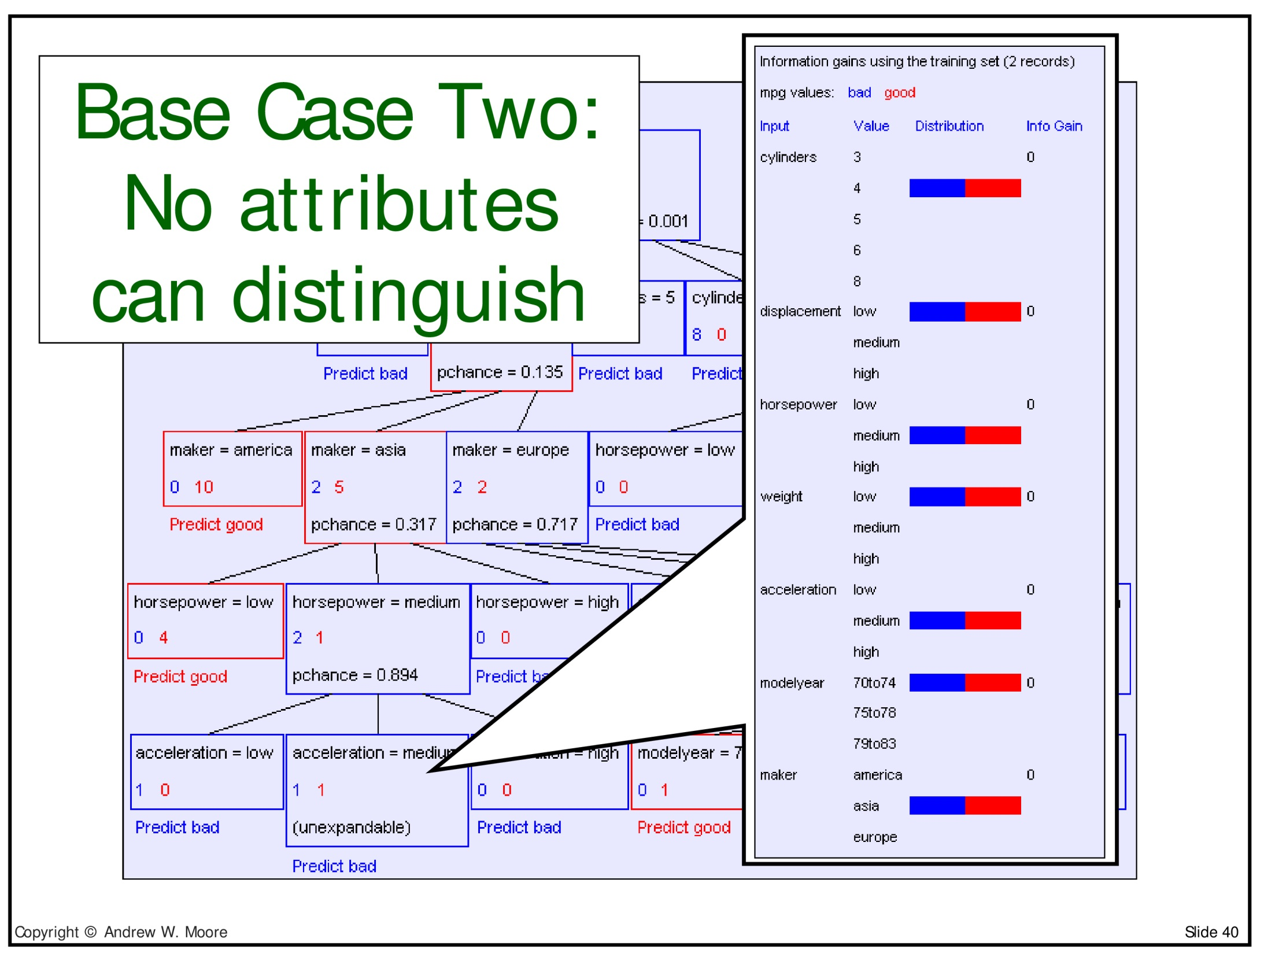

Slide 64
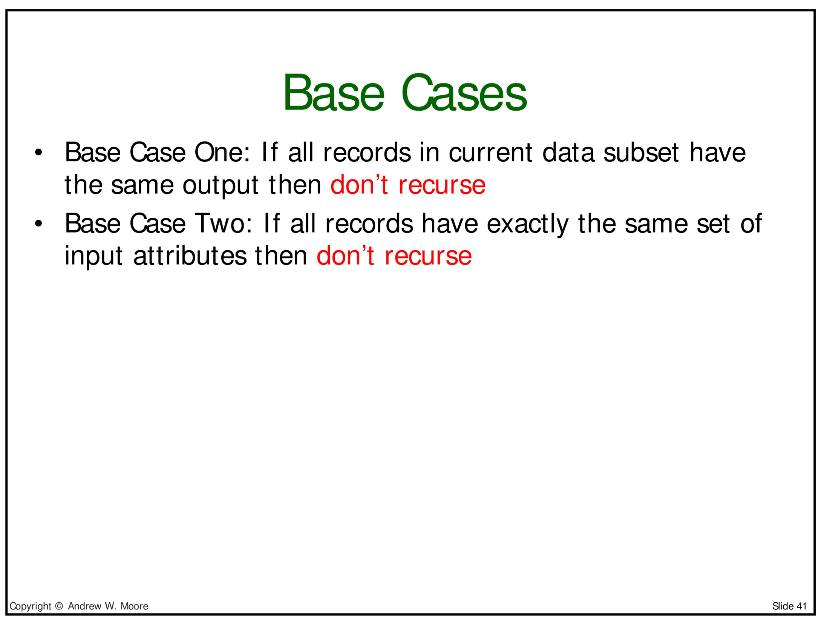

Slide 65
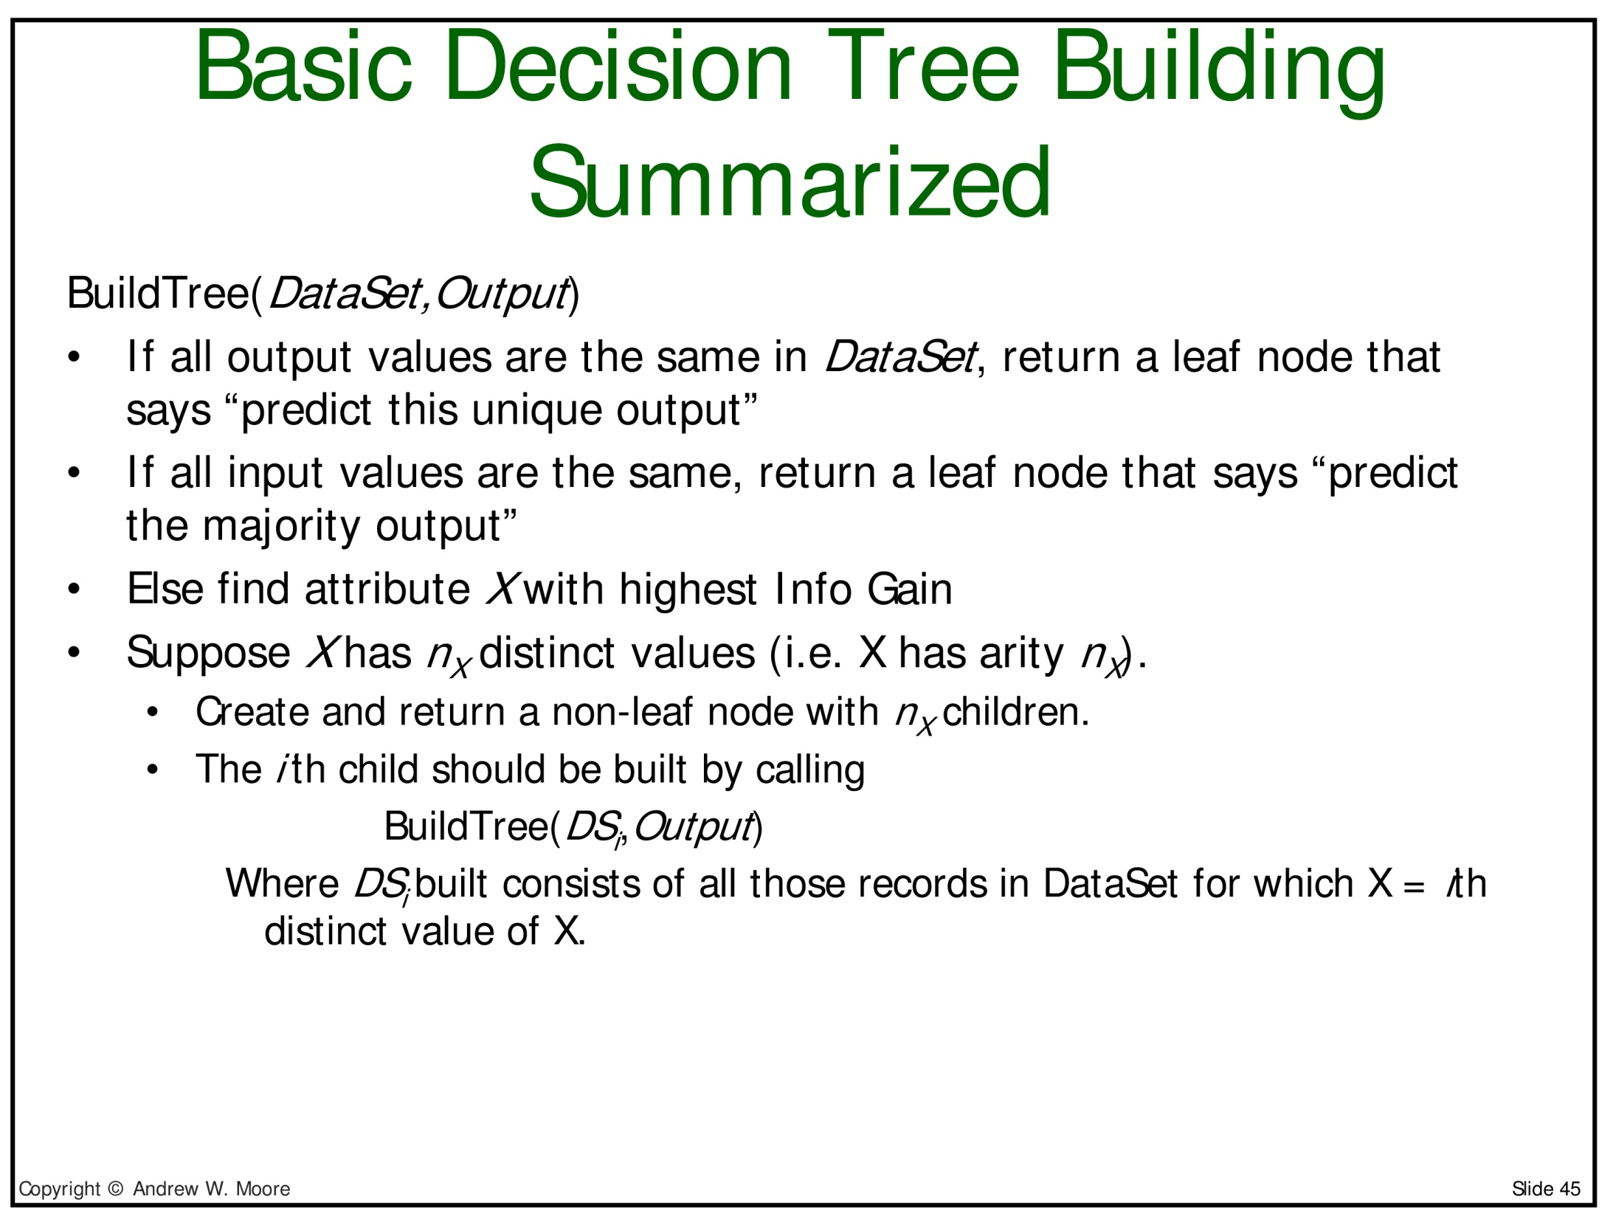

Slide 66
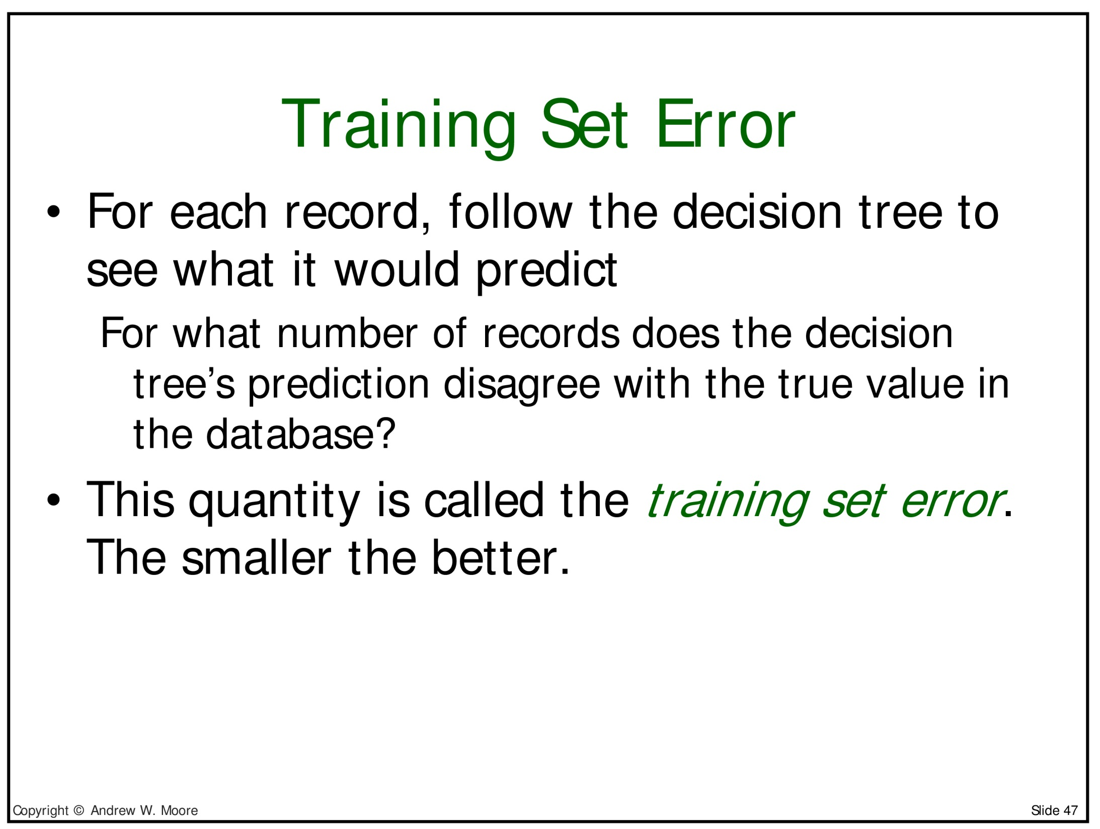

Slide 67
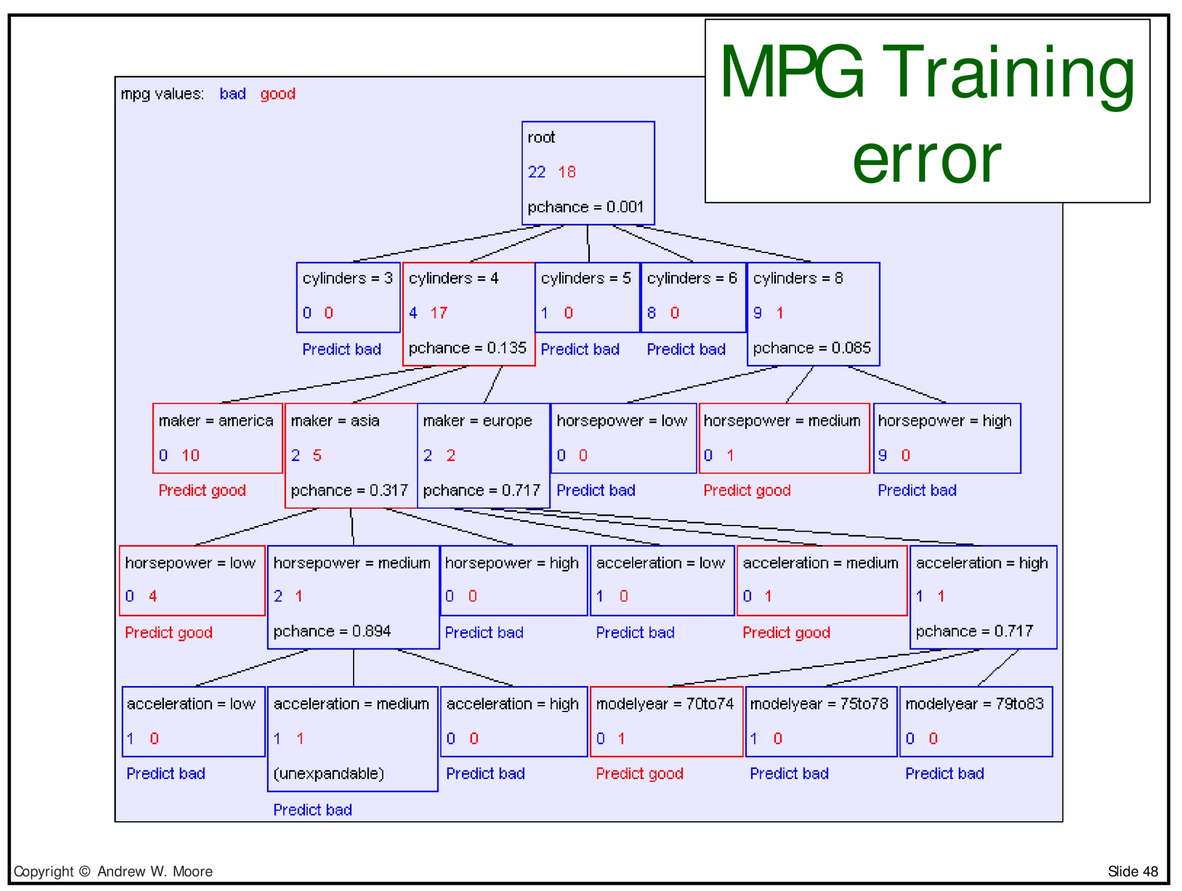

Slide 68
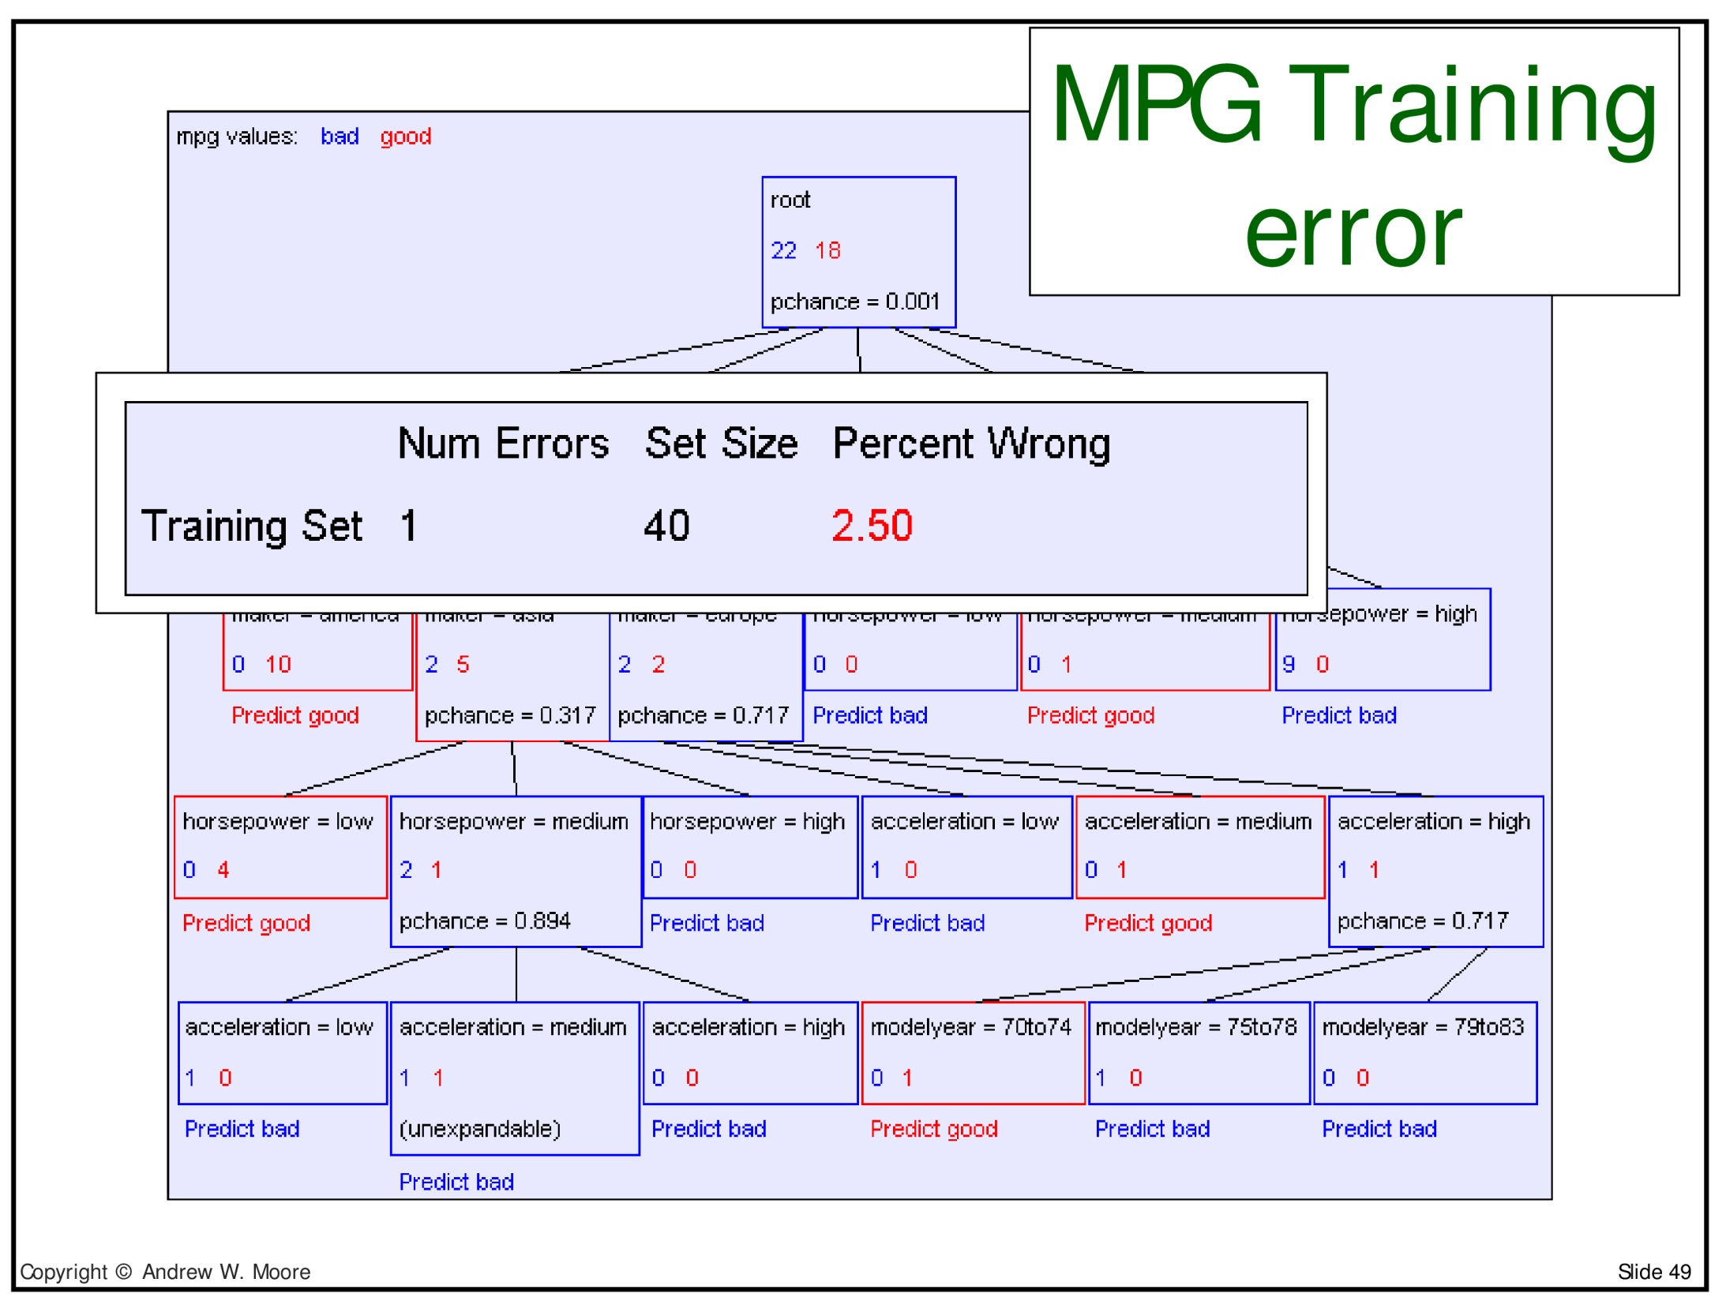

Slide 69
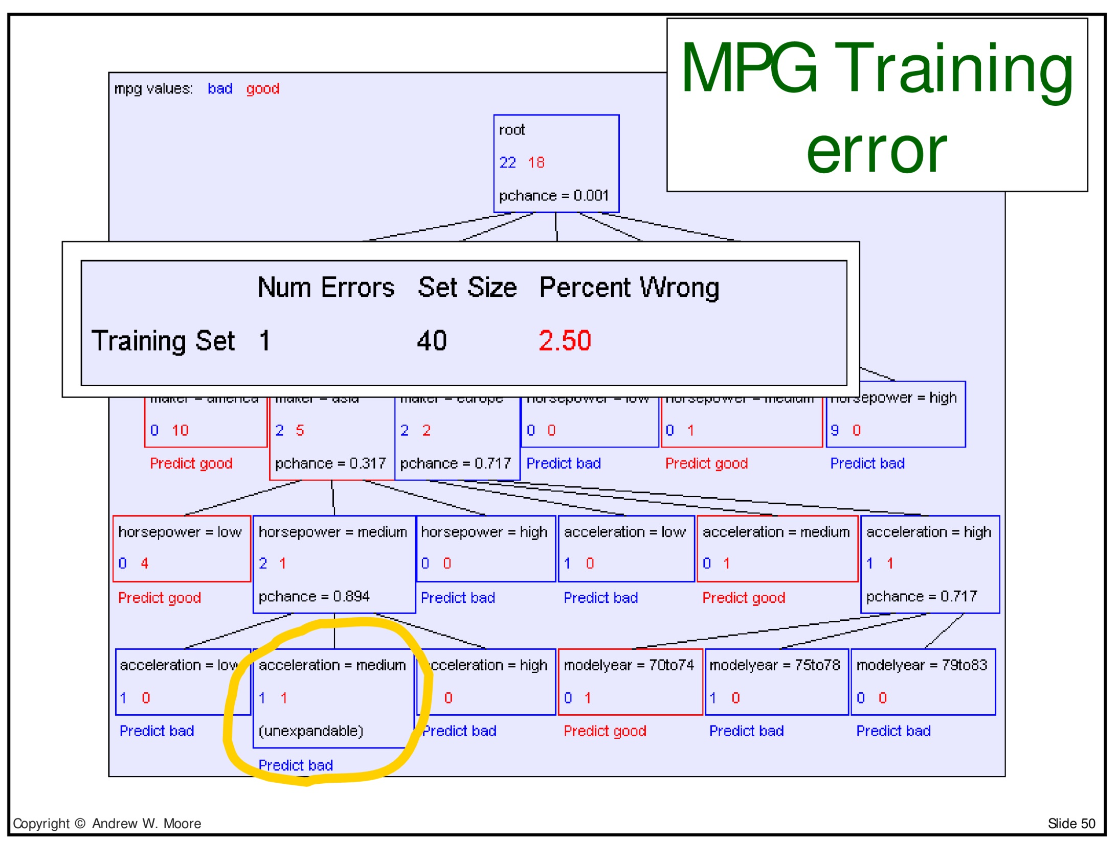

Slide 70
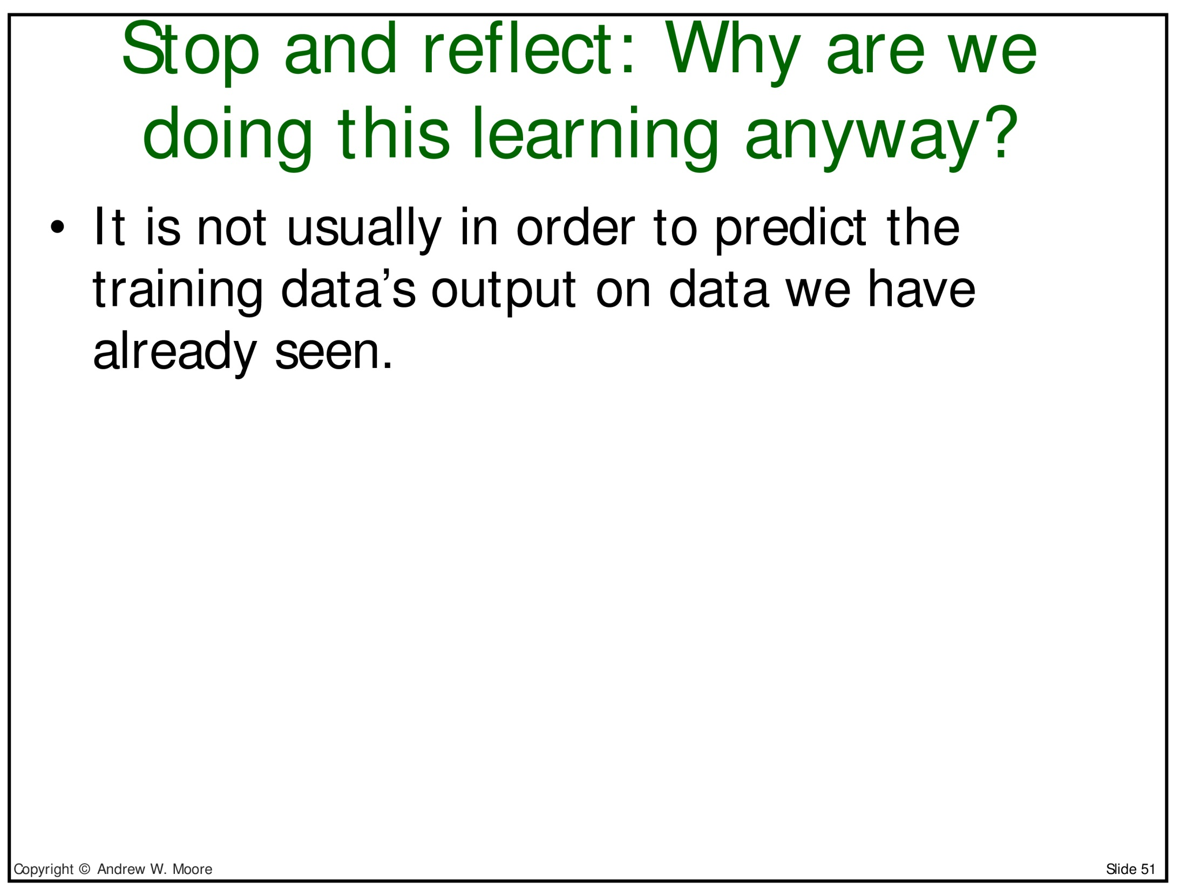

Slide 71
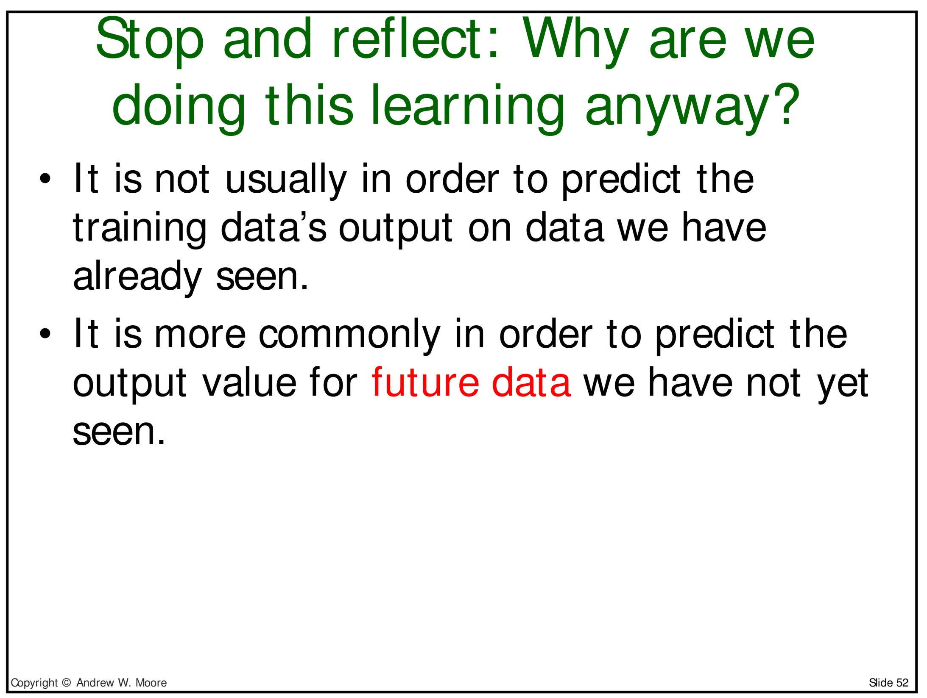

Slide 72
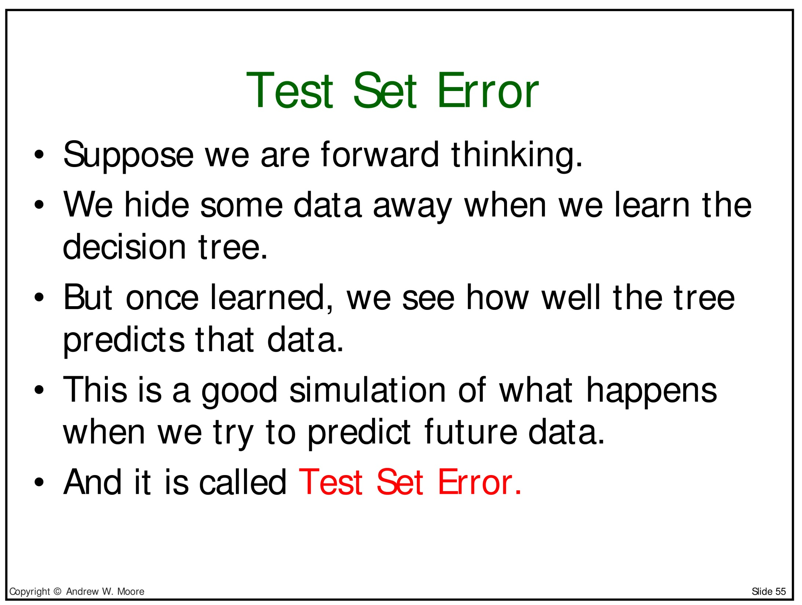

Slide 73
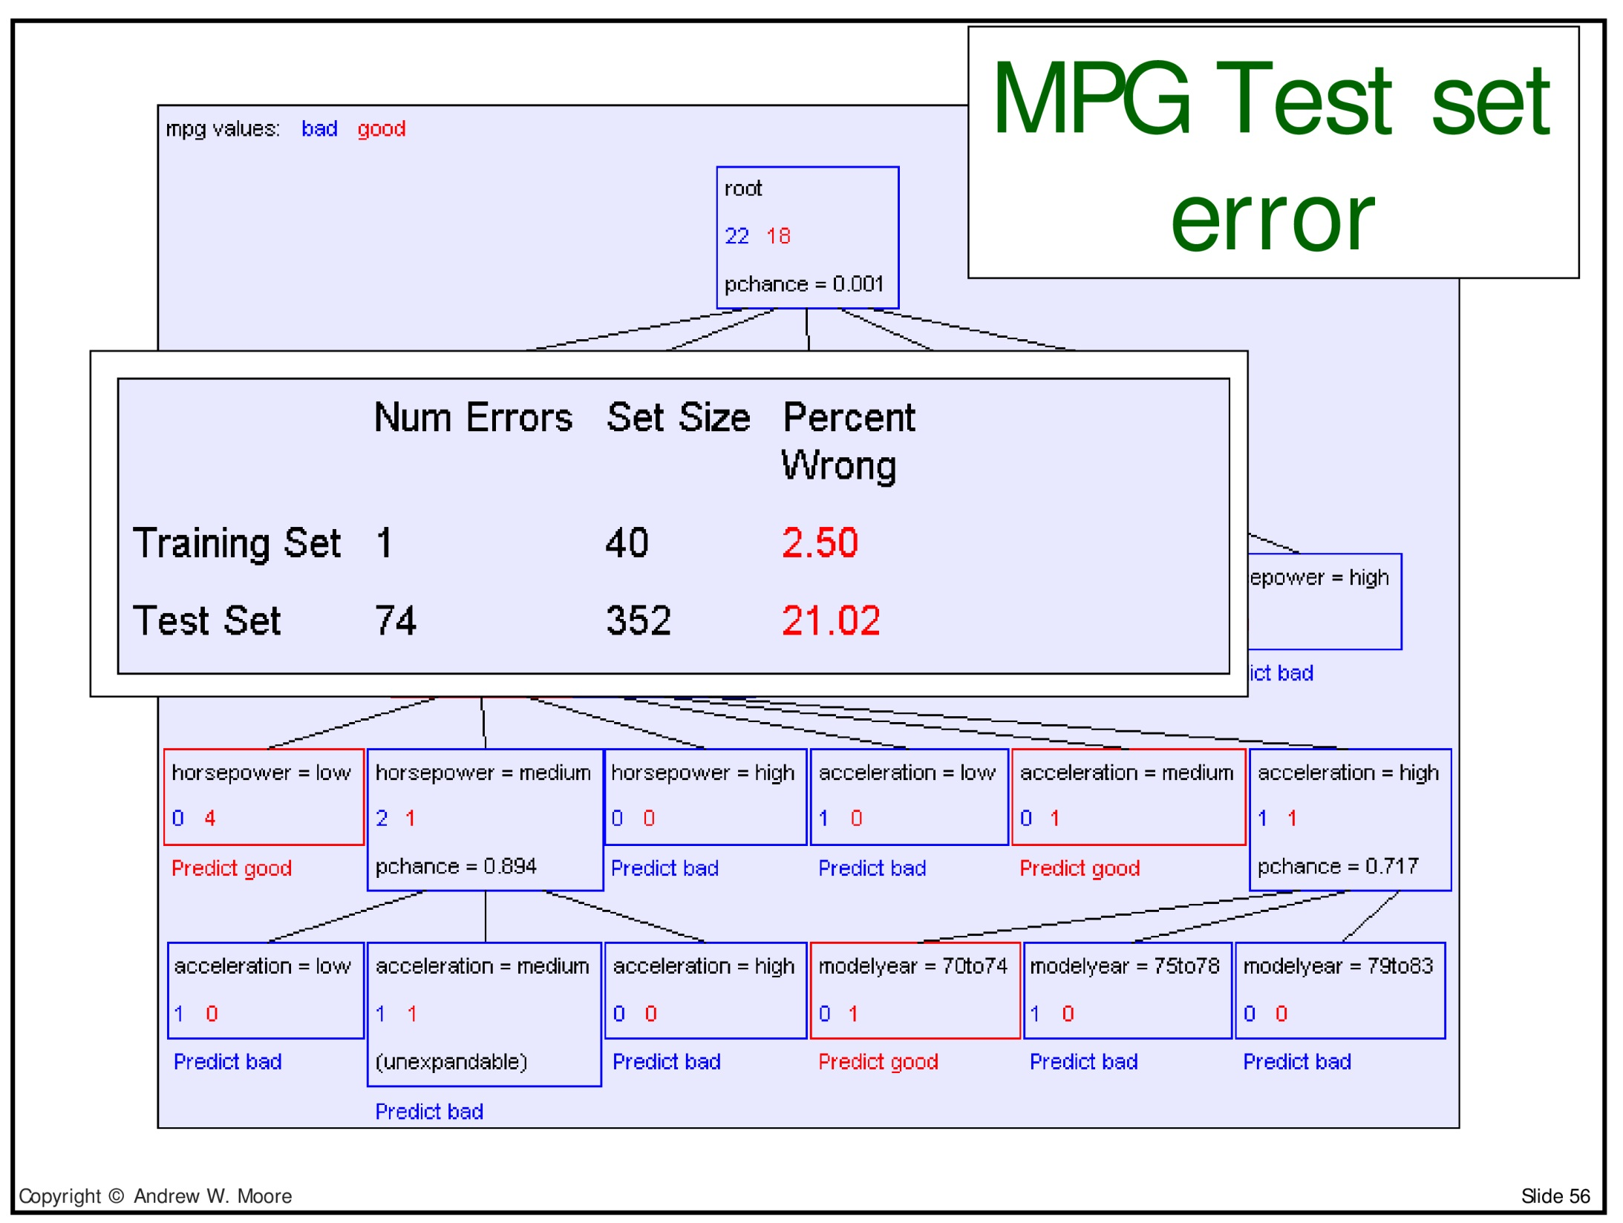

Slide 74
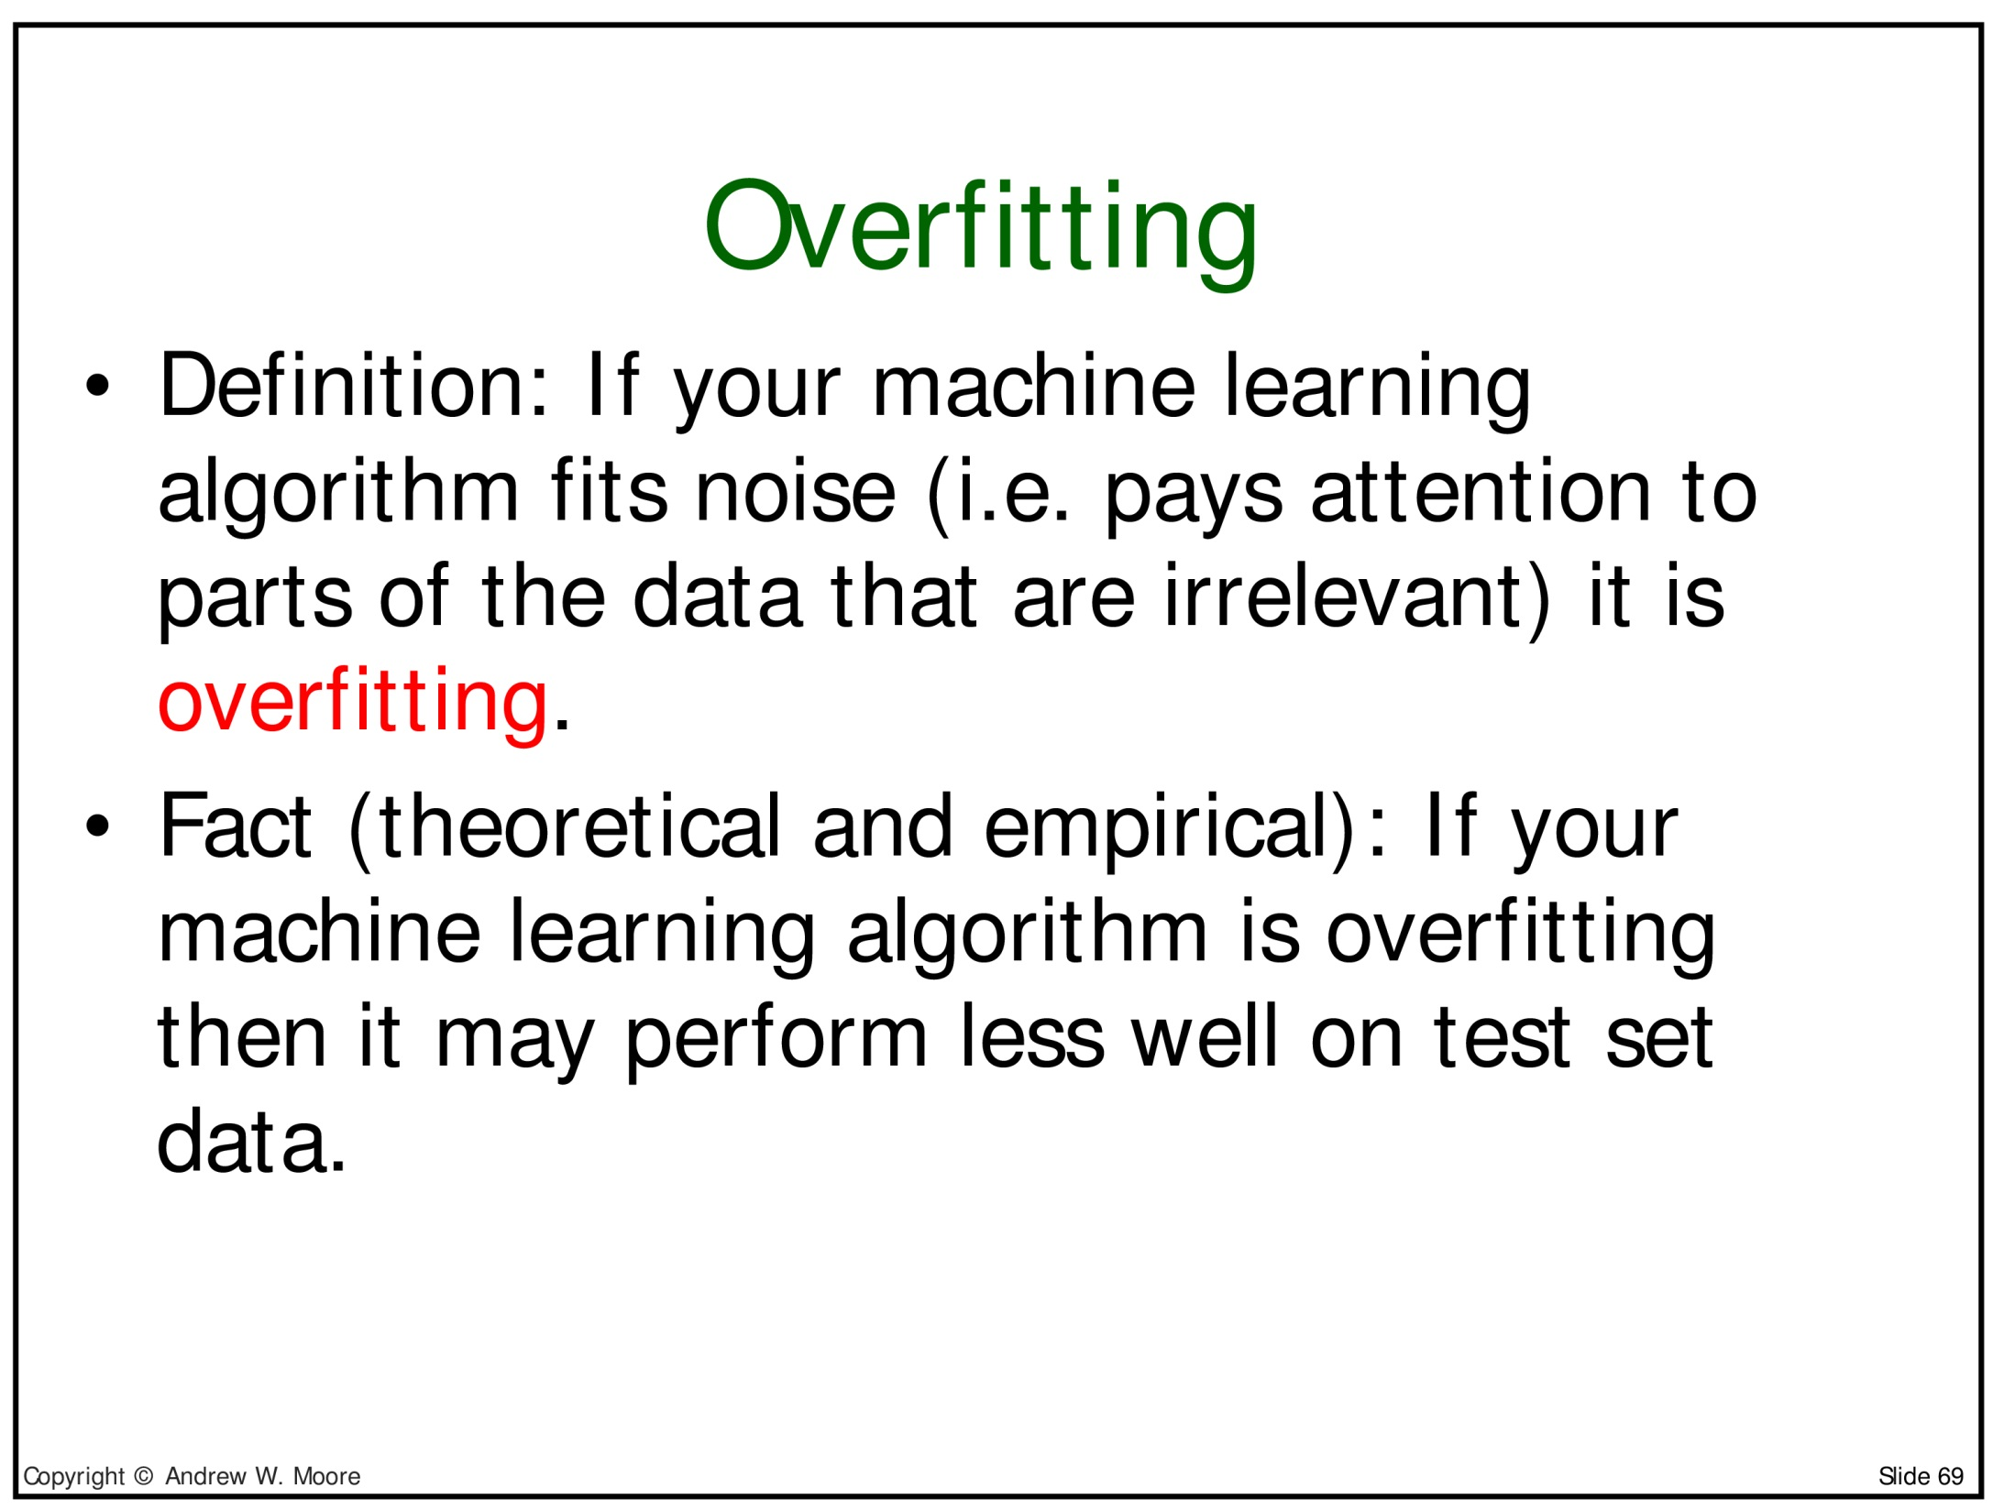

Slide 75
How do I know I am overfitting?
The best way is to have a held-out "development" test set to measure generalization performance on
  This should be held separate from the final test set
An interesting empirical fact about decision trees, is that larger trees tend to overfit more, so trying to create small trees is a good idea
  It is easy to see that very small trees can't overfit
  for instance, always choosing majority class is a very small tree
People often talk about the depth of the tree (distance of the longest path from root to leaf) because of this

Slide 76
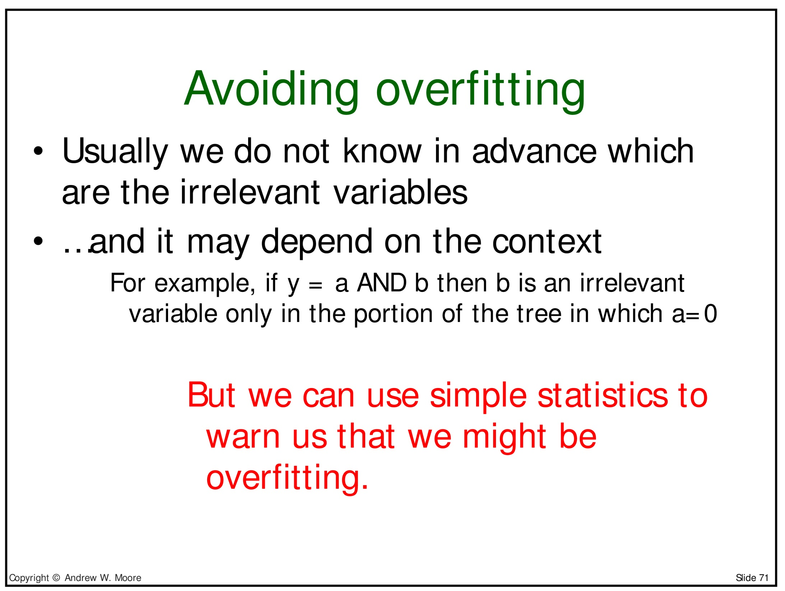

Slide 77
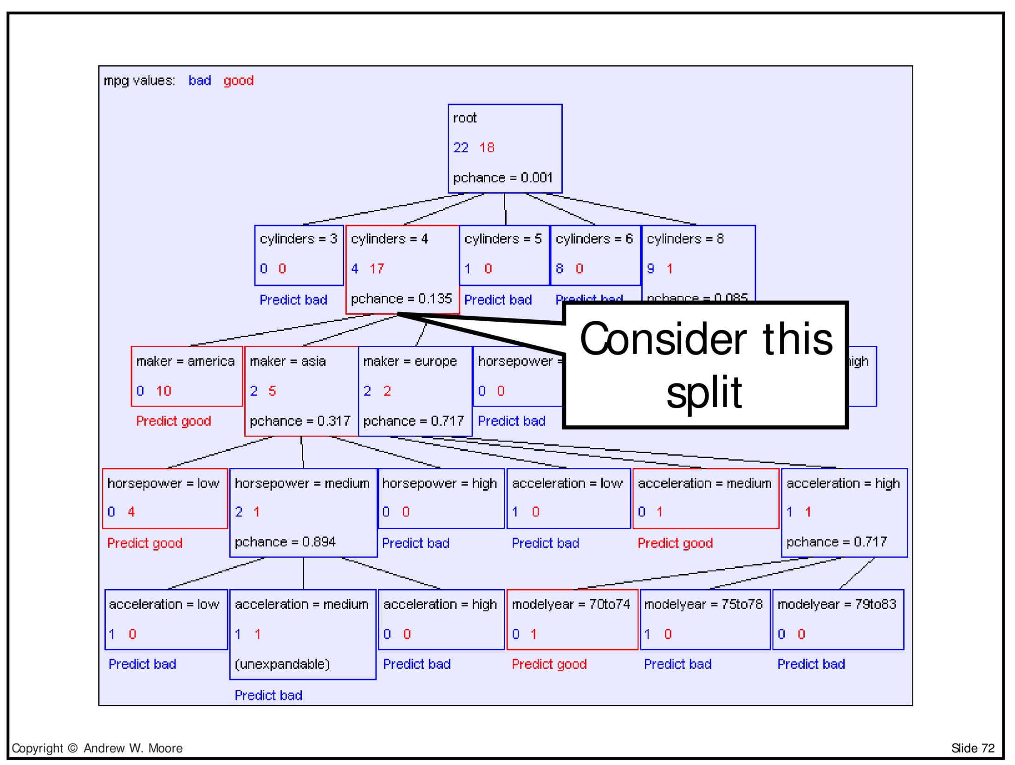

Slide 78
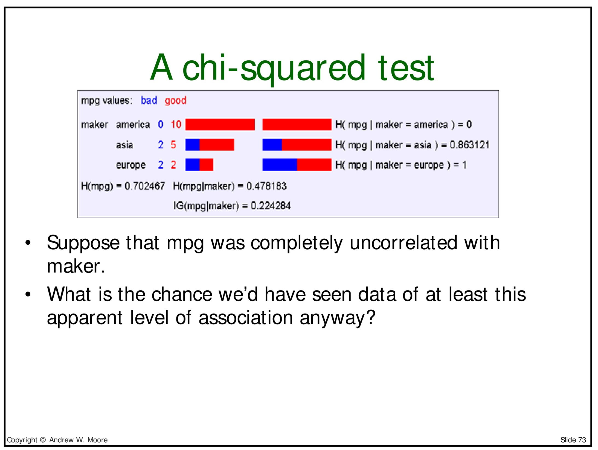

Slide 79
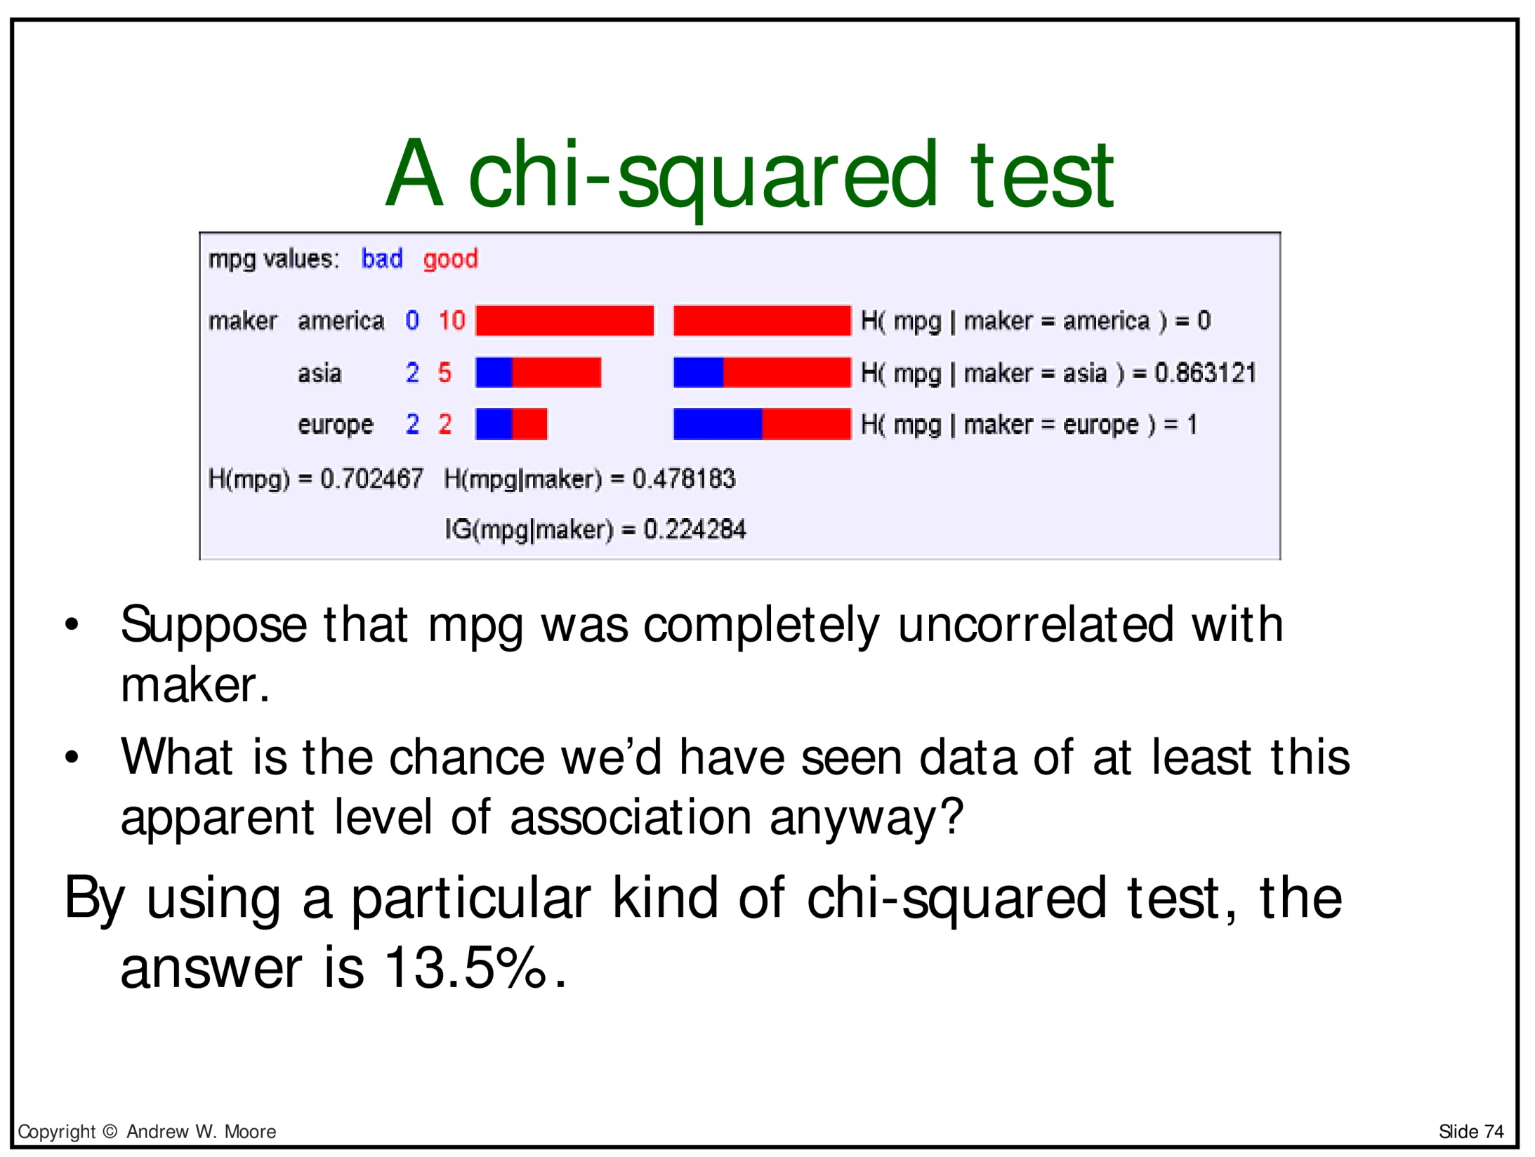

Slide 80
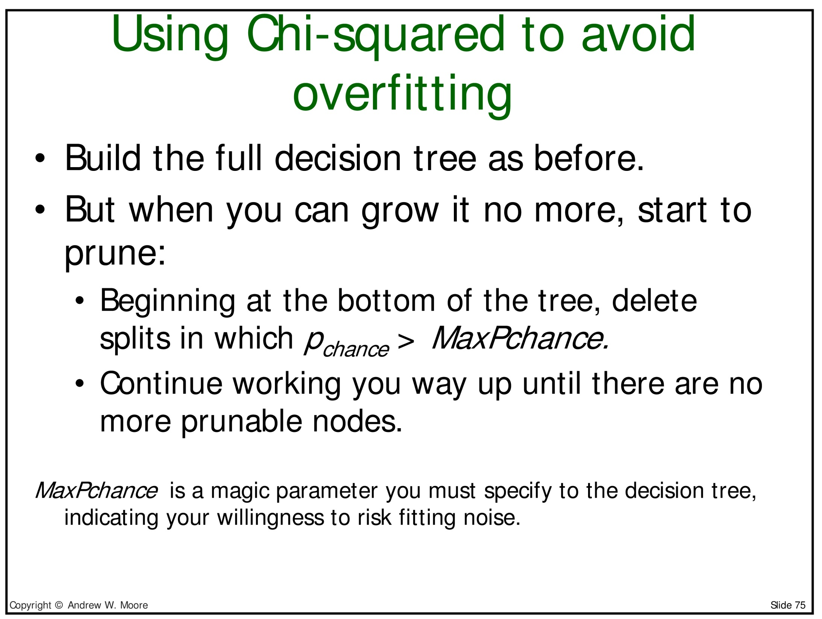

Slide 81
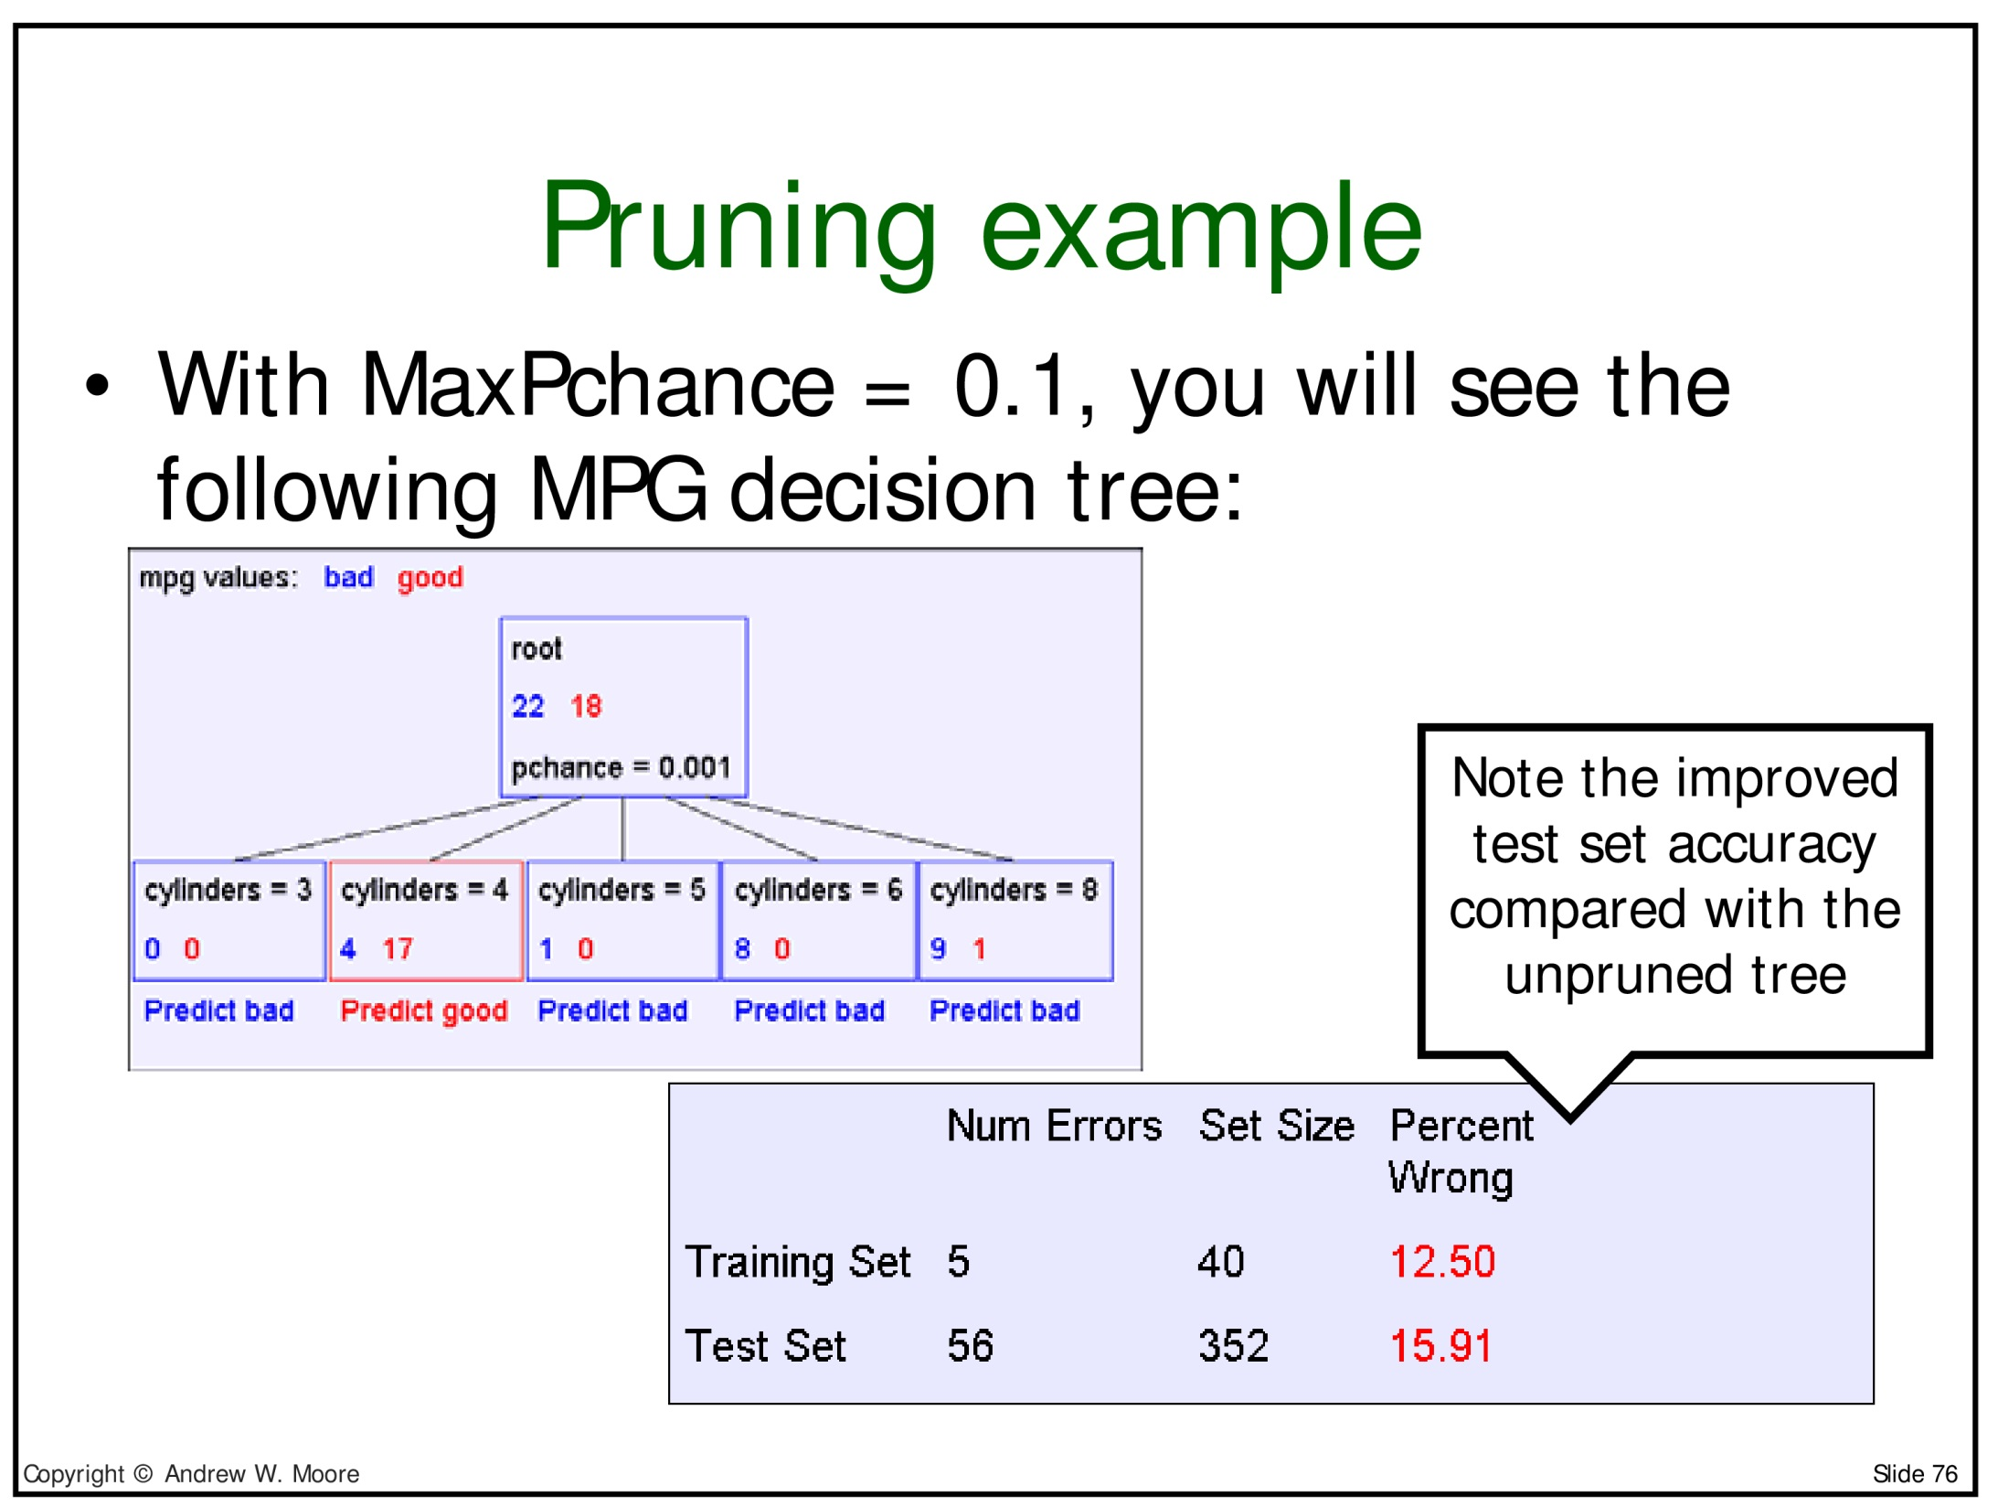

Slide 82
More on pruning
Another way to prune is to work with a special pruning set, which is separate from the data used to grow the tree
This algorithm is called Reduced Error Pruning, and it is due to Quinlan
  First grow the tree completely (as we did in our example)
  Then, starting with each split at the bottom, classify the pruning set, compare:
    1) the accuracy of your current tree
    2) the accuracy of your current tree with this split removed (i.e., with the decision being the majority class before the split)
    If (2) wins, then remove the split
  Then move on to examine each node in the tree in turn, applying the same test
This approach is very easy to understand, and can also be efficiently applied
Big disadvantage: must separate data into data for growing tree, and data used to control pruning
See Esposito et al. 1997 for an influential study of pruning techniques for decision trees

Slide 83
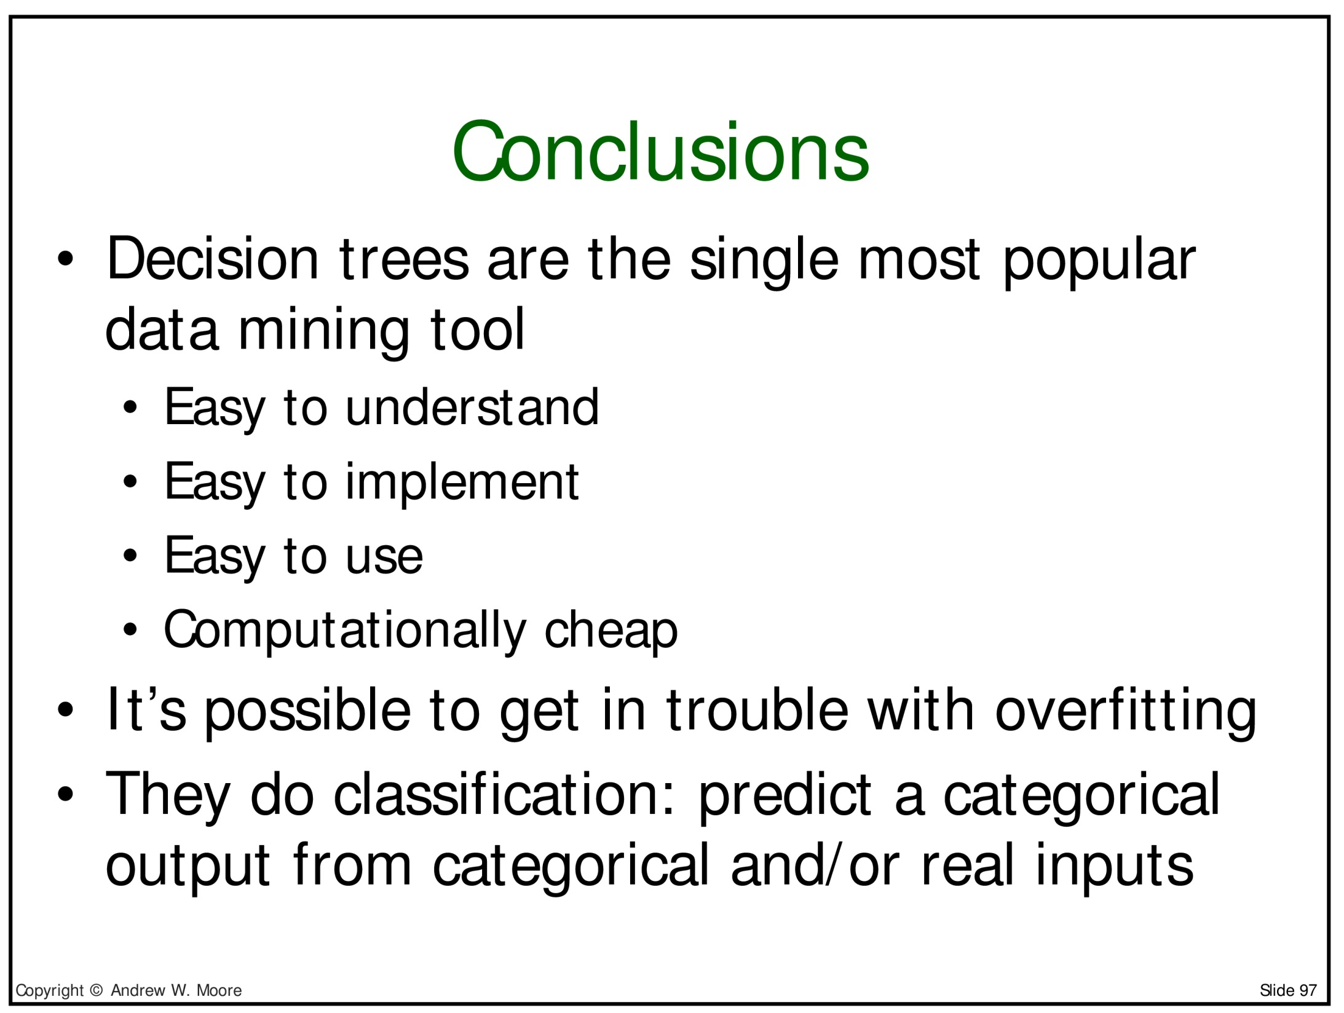

Slide 84
Things I didn't discuss - I
How to deal with real-valued inputs
  Either: discretize these into buckets before building a decision tree
    As was done on the gasoline usage data set we just saw
  Or: while building the decision tree, use less-than checks
    E.g., try all of age < 24 versus age < 25 versus age < 26 (etc...) and find the best split of the age variable (according to information gain)
    But the details are complex and this requires many assumptions
Information Gain can sometimes incorrectly favor splitting on features which have many possible values
  There are alternative criteria that are sometimes preferred
  There are also ways to correct Information Gain for this problem

Slide 85
Things I didn't discuss - II
There are very interesting techniques for further improving on decision trees
  One way is to build a "random forest" of decision trees on different subsets of the data and even different subsets of the features
  Then have the trees in the forest vote on the final classification
  This often works really well!
Finally, there are also very different solutions that work well for classification like this
  For instance, consider Naive Bayes or linear models in general
  Linear models associate one weight with each feature value as we saw in the previous lecture
  The same basic ideas about generalization and overfitting apply!
  We'll discuss these in detail in the next lecture
  Following that, we'll discuss deep learning (non-linear models)

Slide 86
Some credits:
  See Ata Kaban's (Birmingham) machine learning class particularly for the intuitive discussion of the Winston sunburn problem and Information Gain
  See Andrew W. Moore's (Carnegie Mellon) website for a longer presentation of his slides on decision trees, and slides on many other machine learning topics:
    http://www.autonlab.org/tutorials

Slide 87
Thank you for your attention!

