Slide 1
Target-Side Context for Discriminative Models in Statistical MT
Aleš Tamchyna,
Alexander Fraser,
Ondřej Bojar,
Marcin Junczys-Dowmunt
ACL 2016 August 9, 2016

Slide 2
Outline
Motivation
Model Description
Integration in Phrase-Based Decoding
Experimental Evaluation
Conclusion

Slide 3


Why Context Matters in MT: Source
shooting
of
the
expensive
film
?
Wider source context required for disambiguation of word sense.
Previous work has looked at using
source context in MT.
✔
střelba
natáčení
Notes:
guessing game, first sense more frequent a priori, shooting of e.g. “expensive dog” still possible; the required cue word can be far in the sentence

Slide 4
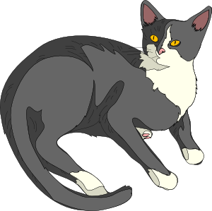
Why Context Matters in MT: Target
the man saw a cat .
Correct case depends on how we translate the previous words.
kočka nominative
kočky genitive
kočce dative
kočku accusative
kočko vocative
kočce locative
kočkou instrumental
Wider target context required for disambiguation of word inflection.
si všiml
uviděl
Notes:
examples won’t be very creative, source context: help choose lemma; target context: help choose surface form of that lemma

Slide 5

How Does PBMT Fare?
shooting of the film . natáčení filmu . ✔
shooting of the expensive film . střelby na drahý film . ✘
the man saw a cat . muž uviděl kočku_{acc} . ✔
the man saw a black cat . muž spatřil černou_{acc} kočku_{acc} . ✔
the man saw a yellowish cat . muž spatřil nažloutlá_{nom} kočka_{nom} . ✘
Notes:
pumping lemma analogy for source ctx
shooting of the expensive film -> LM resorts to bigrams, these are all fine
there is nothing in the model to connect “shooting” and “film”, there is no way the decoder can get it right (other than chance)

Slide 6
Outline
Motivation
Model Description
Integration in Phrase-Based Decoding
Experimental Evaluation
Conclusion

Slide 7
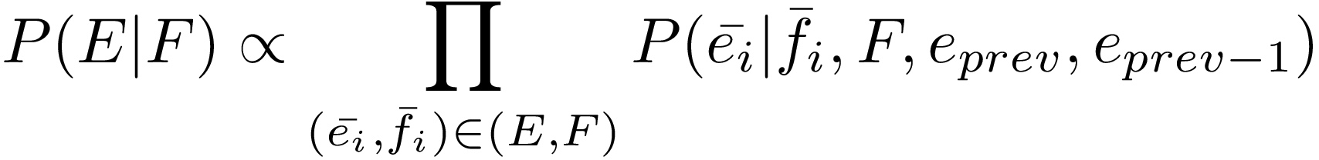
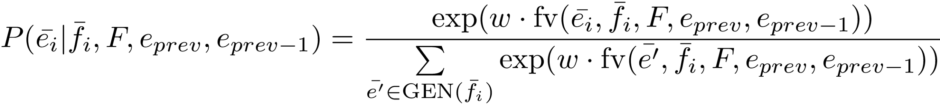
A Discriminative Model of Source and Target Context
Let F, E be the source and target sentence.
Model the following probability distribution:
target phrase
source phrase
source context
target context
Where:
weight vector
feature vector
Notes:
let’s assume we’re given a src sent F, tgt sent E and a particular phrasal segmentation

Slide 8
Model Features (1/2)
Label Independent (S = shared):
source window: -1^saw -2^really ...
source words: a cat
source phrase: a_cat
context window: -1^uviděl -2^vážně
context bilingual: saw^uviděl really^vážně
Label Dependent (T = translation):
target words: kočku
target phrase: kočku
the man really saw a cat .
. . . vážně uviděl kočku
Full Feature Set: { S×T ∪ S ∪ T }
cat&kočku ...a_cat&kočku ... saw^uviděl&kočku ... -1^uviděl&kočku ... a_cat ... kočku

Slide 9
Model Features (2/2)
train a single model where each class is defined by label-dependent features
source: form, lemma, part of speech, dependency parent, syntactic role
target: form, lemma, (complex) morphological tag (e.g. NNFS1-----A----)
Allows to learn e.g.:
  subjects (role=Sb) often translate into nominative case
  nouns are usually accusative when preceded by an adjective in accusative case
  lemma “cat” maps to lemma “kočka” regardless of word form (inflection)
Notes:
richer feature set: allows to learn that: subj->nom, noun should be acc when preceded by adj_acc, car=auto (for all morph. cases) etc.

Slide 10
Outline
Motivation
Model Description
Integration in Phrase-Based Decoding
Experimental Evaluation
Conclusion

Slide 11
Challenges in Decoding
the man saw a cat .
ten pán uviděl kočka .
muž kočkou
ten
. . .
kočka
muž
uviděl
kočkou
kočku
. . .
kočku
kočka
source context remains constant when we decode a single sentence
each translation option evaluated in many different target contexts
  as many as a language model
. . .
uviděl
kočkou
. . .
kočku
muž
.
. . .

Slide 12
Trick #1: Source- and Target-Context Score Parts
the man saw a cat .
ten pán uviděl kočka .
muž kočkou
ten
. . .
kočka
muž
uviděl
kočkou
kočku
. . .
kočku
score(kočku|muž uviděl, a cat, the man saw a cat) =
w · fv(kočku, muž uviděl, a cat, the man saw a cat)
most features do not depend on target-side context “muž uviděl”
divide the feature vector into two components
pre-compute source-context only part of the score before decoding
kočka
. . .
uviděl
kočkou
. . .
kočku
muž
.
. . .

Slide 13
Tricks #2 and #3
Cache feature vectors
  each translation option (“kočku”) will be seen multiple times during decoding
    cache its feature vector before decoding
  target-side contexts repeat within a single search (“muž uviděl” -> *)
    cache context features for each new context
Cache final results
  pre-compute and store scores for all possible translations of the current phrase
    needed for normalization anyway

Slide 14

Evaluation of Decoding Speed
Integration | Avg. Time per Sentence
baseline | 0.8 s
naive: only #3 | 13.7 s
+tricks #1, #2 | 2.9 s

Slide 15
Outline
Motivation
Model Description
Integration in Phrase-Based Decoding
Experimental Evaluation
Conclusion

Slide 16
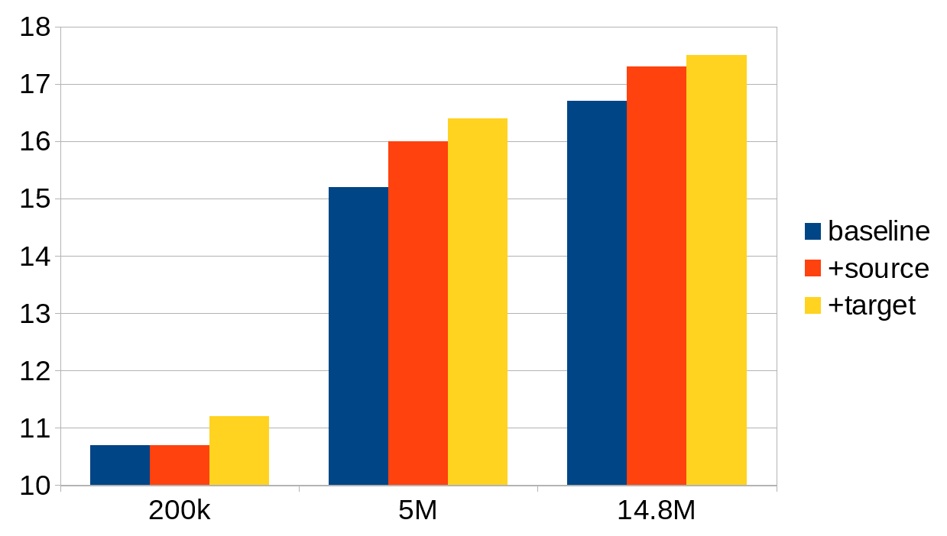
Scaling to Large Data
BLEU scores, English-Czech translation
training data: subsets of CzEng 1.0

Slide 17
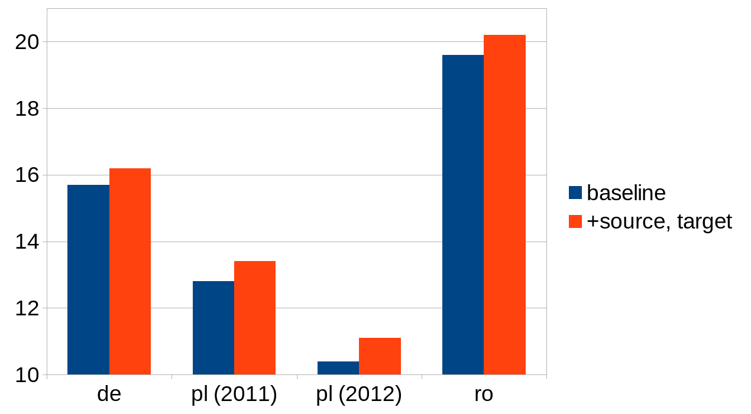
Additional Language Pairs

Slide 18
Manual Evaluation
blind evaluation of system outputs, 104 random test sentences
English-Czech translation
sample BLEU scores: 15.08, 16.22, 16.53
Setting | Equal | Baseline is better | New is better
baseline vs. +source | 52 | 26 | 26
baseline vs. +target | 52 | 18 | 34

Slide 19
Conclusion
novel discriminative model for MT that uses both source- and target-side context information
(relatively) efficient integration directly into MT decoding
significant improvement of BLEU for English-Czech even on large-scale data
consistent improvement for three other language pairs
model freely available as part of the Moses toolkit

Slide 20
Thank you!
Questions?

Slide 21
Extra slides

Slide 22
Intrinsic Evaluation
the task: predict the correct translation in the current context
baseline: select the most frequent translation from the candidates, i.e., translation with the highest P(e|f)
English-Czech translation, tested on WMT13 test set
shooting
Model | Accuracy
baseline | 51.5
+source context | 66.3
+target context | 74.8*

Slide 23
Model Training: Parallel Data
Training examples:
+ střelbě&gunmen střelbě&fled ...
- natáčení&gunmen natáčení&fled ...
gunmen fled after the shooting . pachatelé po střelbě uprchli .
...
shooting of an expensive film . natáčení drahého filmu .
...
the director left the shooting . režisér odešel z natáčení .
...
- střelbě&film střelbě&expensive ...
+ natáčení&film natáčení&fled ...
- střelbě&director střelbě&left ...
+ natáčení&director natáčení&left ...
the man saw a black cat . muž viděl černou|A4 kočku|N4 .
...
the black cat noticed the man . černá|A1 kočka|N1 viděla muže .
- prev=A4&N1 prev=A4&kočka ...
+ prev=A4&N4 prev=A4&kočku ...
+ prev=A1&N1 prev=A1&kočka ...
- prev=A1&N4 prev=A1&kočku ...

Slide 24
Model Training
Vowpal Wabbit
quadratic feature combinations generated automatically
objective function: logistic loss
setting: --csoaa_ldf mc
10 iterations over data
  select best model based on held-out accuracy
no regularization

Slide 25
Training Efficiency
huge number of features generated (hundreds of GBs when compressed)
feature extraction
  easily parallelizable task: simply split data into many chunks
  each chunk processed in a multithreaded instance of Moses
model training
  Vowpal Wabbit is fast
  training can be parallelized using VW AllReduce
  workers train on independent chunks, share parameter updates with a master node
  linear speed-up
  10-20 jobs

Slide 26
Additional Language Pairs (1/2)
English-German
  parallel data: 4.3M sentence pairs (Europarl + Common Crawl)
  dev/test: WMT13/WMT14
English-Polish
  not included in WMT so far
  parallel data: 750k sentence pairs (Europarl + WIT)
  dev/test: IWSLT sets (TED talks) 2010, 2011, 2012
English-Romanian
  included only in WMT16
  parallel data: 600k sentence pairs (Europarl + SETIMES2)
  dev/test: WMT16 dev test, split in half

Slide 27
LMs over Morphological Tags
a stronger baseline: add LMs over tags for better morphological coherence
do our models still improve translation?
1M sentence pairs, English-Czech translation
System | BLEU
baseline | 13.0
+tag LM | 14.0
+source | 14.5
+target | 14.8

Slide 28
Phrase-Based MT: Quick Refresher
the man saw a cat .
query phrase table
ten
. . .
the man saw a cat .
ten pán uviděl kočka .
muž kočkou
uviděl kočku
muž
uviděl kočku
.
decode
uviděl
. . .
. . .
.
P_{LM} = P(muž|<s>) · P(uviděl kočku | <s> muž) · ... · P( </s> | kočku .)
Notes:
let’s see how PBMT is equipped to deal with these phenomena

Slide 29
System Outputs: Example
input: the most intensive mining took place there from 1953 to 1962 .
baseline: nejvíce intenzivní těžba došlo tam z roku 1953 , aby 1962 .
the_most intensive mining_{nom} there_occurred there from 1953 , in_order_to 1962 .
+source: nejvíce intenzivní těžby místo tam z roku 1953 do roku 1962 .
the_most intensive mining_{gen} place there from year 1953 until year 1962 .
+target: nejvíce intenzivní těžba probíhala od roku 1953 do roku 1962 .
the_most intensive mining_{nom} occurred from year 1953 until year 1962 .
✔

